Slide 1
If you want to…
You may use your phone to download the ”Socrative Student” app
If you would rather use a computer, I will have laptops available.

Slide 2
LG 1 and 3 Review

Slide 3
Muslim interactions
Open your notes to page 43, you should have the purple picture notes making sheet on that page. If you come and get one.
We will go over this to ensure you have all of the correct information.

Slide 4
Interactions in Spain
Christians, Jews, and Muslims managed to get along and benefit from each other
Cordoba had paved roads, libraries, and universities. Literature, poetry, and architecture flourished.
Jews and Christians often took jobs shunned by Muslims (butchery, banking, dealing with gold and silver, etc…)

Slide 5
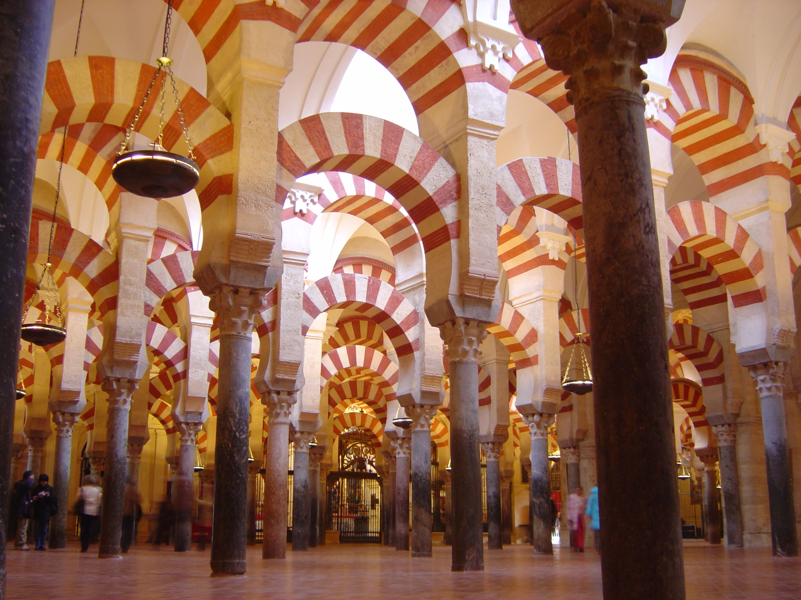

Slide 6
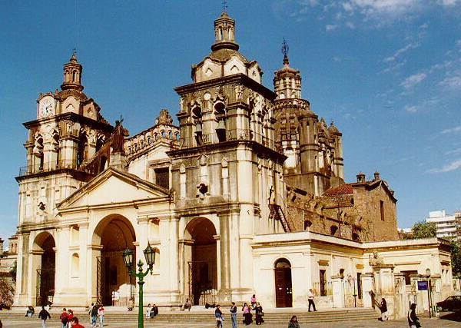

Slide 7
Interactions in India
Islam popular in Northwester corner of Indian Subcontinent, modern day Pakistan and Bangladesh)
Delhi Sultanate – Turkish Muslims ruled in India. Did not force others to convert to Islam (had to pay a tax)
“Indo-Muslim” cultural fusion art, architecture, (Taj Mahal), language, dress, and Scientific advancements.

Slide 8
