Slide 1
Learning Goal 2: Compare the major political, economic, social, cultural and technological developments of the Mayan, Incan and Aztec civilizations. (6A,27B)
Pre-Columbian America

Slide 2
The major political, economic, social, and cultural developments of:
Maya
Aztec
Inca
And…..
How did prior civilizations influence their development?

Slide 3
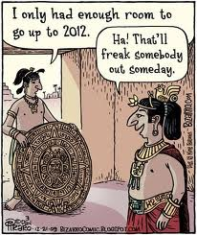

Slide 4
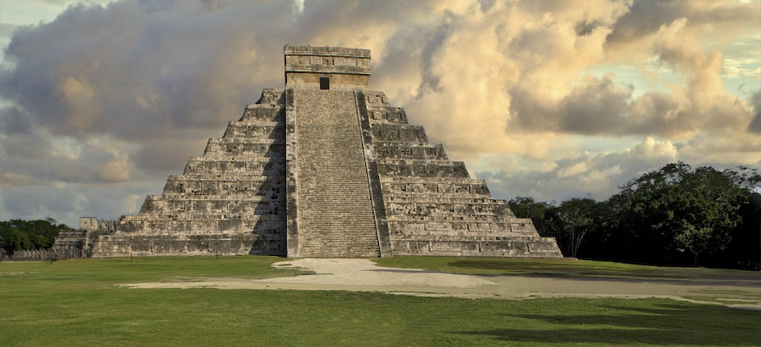
Maya

Slide 5
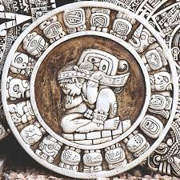
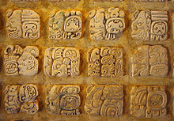
Maya
Technically a classical civilization
Political
  Organized in city states
  City states were often at war with each other
Economic
  Slash-and-burn agriculture – cut down forests, burned trees and plants for fertilizer, the cultivated the plot of land
  This required a lot of land to support a family
  Maize was their main crop
  Developed a calendar because agriculture
  required an accurate predictions of time
  and weather
  developed a system of mathematics
  advanced astronomical observations

Slide 6
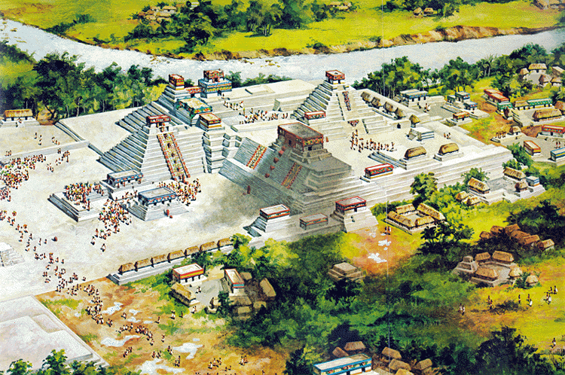
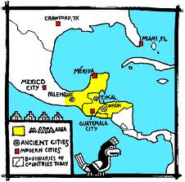
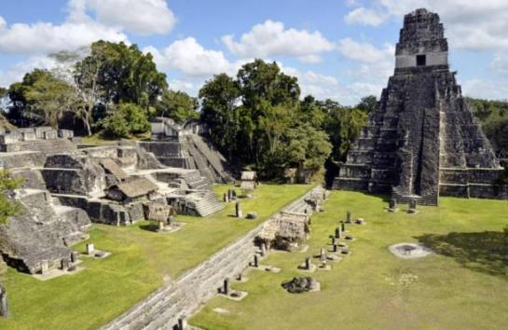
Maya
Geographical
Social
  Pyramids and religion were heavily influenced by the Olmec
  Mayan were polytheistic
  They built cities as trade centers and to worship gods
  Blood-letting – a victim voluntarily pierced their body to give blood to the gods

Slide 7


Slide 8
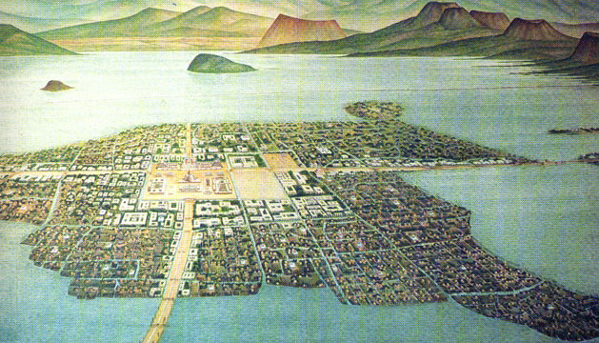
Aztec

Slide 9
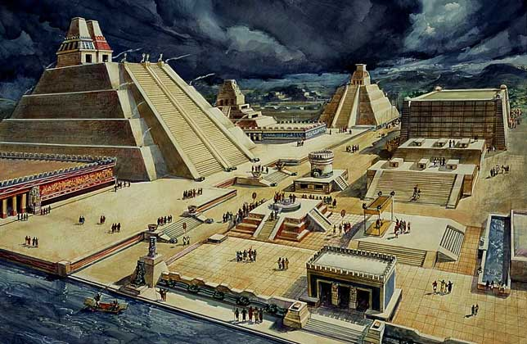
Aztec
The Aztec empire was centered around the city of Tenochtitlan (modern day Mexico City) built on an island in Lake Texcoco in what is now Central Mexico.
Cities were densely populated
  Tenochtitlan – as many as 300,000
Political
  Ruled by Kings
  Mostly allowed conquered peoples to rule
  themselves, but demanded they paid
  tribute in human sacrifice, food, and
  wealth
  If local rulers refused, Aztec armies would
  destroy the tow

Slide 10
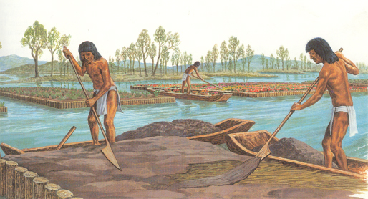
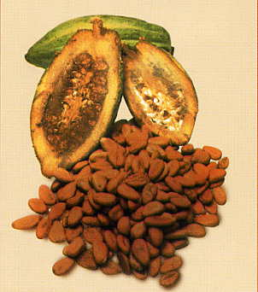
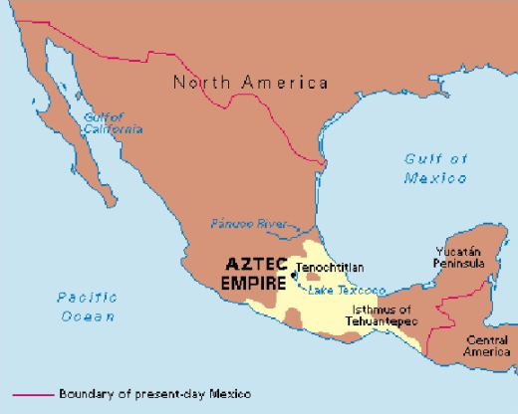
Aztec
Economic
  Chinampa method of agriculture, flat reeds were placed in shallow areas of the lake, covered in soil, and then farmed
  Maize was most important crop
  Developed extensive trade routes all over Mesoamerica
  Used cacao beans as currency
Geographic

Slide 11
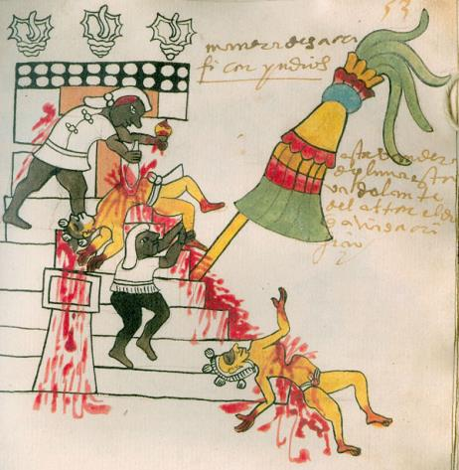
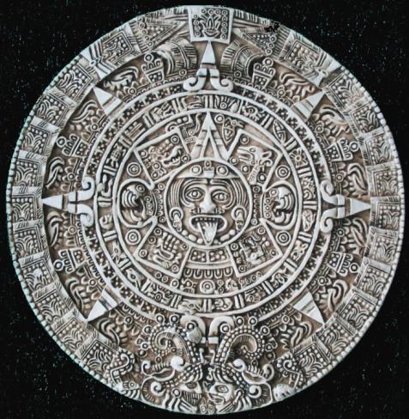
Aztec
Social
  Separated into 2 social classes
  Polytheistic religion
  Worships gods in Pyramids or raised temples
  Practiced human sacrifice because they believed that the gods gave human beings things only if they were nourished by gods
  Preformed more human sacrifice than the Mayans because they believed the gods were fighting over destroying the world
  Developed a calendar because they believed that every 52 years, the world might be destroyed

Slide 13
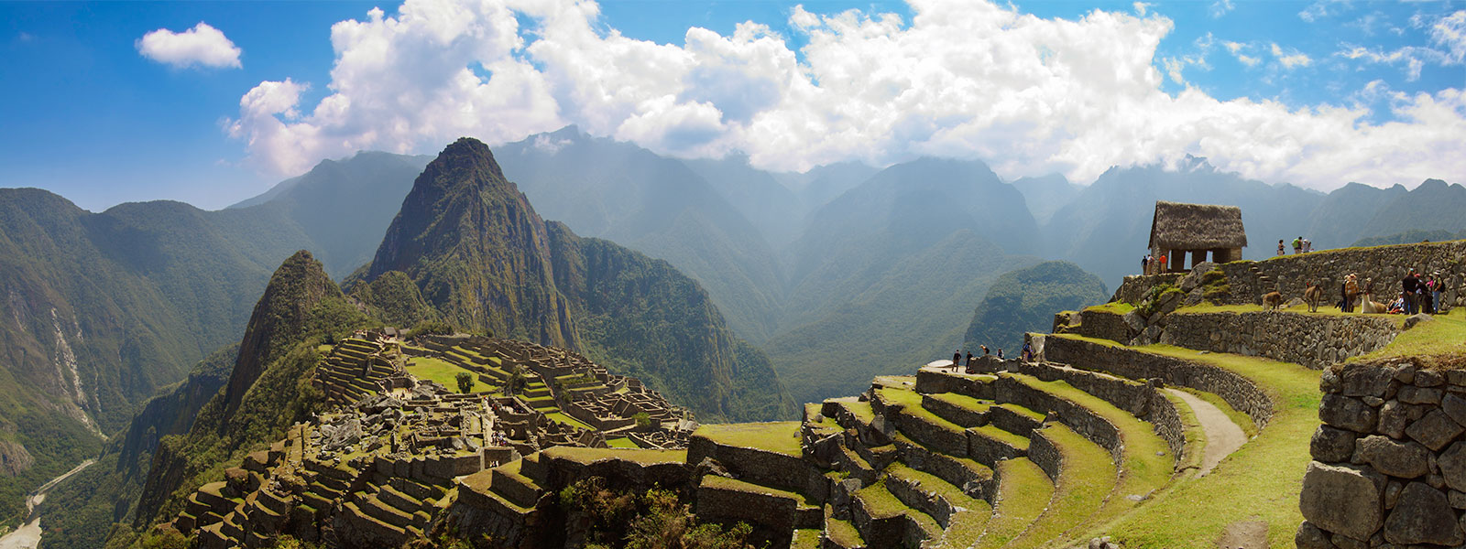
Inca

Slide 14
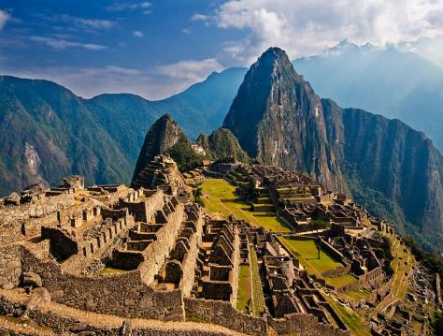
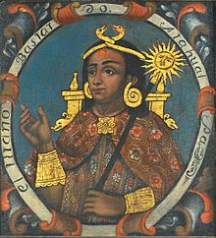
Inca
The Inca civilization arose in the early 13th century in modern day Peru and was centered around it’s capital of Cuzco.
established an empire in 1438
largest empire in pre-Columbian Americas
Machu Picchu – most famous Inca city
Political
  Ruled by Emperor “Sapa Inca”
  Emperor was believed to be a descendant of the sun god and ruled with complete authority

Slide 15
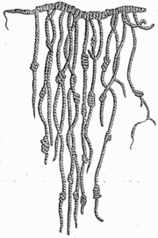
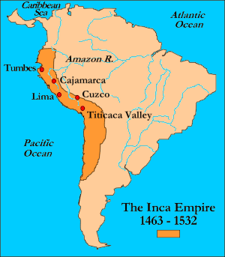
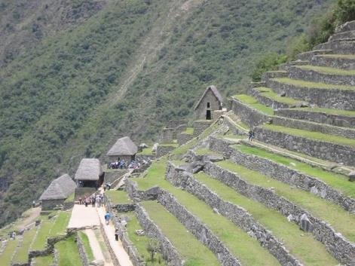
Inca
Economic
  Mita was a labor tax paid by the commoners
  Developed Quipu as a method of record keeping
  Adapted to their environment using terrace farming
  Built elaborate road system through mountains
Geographical
Social
  “Sapa Inca” was the Emperor
  Upper class – government officials and priests
  Lower class – artisans, farmers, and servants
  Polytheistic religion

Slide 16
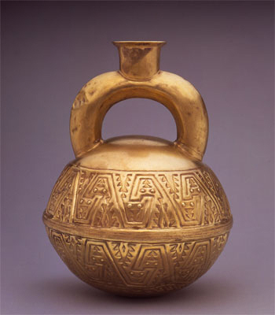
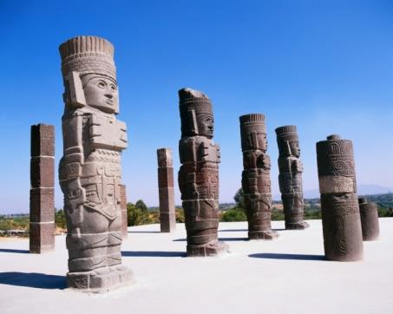
How did prior civilizations influence their development?
Olmec head
Olmec (1220-400BCE) art (colossal heads carved from stone), monumental architecture, and religion impacted the Mayans.
The Chavin (850-250BC) culture was advanced at weaving, pottery making, and metalworking practices that were later incorporated into Inca culture. Additionally the Chavin created an urban, class-stratified society and domesticated the llama.
Aztec culture was influenced by the war like Toltecs and the Aztecs were influenced by the Toltec city of Teotihuacan.
Chavin gold jug
Toltec warrior statues

Slide 17
Your Assignment
Answer the following question using evidence from what you have learned today
  Take a stance.
  Give 2 pieces of evidence that back up your stance!
Prompt: Based on the information learned today, which of the three pre-Columbian civilizations was the most advanced?
Underline your stance and highlight your 2 pieces of evidence!

Slide 18
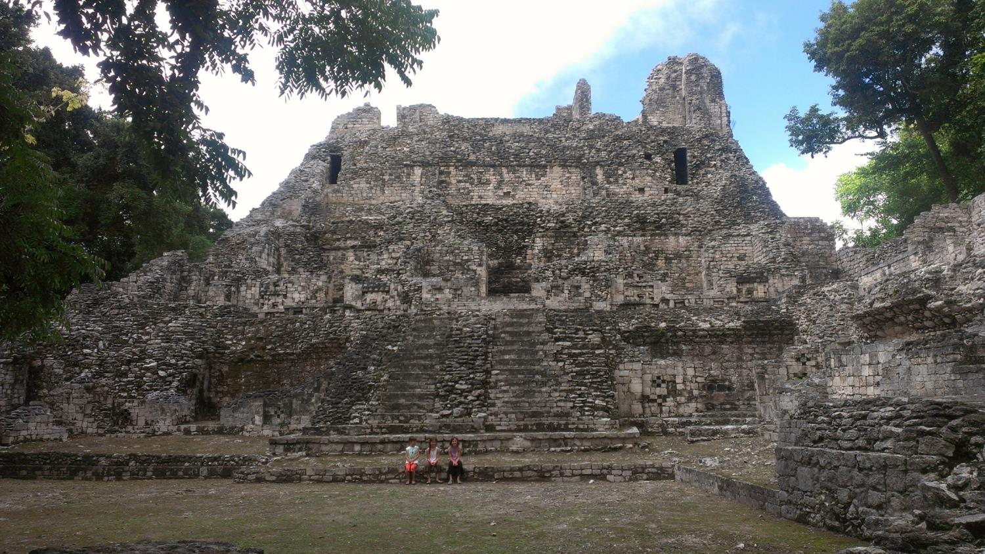

Slide 19
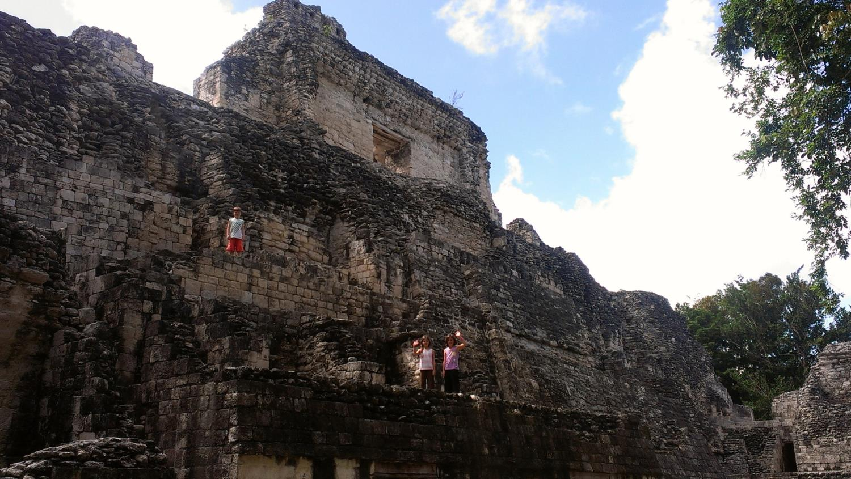

Slide 20
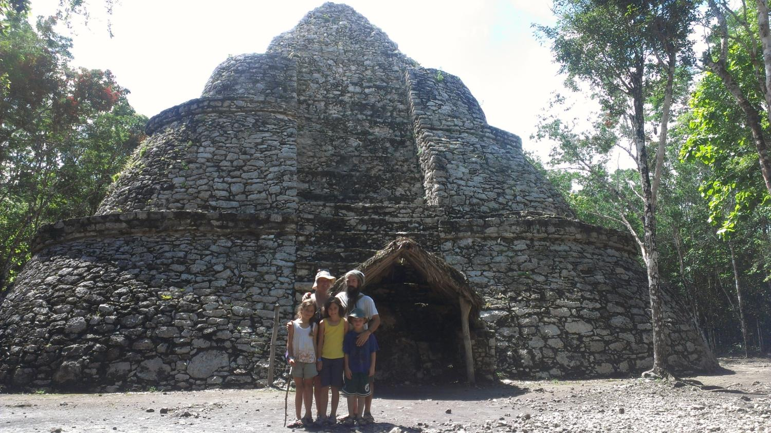

Slide 21
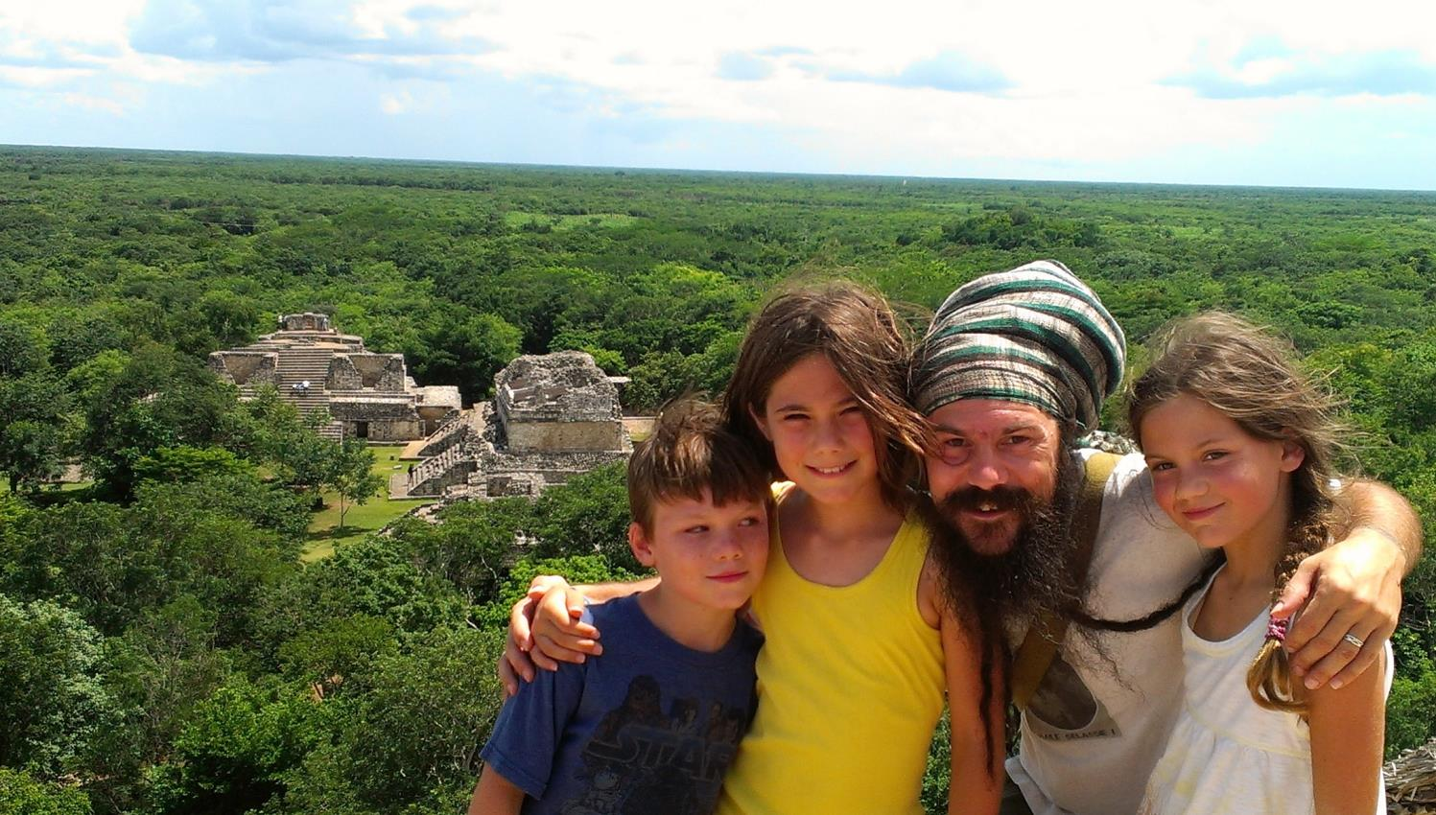

Slide 22
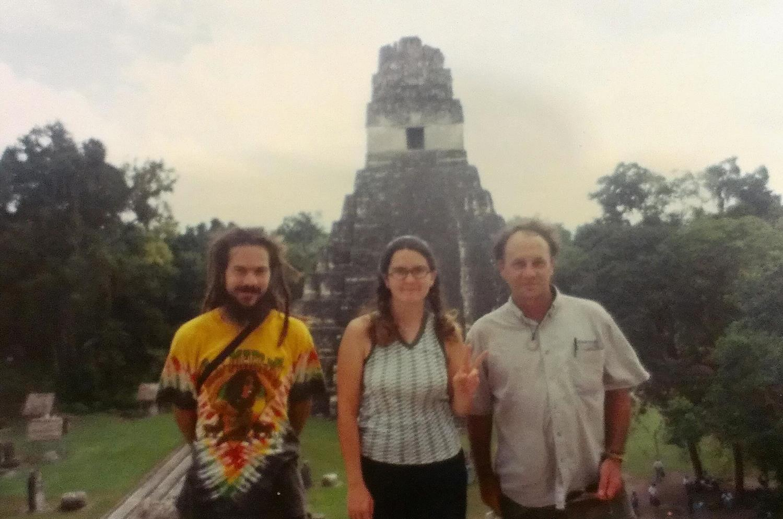

Slide 23
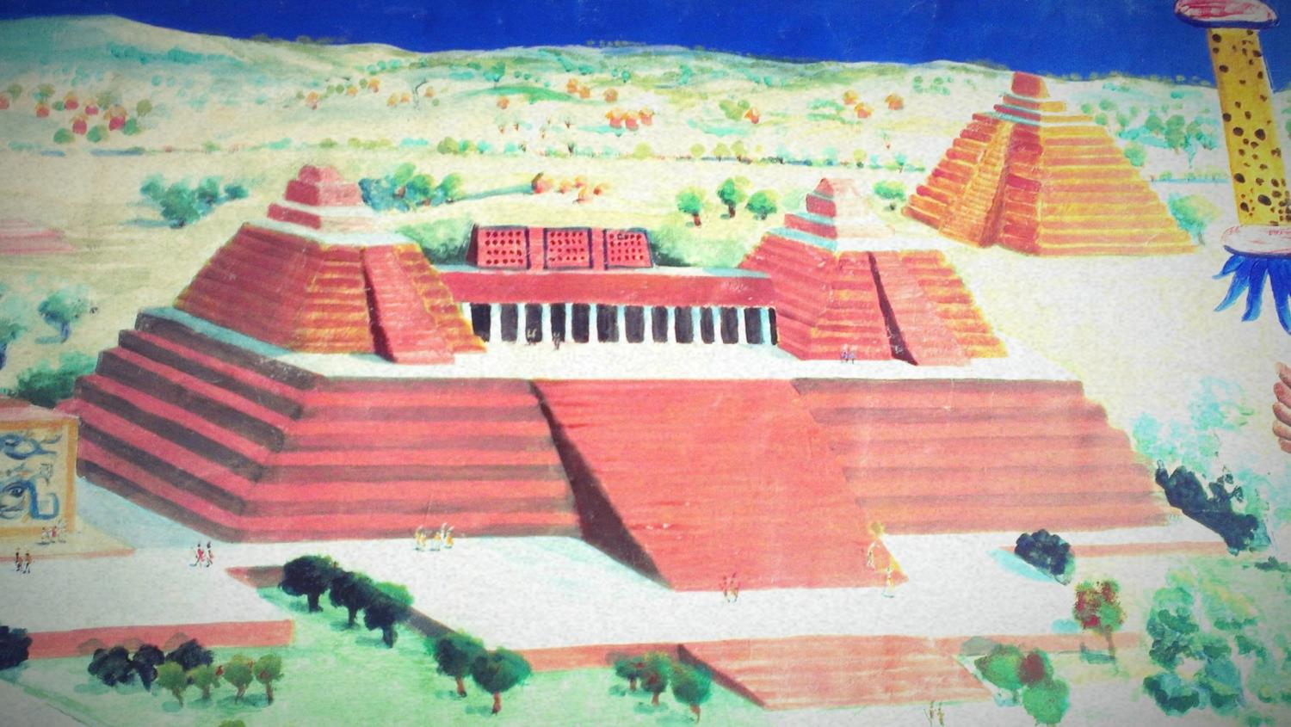

Slide 24
