Slide 1
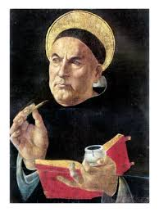
St. Thomas Aquinas & Scholasticism Pg. 39

Slide 2
Reading the following quotes and draw a picture that represents what the quotes say.
“The truth can be perceived only through thinking, as is proven by Augustine.” ― Thomas Aquinas, Summa Theologica, 5 Vols
"It is necessary for the perfection of human society that there should be men who devote their lives to contemplation." — Thomas Aquinas

Slide 3
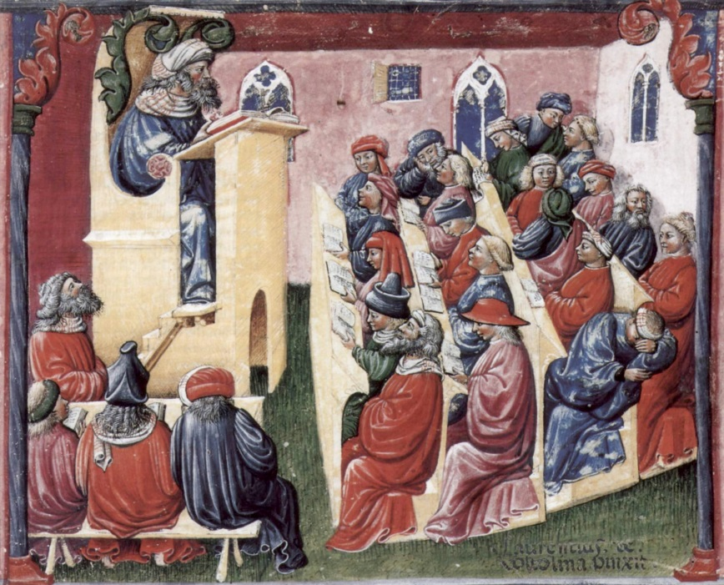
Scholastics
Scholastics were scholars who gathered and taught at medieval European universities.
Emphasized logic and reason in defending religious dogma (beliefs)

