Slide 1
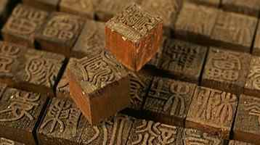
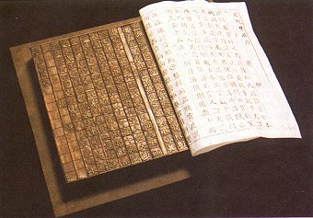
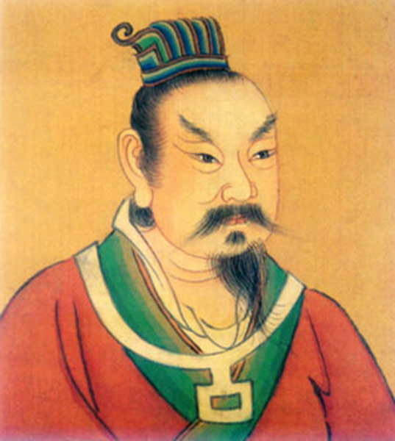
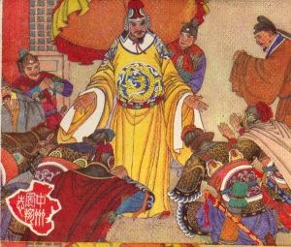
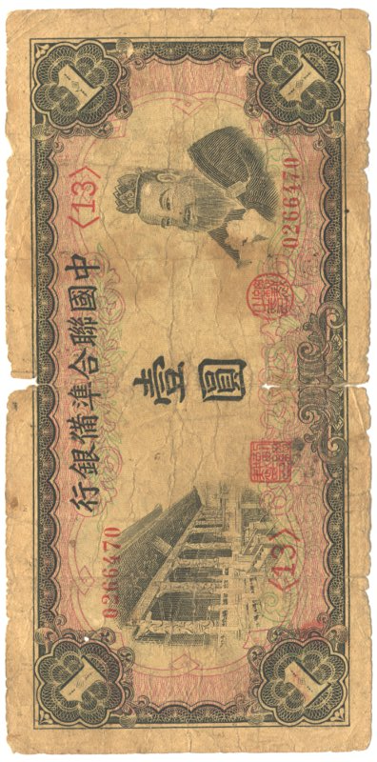
Tang and Song Dynasties in China

Slide 2
Introduction
Use the readings at your table to make notes on your Venn diagram about the Tang or Song Dynasty.
Together we will share out and compile a Venn Diagram comparing/contrasting the 2 Dynasties.
Things to look for
How important was trade/the outside world?
What philosophy is important?
How was government run?
How did they fall?

Slide 3
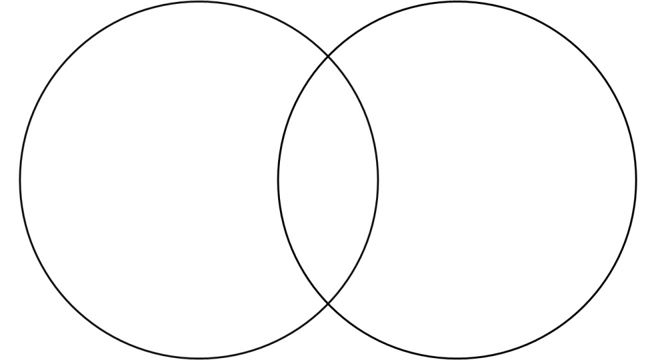
Tang Song
Focused on philosophies and experience
Increased Prosperity at home (not expanding)
Relocated to Southern Song
Cut off from silk road- Ocean trade
Magnetic compass
Turn away from Buddhism
Surrendered to Mongol
Center for foreign exchange of goods and ideas
Powerful military
Confucian values and ideas
Transition to Buddhism
Silk Road- military bases
Overthrown due to heavy taxes/corruption
Civil Service Exams –bureaucracy
Invasion of nomadic people

