Slide 1
Warm up
Historians divide time into different eras or periods. Each era has specific political, economic, geographic and social characteristics. Some time periods start with one major event, like World War I. Most time periods, however, do not start or stop because of one major event. Most of the time several events are happening out over an extended period time to bring about changes. Once these changes result in new political, economic, geographic and social patterns, a new time period is created.

Slide 2
Warm up
Humans also divide their lives into different time periods or phases, such as infancy, toddlerhood, childhood, teenage years, young adulthood, adulthood, middle age, and old age. A birthday can mark the change from one phase of life to the next, yet many underlying changes are also taking place.

Slide 3
Warm up
Title Assignment #48 in spiral “Decline of Feudalism in Europe”
Write the following question and answer it in your spiral.
What events brought your childhood to an end?
List your ideas in your spiral and be prepared to share.

Slide 4
DO NOW→
There are 4 readings covering the Crusades, The Black Death, The Hundred Year’s War & The Great Schism
Using the readings describe the four events, and take notes on the Graphic Organizer on how they lead to the decline of Feudalism & the rise in Democratic Thought
Complete the notes with the noble, commoners and knights reaction to the end of feudalism. Complete sentences! Don’t forget to draw their faces…
WHEN YOU FINISH!
We will take notes over the decline of feudalism on page 48

Slide 5
When you finish your Green notes from the reading and the characters thoughts turn them in.
They are for a grade! Due at the end of class. Assignments not turned in by the end of class will be a zero.
You may not start your notes until you have completed the reading and the character notes!

Slide 7
Medieval Europe Ends
LG 4: Explain how the Crusades, the Black Death, the Hundred Years’ War, and the Great Schism contributed to the end of Medieval Europe and describe how new political ideas emerged in Europe at the end of the Middle Ages.
Take the following Notes of “Decline of Feudalism” in your notebook on #37

Slide 8
How did the Crusades, Black Death, 100 Years’ War, and Great Schism lead to the decline of Feudalism and rise of democratic thought?

Slide 9
Decline of Feudalism
In the late middle ages you see a decline in Feudalism and a rise in democratic (people rule!) thought.
This rise will eventually lead to the Renaissance, but first we must talk about the decline.
Four possible causes

Slide 10
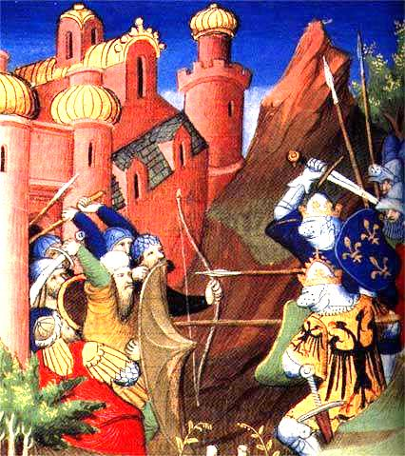
Cause 1: The Crusades
1096 – “Holy Wars”
Pope Urban II called on Christian knights to take back the Holy Land (Jerusalem) from Muslims (controlled since 1071)
Also…. Bring prestige to the Church, wealth, population control, and TRADE
Crusades increased power for European kings bringing about consolidate nation-states in Europe (end of Feudalism)

Slide 12
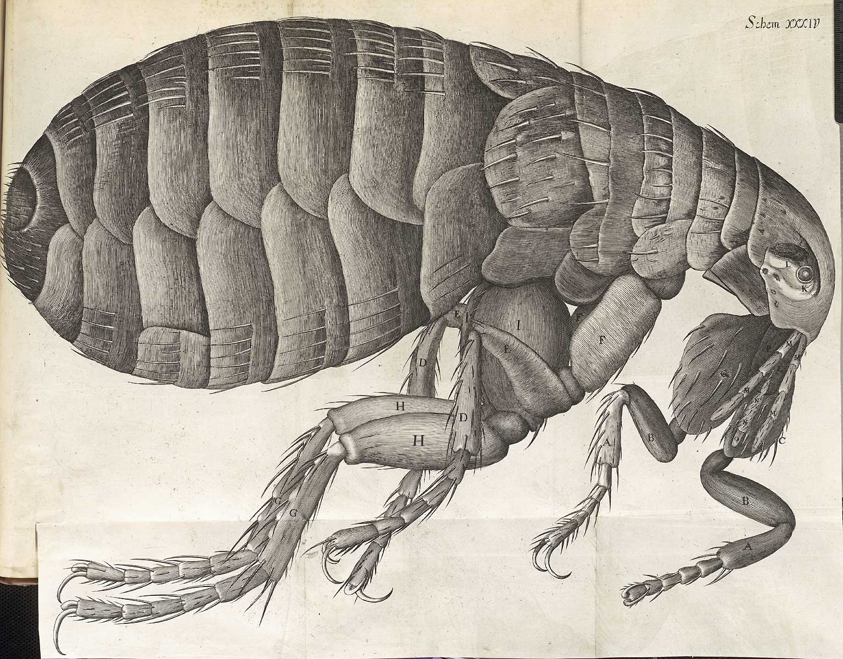
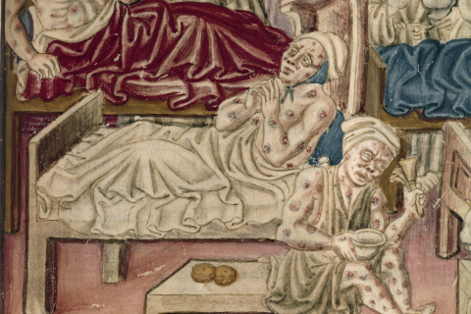
Cause 2: The Black Death
Originated in Asia – 1300s
Spread via trade routes by fleas!
Characterized by fever, vomiting, boils, internal bleeding, etc.
Responsible for the deaths of over 1/3 of the population
Social upheaval (disorder) resulted and many blamed Jews for the issues
Accused Jews of contaminating water wells & spreading the disease.
Huge population loss accelerated the end of serfdom (end of feudalism)
Smaller population meant less competition for jobs

Slide 13
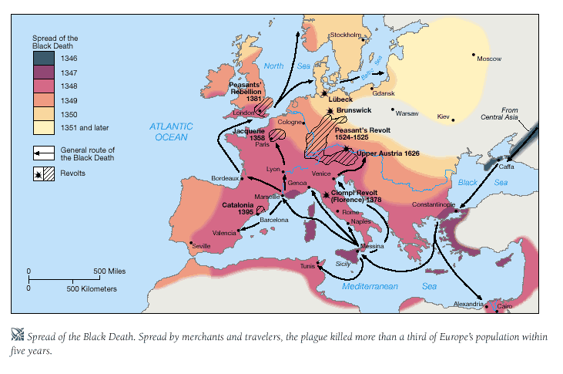

Slide 14
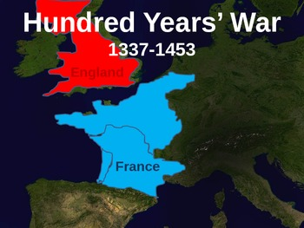
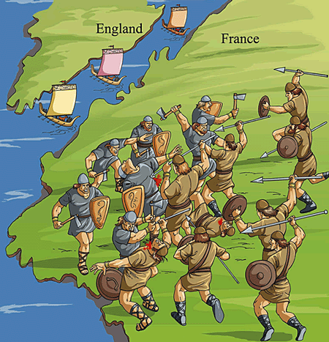
Cause 3: The Hundred Years’ War
1337 – 1453 & England vs. France
Fought over land
English kings once had feudal manors on French lands and French kings started to dispute the claims
French King Philip VI claimed lands and England’s King Edward III declared war!
England ahead, but France slowly crept back and won
French were outnumbered by English in most of the battles and the English won most of the battles.
French ultimately won the war
Joan of Arc
Historians credit Joan of Arc with rallying the French, leading men in key battles

Slide 15
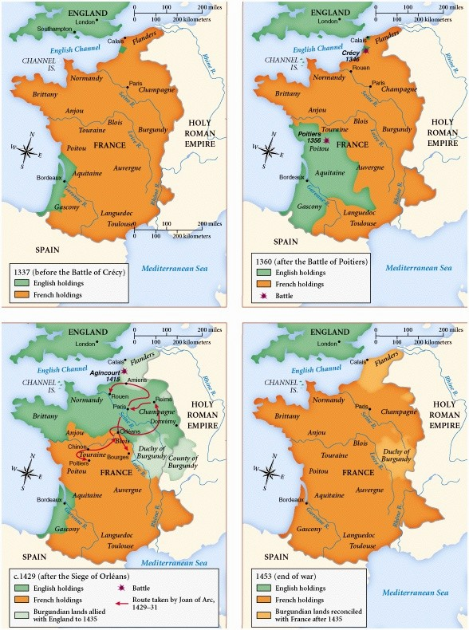
Cause 3: The Hundred Years’ War
Effect→ France’s royal power is centralized, France became a major European power, army loyal to French king
Contributed to a creation of a system of government taxation and paid military service (no need for knights/vassals) *end of feudalism

Slide 16
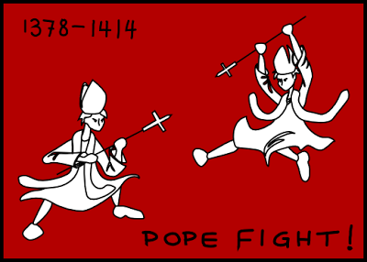
Cause 4: The Great Schism
1305– Frenchman is elected Pope and the papacy moved to France in Avignon (French have great influence over pope)
1378: Italian is elected pope – Pope Urban VI. Papacy moved back to Rome.
Effect→ The French cardinals upset and elected another person – Clement VII – as pope to keep papacy in France
TWO POPES!?

Slide 17
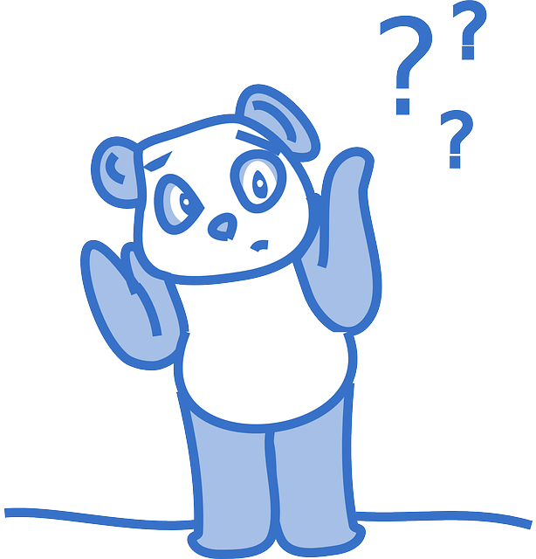
Cause 4: The Great Schism
People couldn’t decide who was the true pope and this lasted 40 years!
1409- a third pope is elected
Effect→
Corruption in church
no focus on religious matters
Power of church declines in Europe (*end of feudalism)

