Slide 1
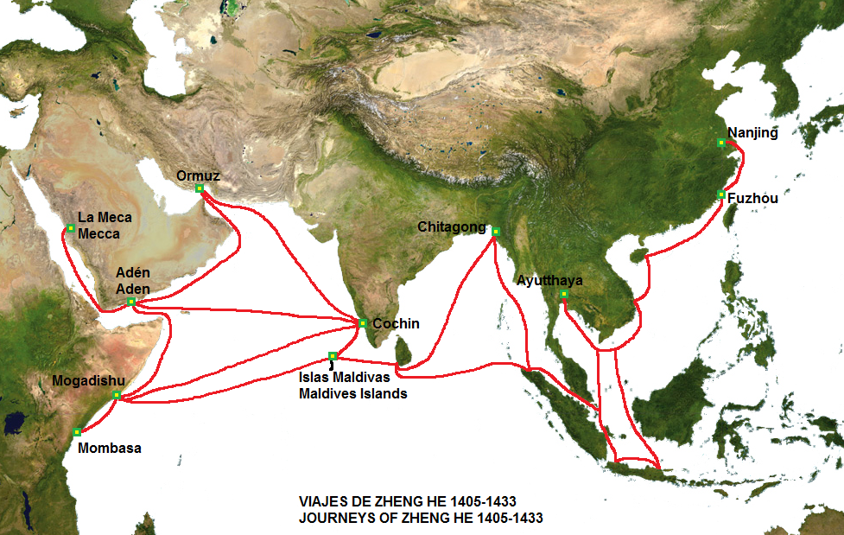
Indian Ocean Trade
Learning Goal 3: Describe what characteristic of global trade after the European discovery of the western hemisphere and explain the role Ming China played in global trade.

Slide 2
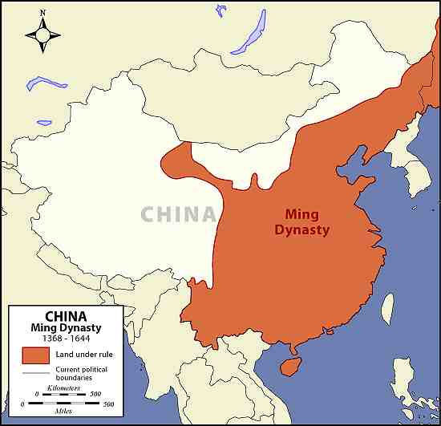
Ming Dynasty
1368 – 1644
Peasant revolt and uprising drove out the Mongols
Ming Dynasty founded by Hong Wu, peasant soldier and Buddhist monk
Reestablish Chinese rule and make sure no foreign rule would ever happen again

Slide 3
Emperor Hong Wu
Brought stability to China
Rebuilt the infrastructure
Bridges
Canals
Roads
temples

Slide 4
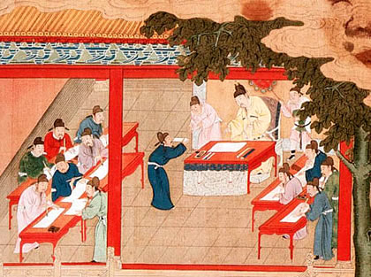
Ming Government
Reinstated the civil service exams
Centralized government and put eunuchs in charge
Neo-Confucianism

Slide 5
Forbidden City
Located in Beijing
Surrounded by 40-foot high walls and a moat
Highest-ranking civil servants and officials lived in the city
Emperor’s palace in very center
Only the emperor, his family, and certain officials/eunuchs were allowed in his palace

Slide 6
Forbidden City

Slide 9
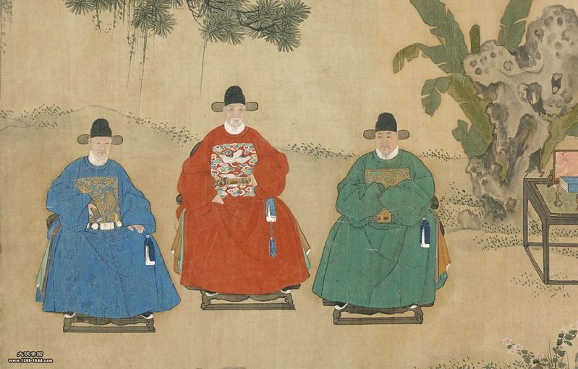
Ming Society & Religion
Confucianism revived (Neo-Confucianism)
Many combined all three traditional beliefs: Daoism, Confucianism, and Buddhism
Emperor Hong Wu was a Buddhist monk and he ran the government based on Confucianism

Slide 11
Background Essay pg
As we read the background essay, answer the questions on your half sheet
When you are finished you will glue this in on page

Slide 12
Important terms to know
Eunuch
castrated male. Important servants in the Ming government
Tribute
gifts offered to show respect and admiration
Emissary
Ambassador or representative sent to another country
Colonialism
Act of one country taking control of another country or region

Slide 13
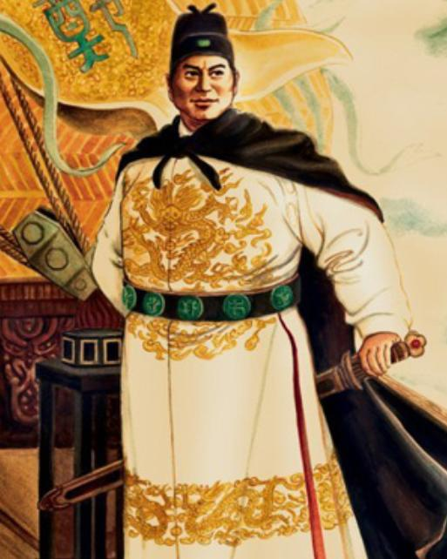
Should we celebrate the voyages of Zheng He?

Slide 14
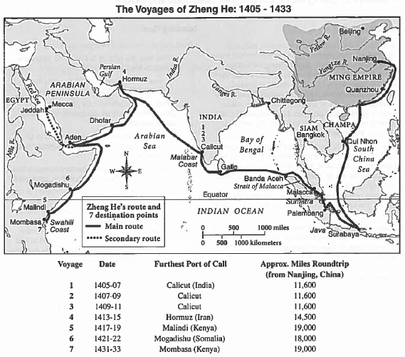
Document A

Slide 15
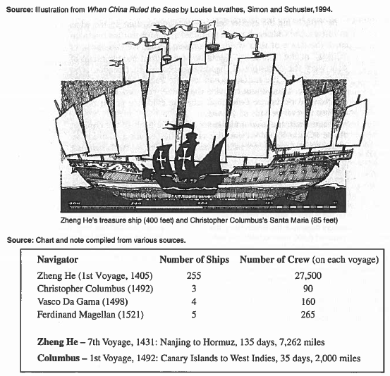
Document B

Slide 16
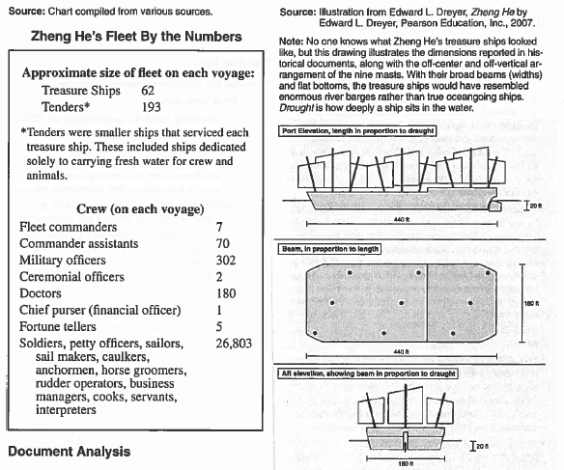
Document C

Slide 17
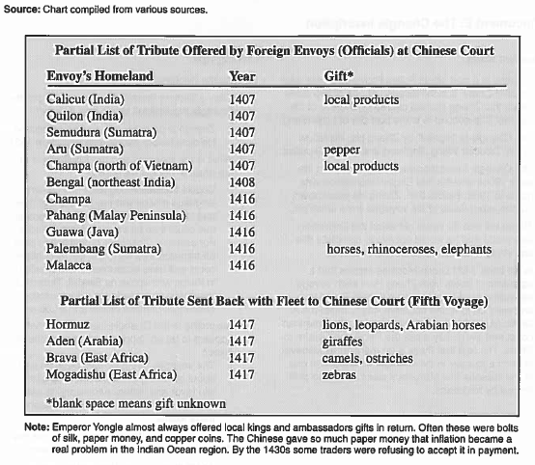
Document D

Slide 18
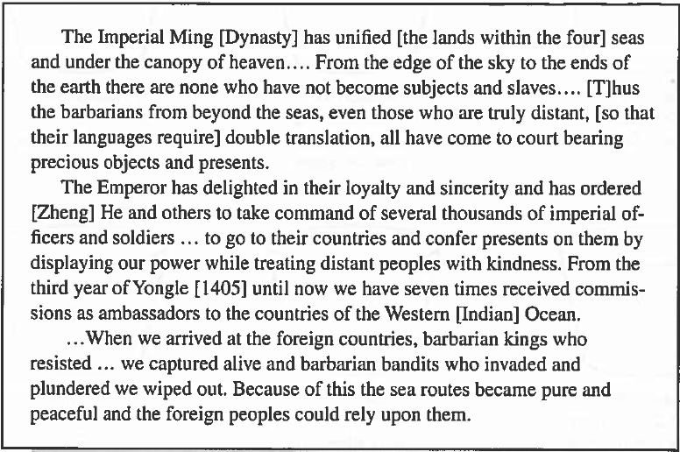
Document E

Slide 19
Decline of Ming
No foreign trade = no market for Chinese goods
No market = no money for producers
Political corruption
Emperors would waste money on lavish parties
Heavy taxes (dynastic cycle is starting!!!)
Peasants get mad!
Weak → invaded by the Manchus

Slide 20
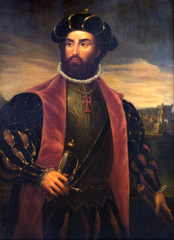
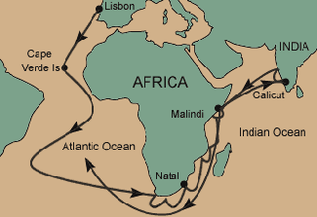
Vasco de Gama (1497 – 1499)
Portuguese
Sailed from Europe → Calicut (India)
Motivation: trade and commerce
Indian Ocean Trade & Silk Road
SPICES!!!!!!!!!!

Slide 21
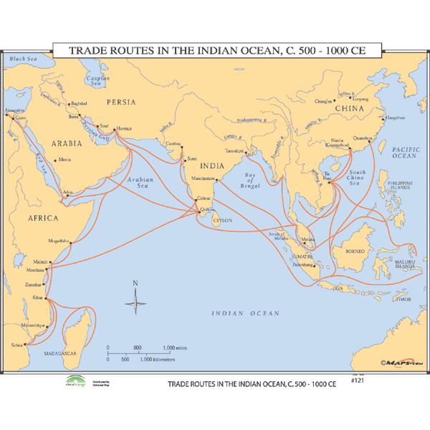
Competition
Muslims controlled most of the trade routes
China pulled out after the Ming Dynasty
Portugal had military advantage
Established military bases along coast of Africa, Persian Gulf, India, Southeast Asia, and China
“Trading post empire”

Slide 22
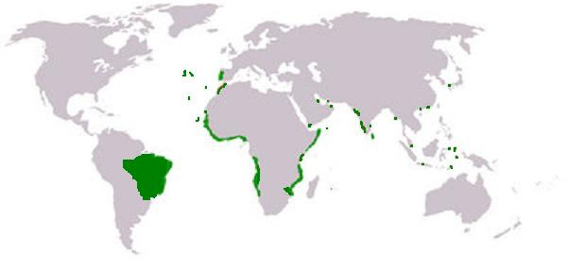
Trading Post Empire
Lasted about a century
Eventually assimilated into local societies in Asia and Africa
Steep decline by 1600 – overextended and competition

Slide 23
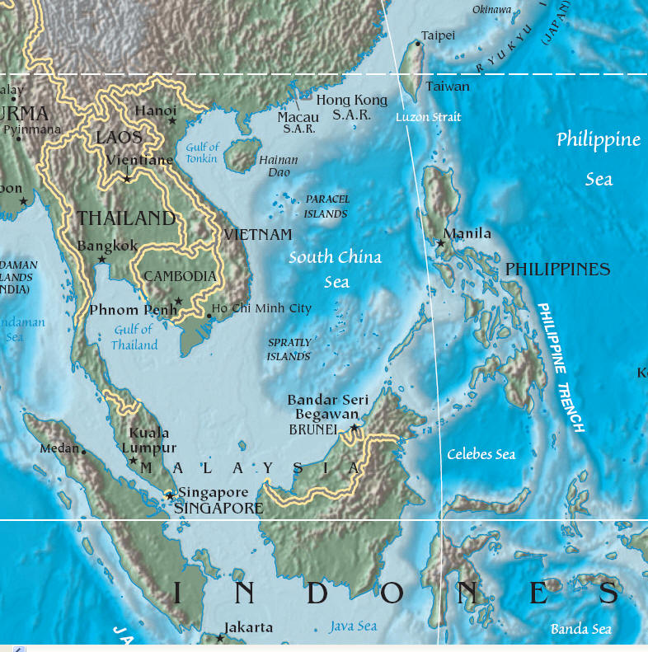
Spain and the Philippines
1565: takeover begins
“There is no king and no sole authority in this land; but everyone holds his own view and opinion, and does as he prefers.”
Easy and bloodless
Major missionary effort
Will remain Spanish colonial territory until the Spanish-American War of 1898

Slide 24
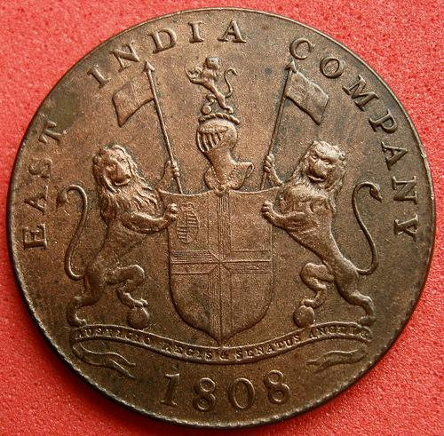
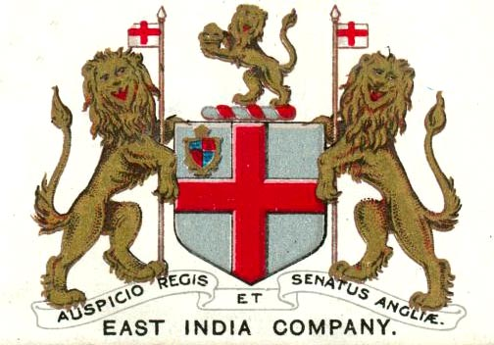
East Indian Companies
Dutch and English
Militarily and economically stronger than the Portuguese
Organized through private trading companies: British East India Company & Dutch East India Company
Both will begin to deal in bulk for a mass market
Trading posts will eventually turn into a conventional form of colonization

Slide 25
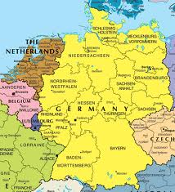
Dutch
Focused in Indonesia
Controlled small spice-producing islands
Banda Islands
Dutch killed, enslaved, or left to starve almost the entire population (15,000) and then replaced them with Dutch farmers and slave laborers
Would sell nutmeg, mace, and cloves at 14 – 17 times the price they paid in Indonesia
Profits soared, but local economy of the Spice Islands was shattered and people were left impoverished

Slide 26
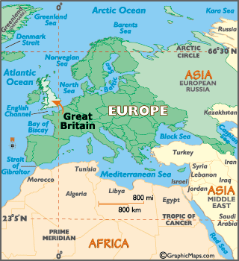
British
Focused on India: Bombay, Calcutta, and Madras
Established trading bases WITH the permission and cooperation from the Mughal Empire
Pepper, spices, and cotton textiles

Slide 27
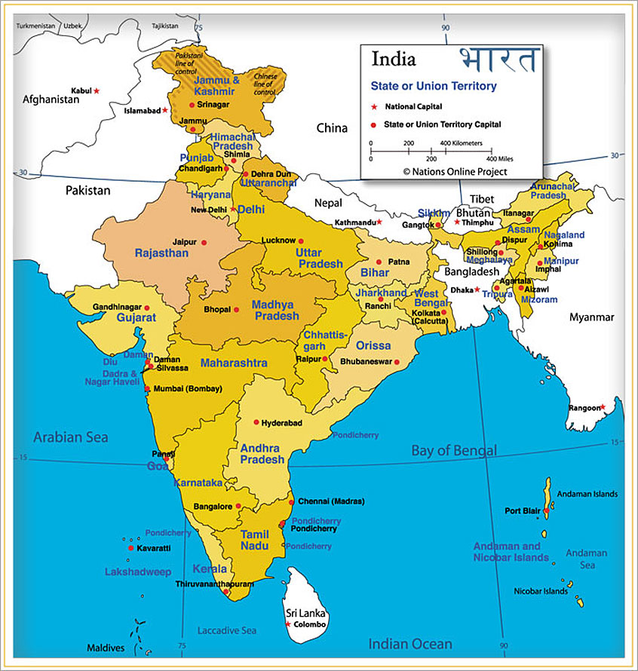

Slide 28
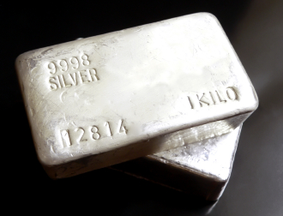
Silver Trade & Commerce
Silver “went round the world and made the world go round”
Bolivia, Japan, Spanish America, and the Philippines
Initial demand came from China – population required to pay tax in silver
Southeast Asia and China became known as “silver drain”

Slide 29
Japan
Tokugawa shoguns used profits from silver to defeat rival lords and unify country
Supported merchant class and developed a market-based economy
Invested heavily in agriculture and industry
Families took steps to have less children
Outcome: flourishing, highly commercialized economy
Laid foundation for the 19th century Industrial Revolution

Slide 30
China
Economy became more regionally specialized
To obtain silver, more and more people had to sell something → commercial economy
Central to world economy
American silver was brought to Asia for China’s demand
Chinese goods were picked up and sent all around the world

Slide 31
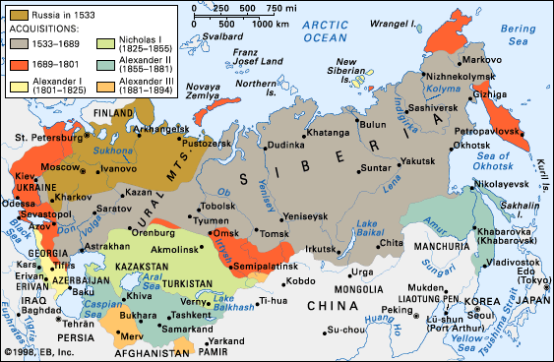
Russia
Fairly new
Major source of furs for Western Europe and Ottoman Empire
Profits from furs allowed for rapid expansion
Tax or tribute imposed on every male between 18 – 50 payable in furs

