Slide 1
Absolutism
1. ___________________________________________
2. ___________________________________________
3. ___________________________________________
Draw on page #12
(top half)
Complete this using the reading
1. ___________________________________________
2. ___________________________________________
3. ___________________________________________

Slide 2
Absolutism
Religious and territorial conflicts created fear and uncertainty
Growth of armies to deal with conflicts caused rulers to raise taxes
Heavy taxes led to more unrest
Check your answers
Regulate religious worship and gatherings to control spread of ideas
Increased size of courts to appear more powerful
Created bureaucracies to control economies

Slide 3
English Civil War and Glorious Revolution Reading
First we will read the beginning together and answer #1.
Then you will be assigned a paragraph in your “group” and you will read that paragraph and answer the corresponding answers
Group 1 reads “King James”
Questions 2&3
Group 2 reads “Charles in Charge”
Questions 4&5
Group 3 reads “The English Civil War”
Question 6
Group 4 reads “Glorious Revolution”
Questions 7&8

Slide 4
The English Civil War and the Glorious Revolution
Draw a timeline down the middle of page in your notebook

Slide 5
Draw a timeline in your notes on Pg 13.
Recommendation
wait until after you write the information to draw the boxes.

Slide 6
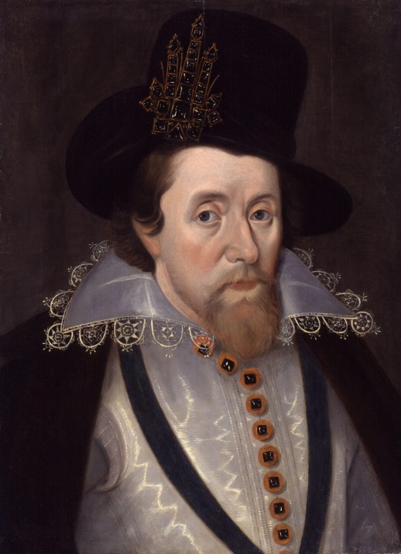
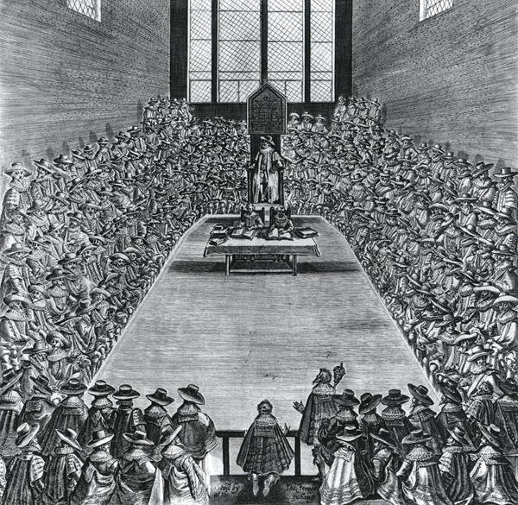
1603 – King James I
After Queen Elizabeth’s death, her cousin the King of Scotland, becomes the King of England
Enter King James I
King James Raises taxes and this made Parliament very angry…

Slide 7
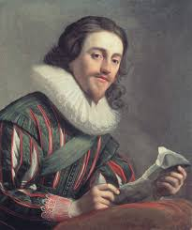
1625 – King Charles I
When James dies, his son Charles I became king.
Charles dissolves (breaks up) Parliament but later has to call them back because he needs money.

Slide 8
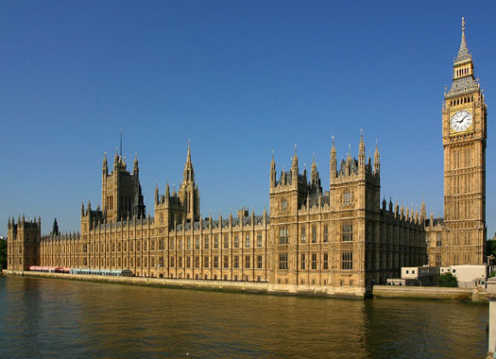
Quick recap
Basically at this point, Parliament has had it with the King of England.

Slide 9
1642 – Civil War Begins
They give the King one last chance!
Parliament agrees to help Charles if they can control the army.
Charles doesn't agree and instead decides to invade Parliament.

Slide 10
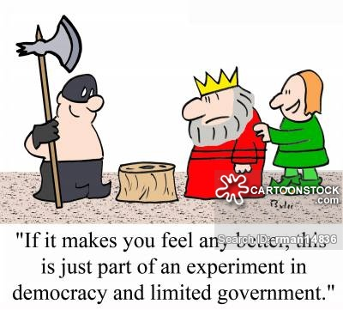
1646 – Abolish Monarchy
The Cavaliers (King’s troops) are successful at first but eventually, the Roundheads (led by Oliver Cromwell) win.
Charles I was beheaded in public 3 years later.
“If it makes you feel any better, this is just part of an experiment in democracy and limited government.”

Slide 11
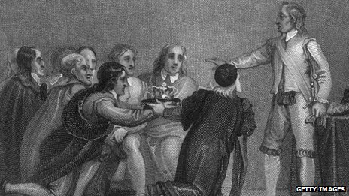
1653 – Lord Protector
Oliver Cromwell declares himself “Lord Protector” (which is really just a nice way to say military dictator)

Slide 12
1660 - Restoration
After Oliver Cromwell dies, his son tries to keep power but is unsuccessful.
Many of Cromwell’s policies were very unpopular (who doesn’t want to celebrate Christmas??)
England decides to bring back the king and they ask King Charles in Scottland to be king.
Sorry for beheading your dad Charles, but will you be king please??
Sure!!

Slide 13
1685 – James II King
Charles II dies without a legitimate heir so his brother, James, becomes king.
The only problem with James is that he has done the unforgivable…. He has married… a CATHOLIC!

Slide 14
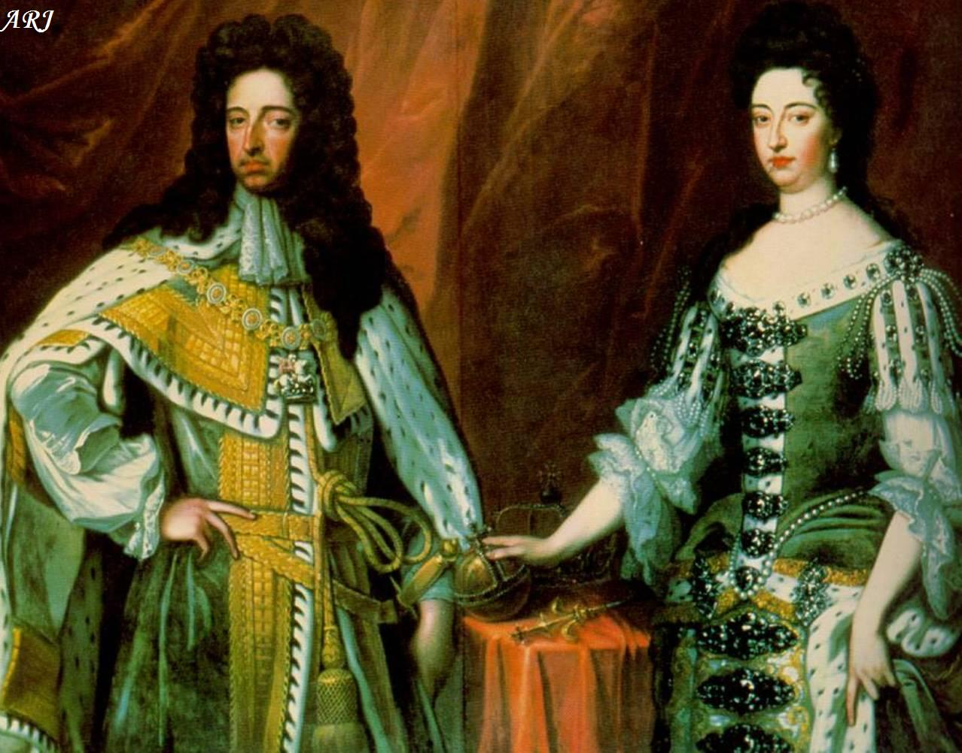
1688 - Glorious Revolution
To avoid the issues they had during the civil war, the English decided to invite James I’ older daughter, Mary, and her husband, William, (both protestant) to be the queen and king of England.
They accepted (it was glorious) and James II fled to France.

Slide 15
1689 – English Bill of Rights
Parliament was finally in charge and to make sure that the monarch in England never tried to over power them again, they had William and Mary sign the English Bill of Rights
Power was transferred to Parliament and English will from here on remain a Constitutional Monarchy.

Slide 16
Government Principles Review pg. 15
First we need to review the principles of government that came from the enlightenment…

Slide 17
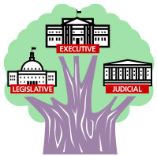
Separation of Powers
Idea came from: French philosopher, Baron de Montesquieu presented in The Spirit of Laws
3 independent and equal branches of government with a system of checks and balances

Slide 18
Checks and Balances
System designed to prevent any one branch of government from dominating the others.

Slide 19
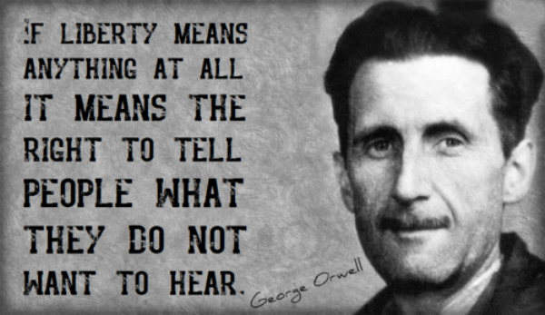
Liberty
A political philosophy proposing the idea that an individual has the right to act according to his or her own individual liberty

Slide 20
Equality
An idea that each individual is subject to the same laws, with no individual or group having special legal privileges

Slide 21
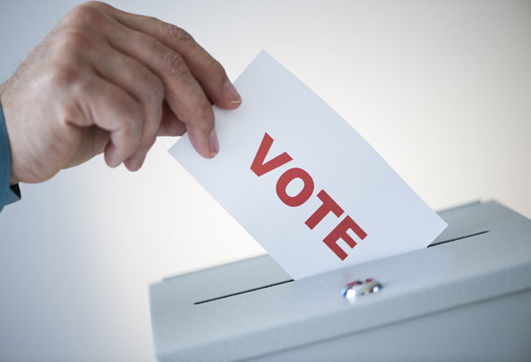
Democracy
A political form of government characterized by either direct rule by the people (direct democracy) or by elected representatives of the people (representative democracy).

Slide 22
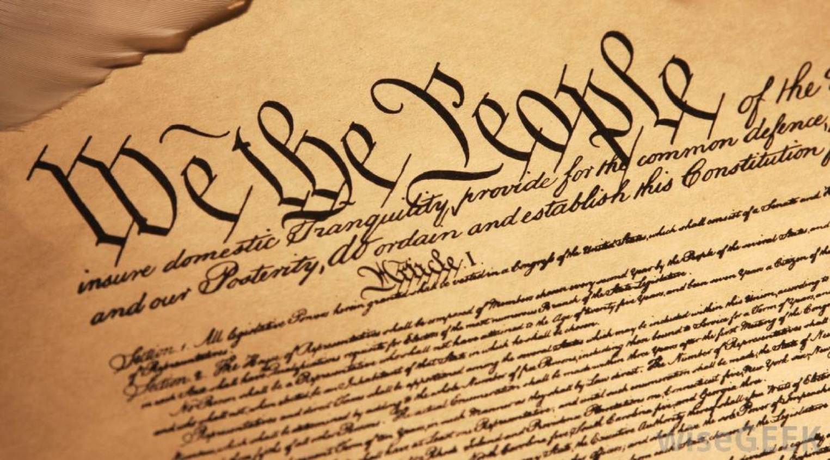
Popular Sovereignty
The concept that political power rests with the people who create and can change and end government.
The voice of the people is heard through voting and free participation in government.

Slide 23
Human Rights
The inalienable rights of life, liberty, and the pursuit of happiness, as well as freedom of speech, religion, and the press.

Slide 24
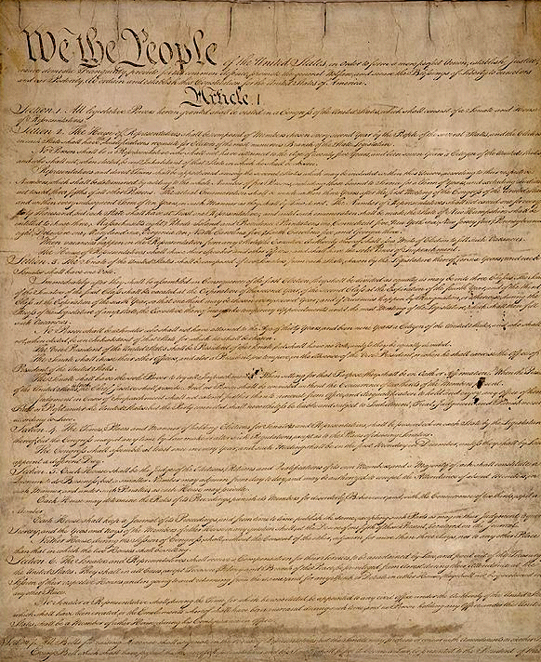
Constitutionalism
An idea that the basic principles and laws of a government should be organized and administered through compliance with a written or unwritten constitution.

Slide 25
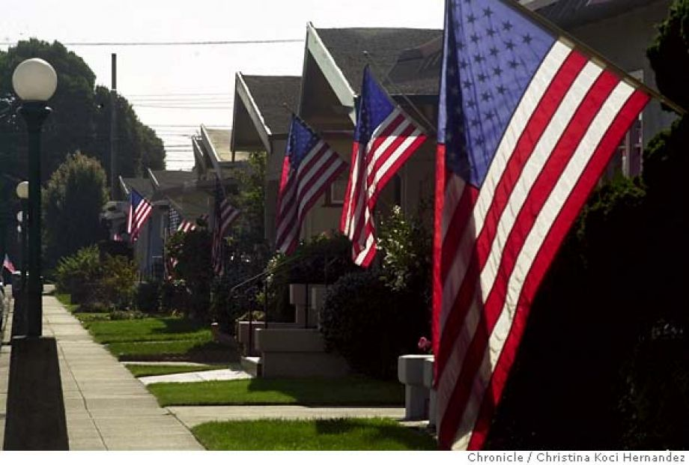
Nationalism
The belief that each nationality (ethnic group) is entitled to its own government and national homeland and is superior to others
Shown through
national culture with a common language, religion, and history
symbols of nations
(flags & anthems)

Slide 26
How did the following ideas
influence
the political revolutions
of this era?

