Slide 2
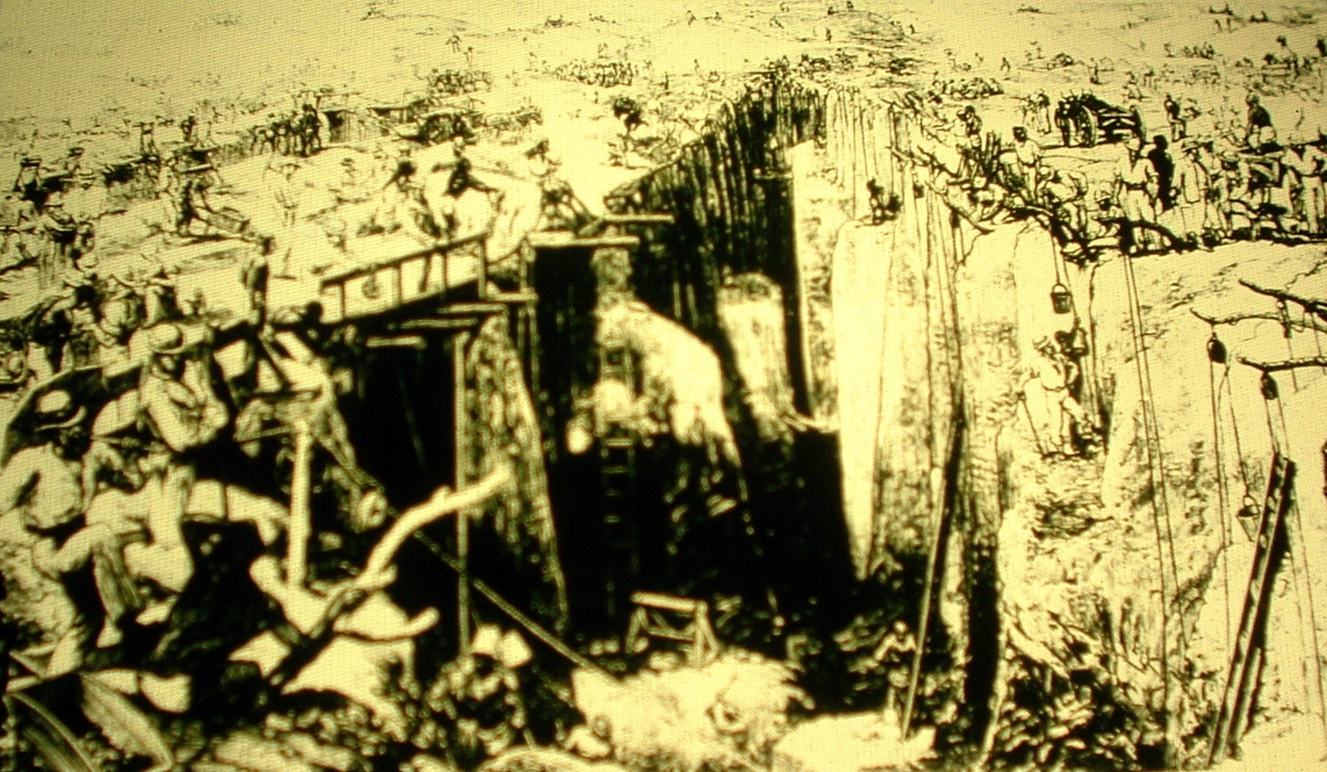
#1: Open-shaft diamond mining in Kimberly, South Africa, 1872

Slide 3
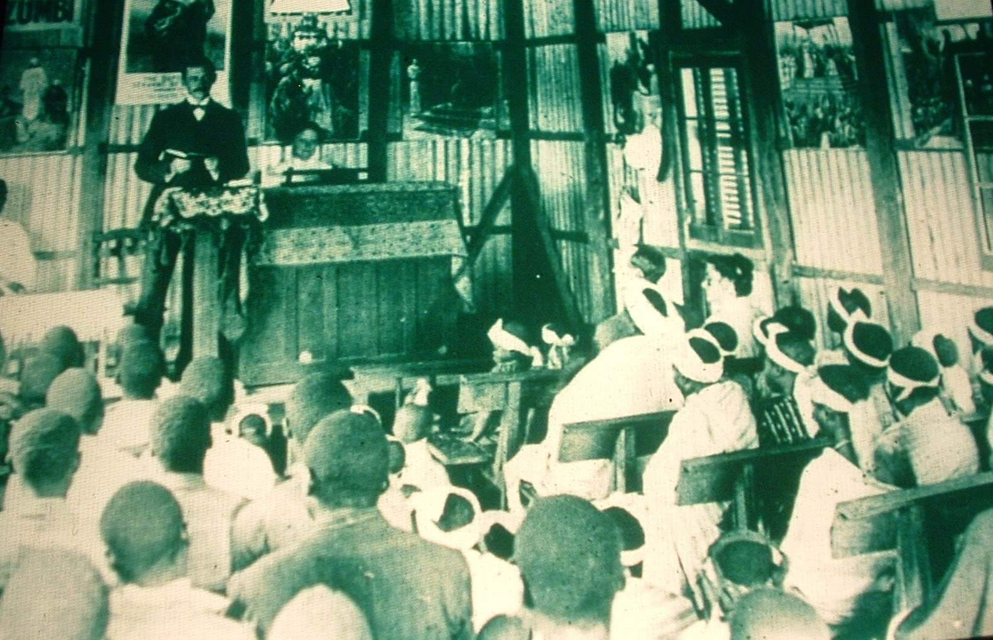
#2: A Methodist Sunday School at Guiongua, Angola, 1925

Slide 4
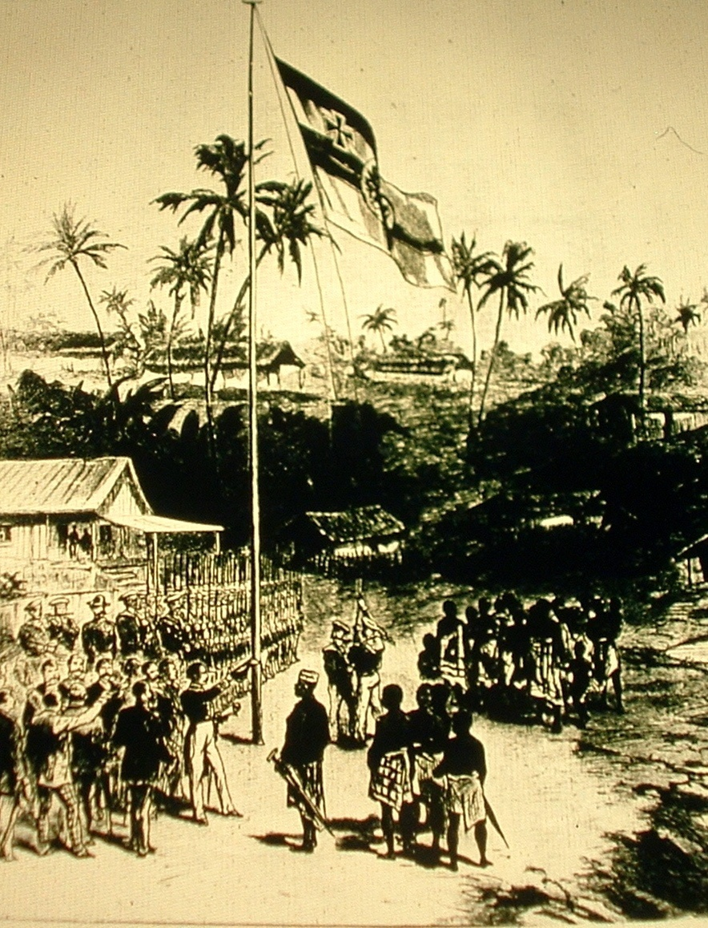
#3: Germans taking possession of Cameroon in 1881

Slide 5
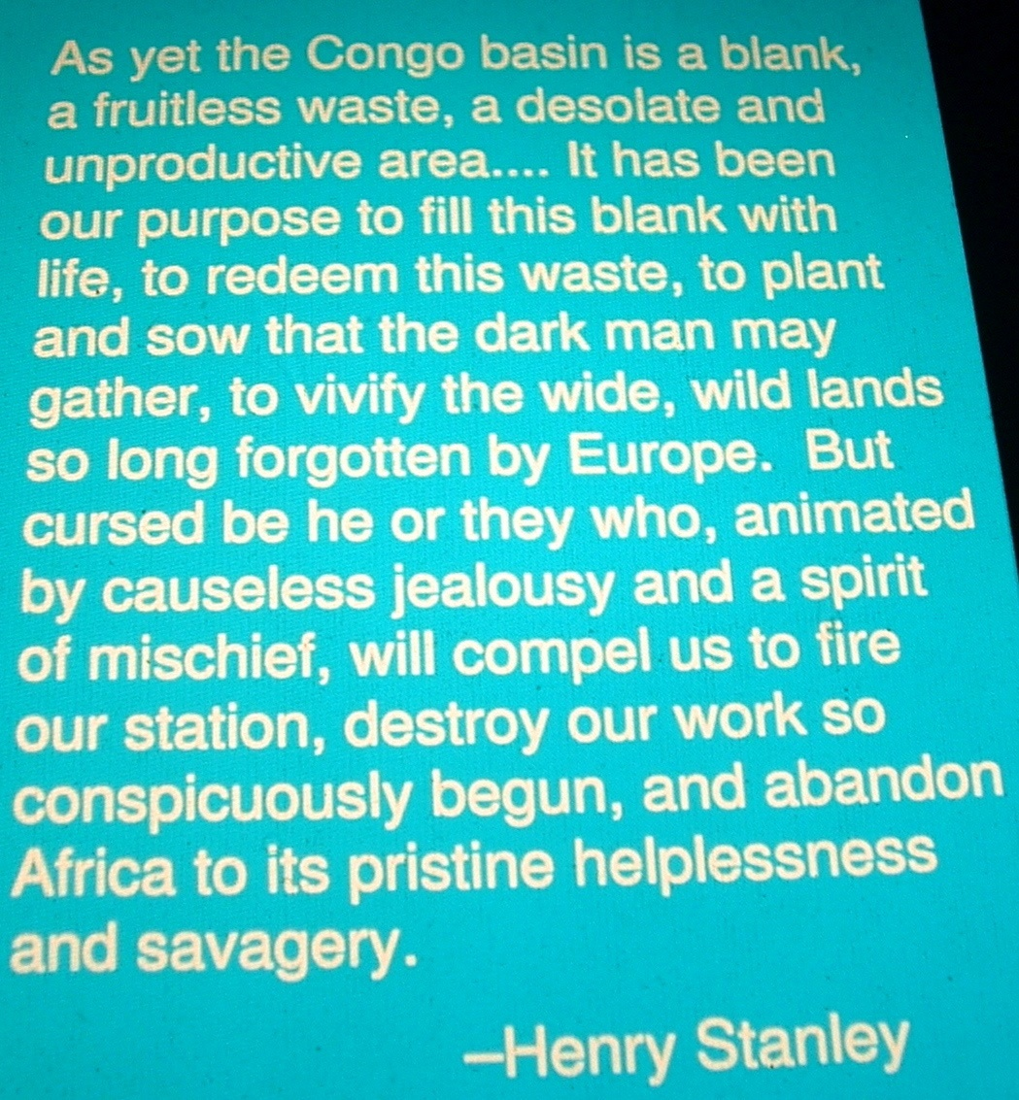
#4: Quote from Henry Stanley in 1882

Slide 6
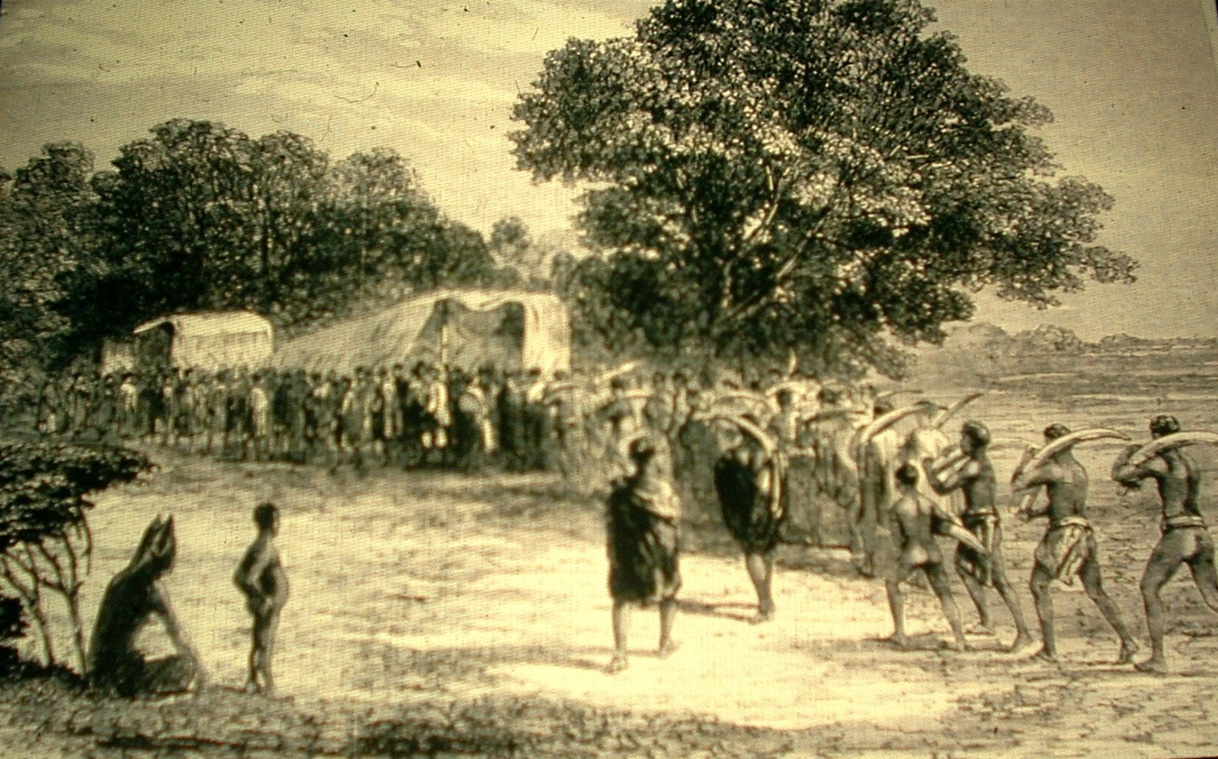
#5: Africans bringing ivory to the wagon in South Africa, c. 1860

Slide 7
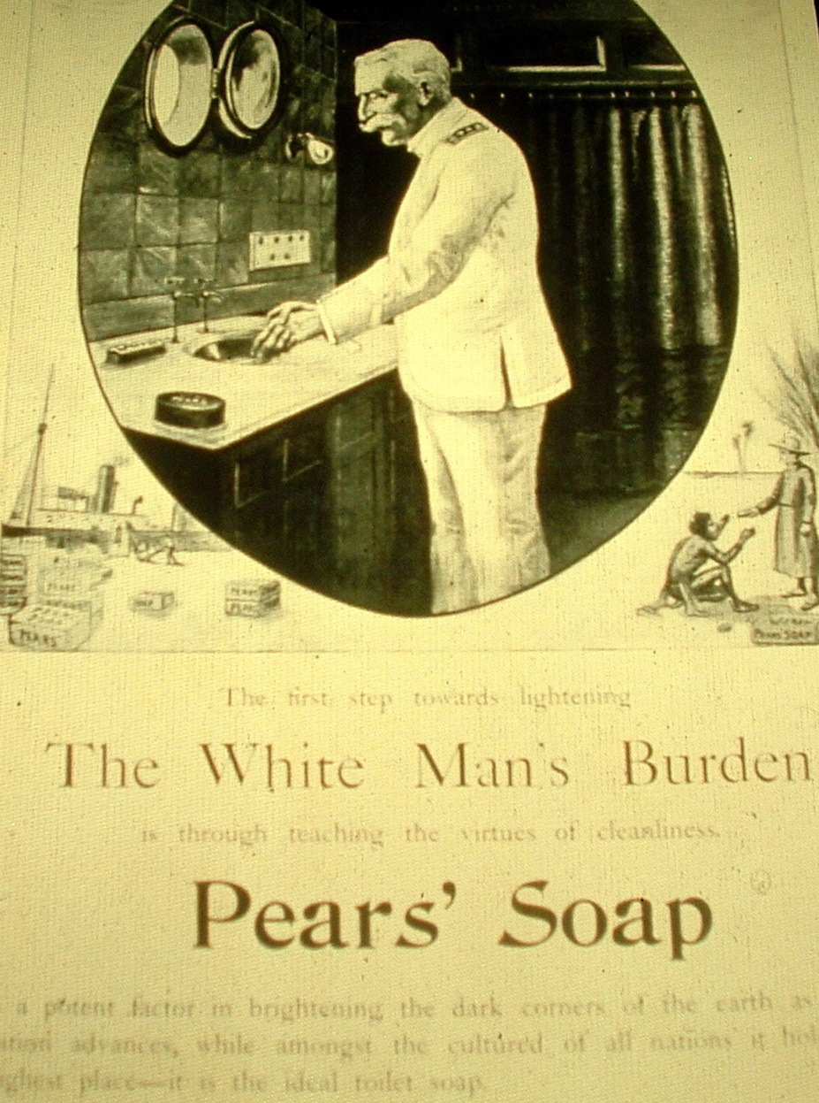
#6: An advertisement for Pears’ Sope from the 1890s, and one stanza of the British poet Rudyard Kipling’s poem, The White Man’s Burden, written in 1899

Slide 8
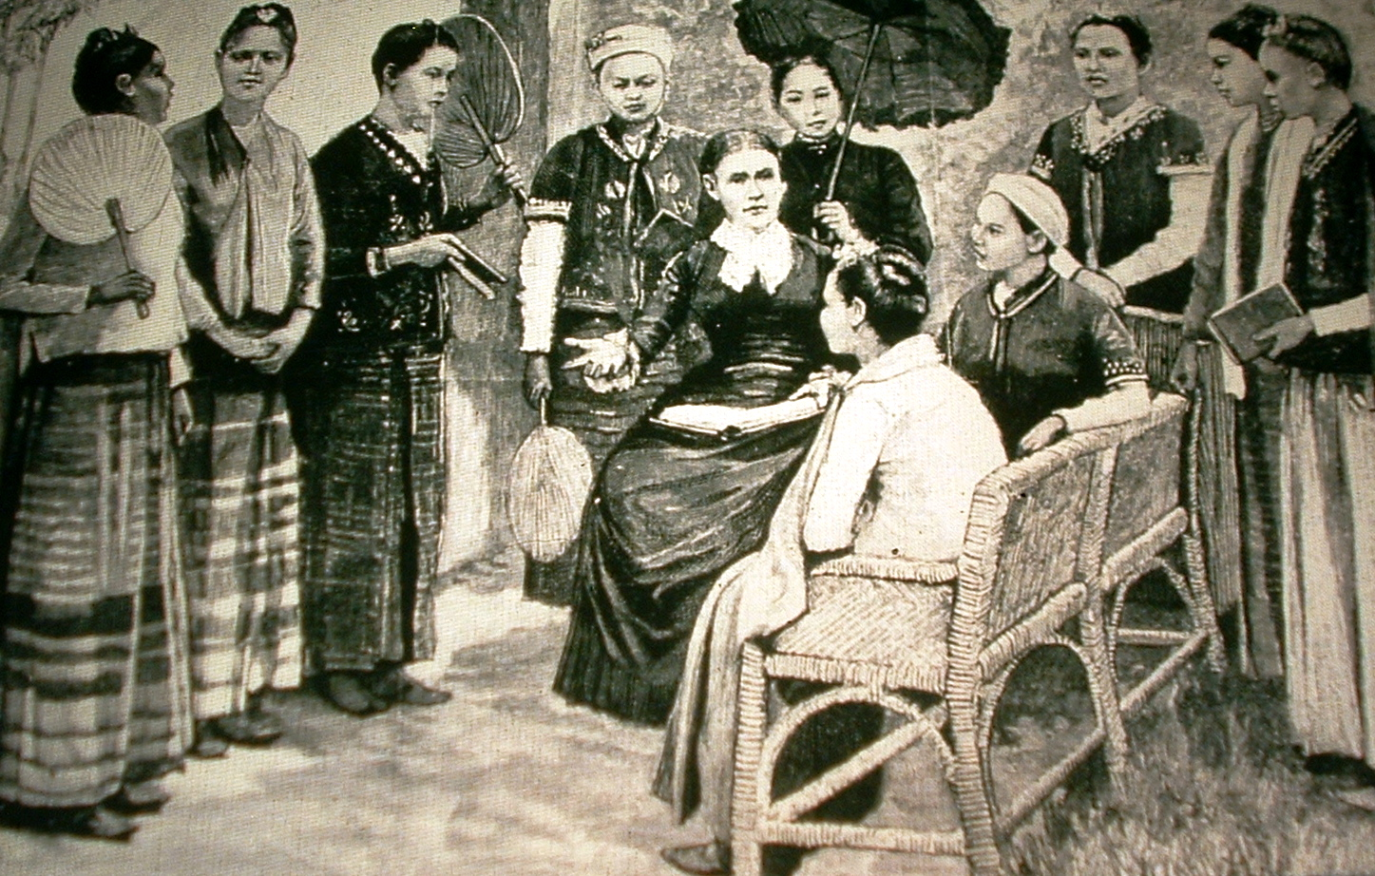
#7: Mrs. Maria C. Douglas, a doctor and missionary, and the first class of pupil nurses in Burma, 1888.
\

Slide 9
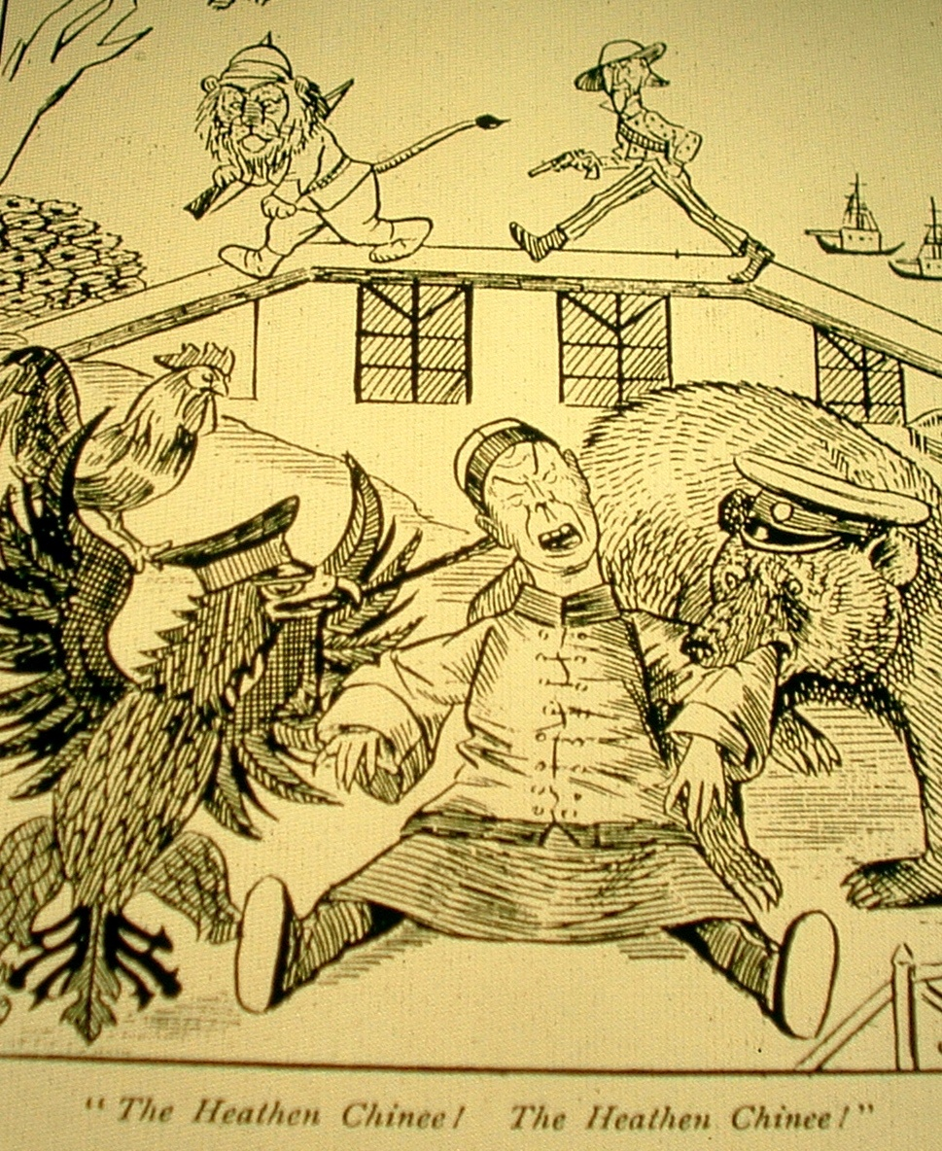
#8 British cartoon showing the Chinese being savaged by European powers, and the poem The Partition of China 1897

Slide 10
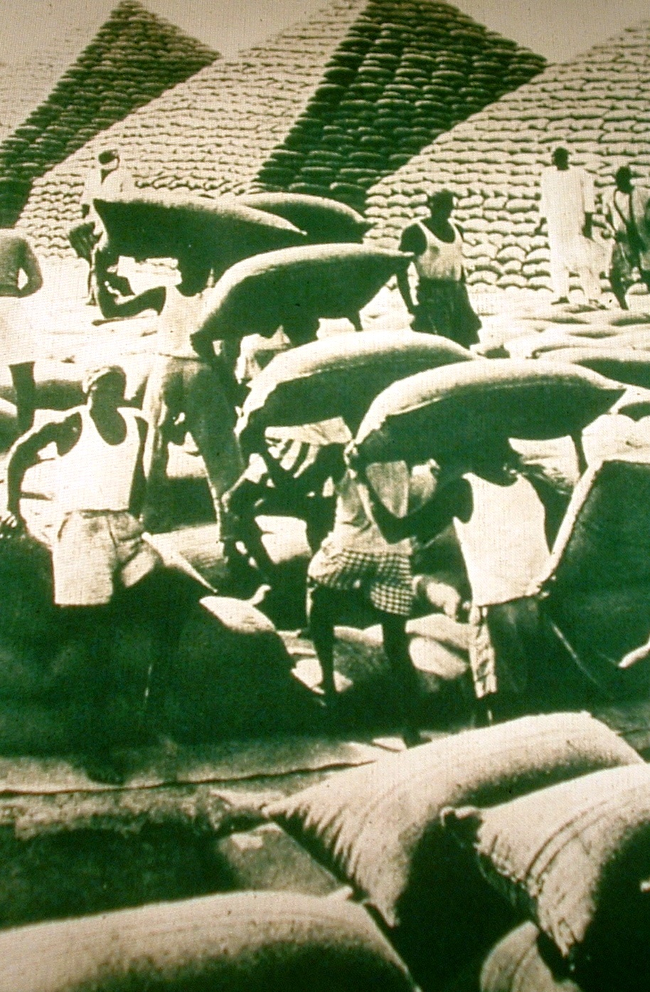
#9: Bagged groundnuts in pyramid stacks in West Africa

Slide 11
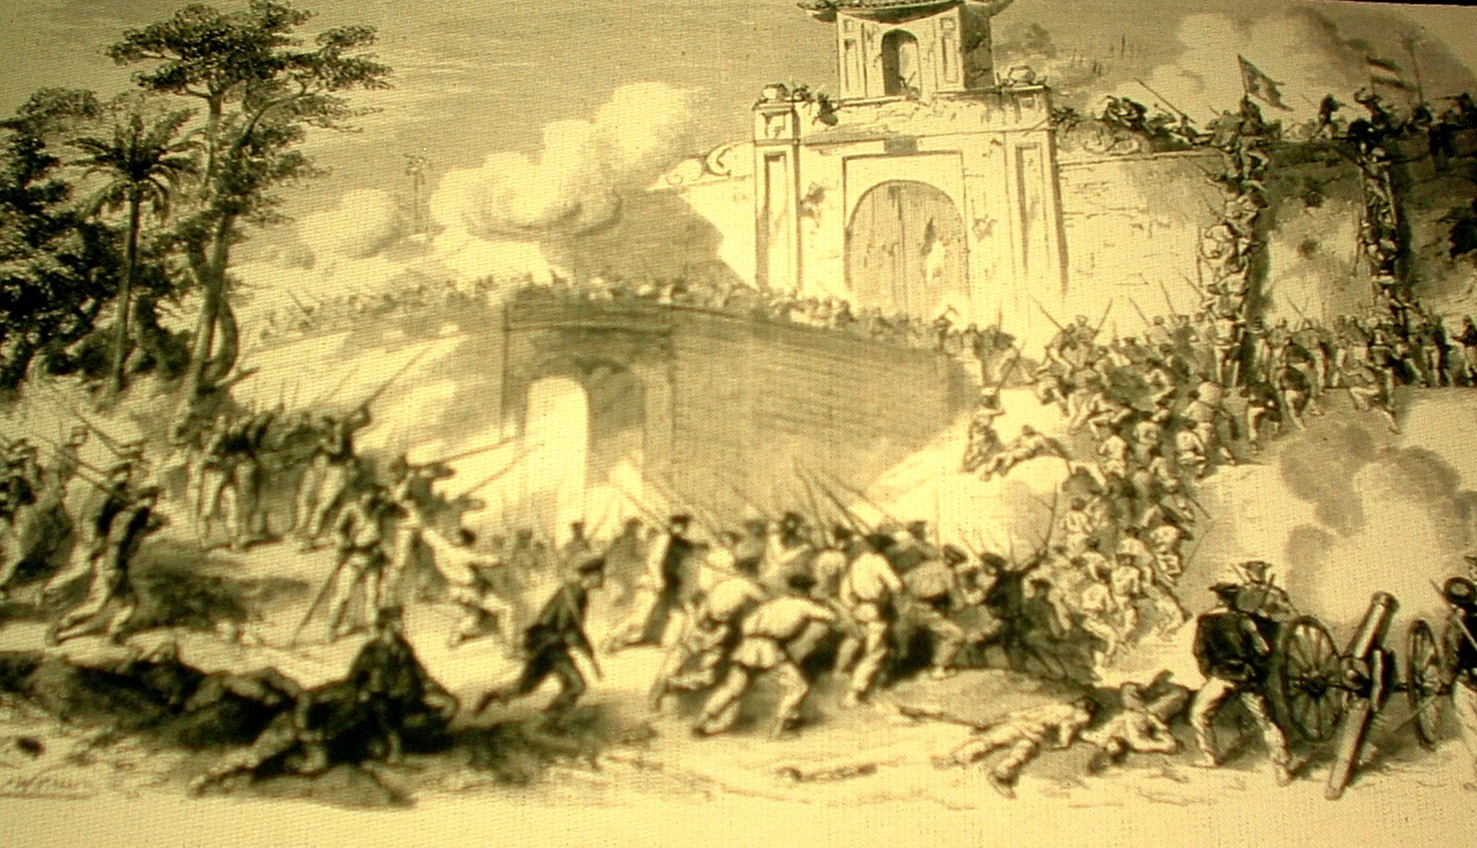
#10: French capture of the citadel of Saigon, Vietnam

Slide 12
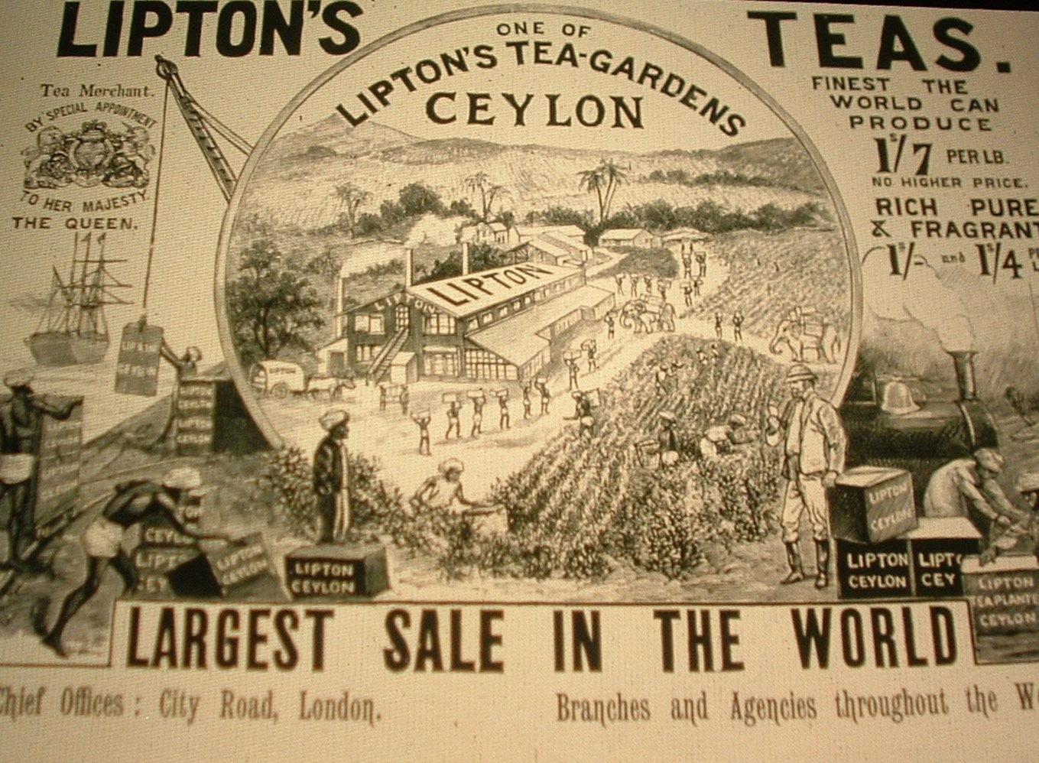
#11: British Lipton Tea advertisement in the 1890s

Slide 13
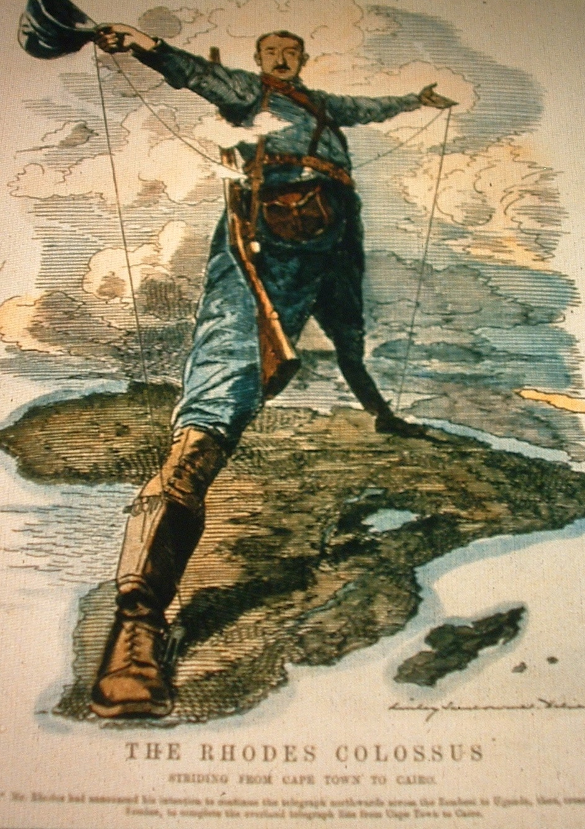
#12: British cartoon “The Rhodes Colossus” showing Cecil Rhodes’ vision of making Africa “all British from Cape to Cairo” 1892

Slide 14
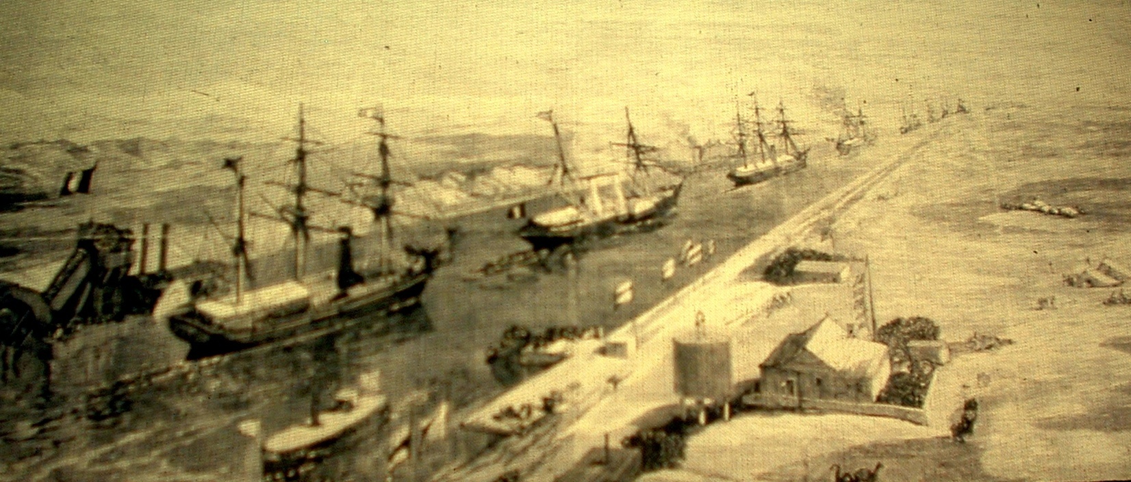
#13: An imperial yacht passing through the Suez Canal in Egypt at the opening of the canal in 1870

