Slide 1
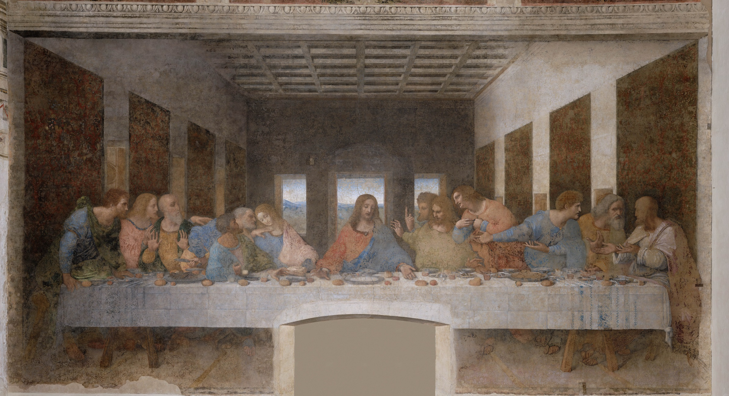

Slide 2
The Last Supper
Artist: Leonardo da Vinci
Type: Mural painting
Subject: Christ’s final meal with his apostles before Judas identifies Christ to the authorities who arrest him.

Slide 3
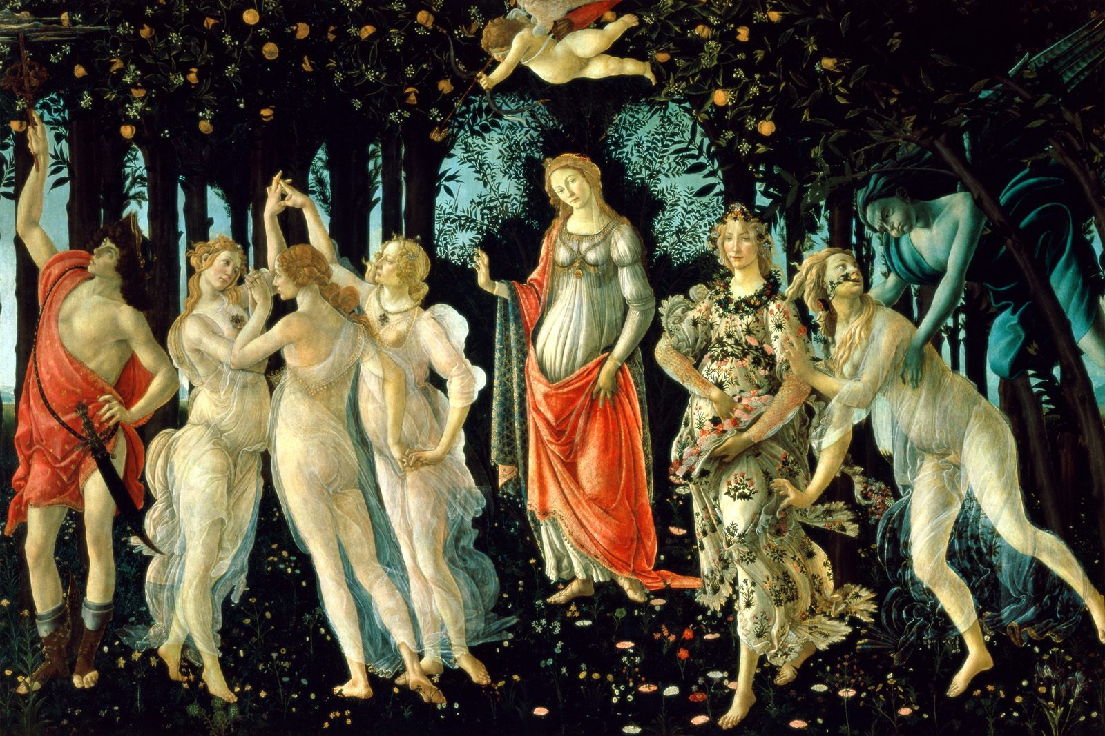

Slide 4
Primavera
Artist: Sandro Botticelli
Type: Tempera panel painting
Subject: Contains numerous references to classical and contemporary texts, and is open to almost endless interpretations by scholars and art historians.
Created: ca. 1482

Slide 5
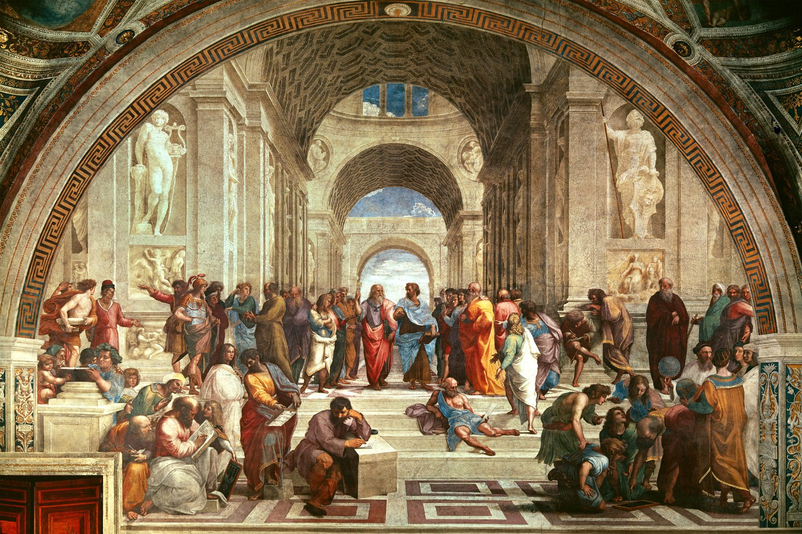

Slide 6
School of Athens
Artist: Raphael
Type: Fresco
Created: 1509-1511
Subject: The School of Athens represents all the greatest mathematicians, philosophers and scientists from classical antiquity gathered together sharing their ideas and learning from each other. These figures all lived at different times, but here they are gathered together under one roof. The two thinkers in the very center are Aristotle and Plato

Slide 7
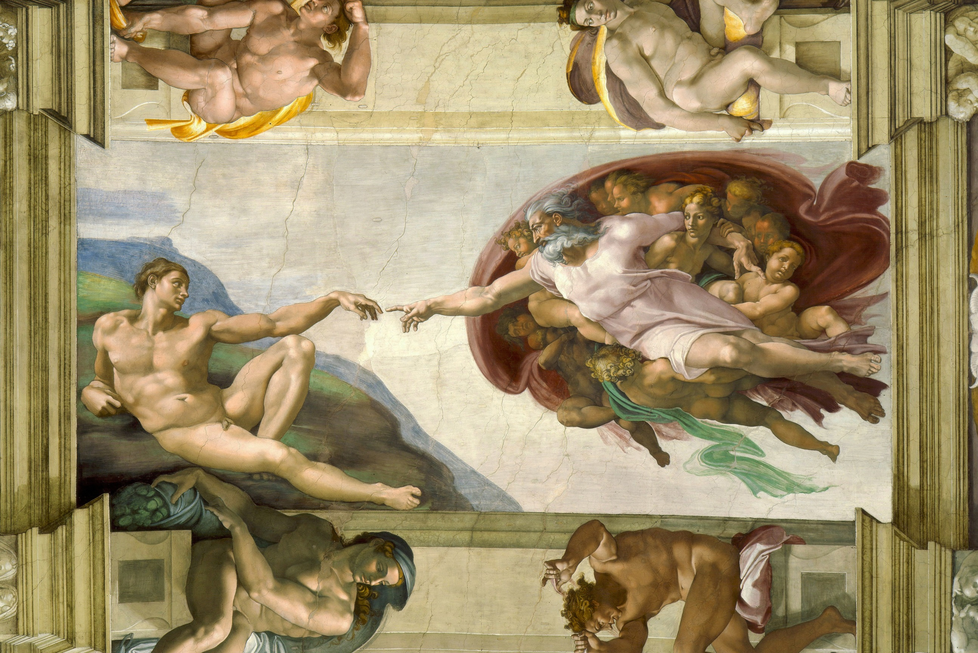

Slide 8
Creation of Adam

Slide 9
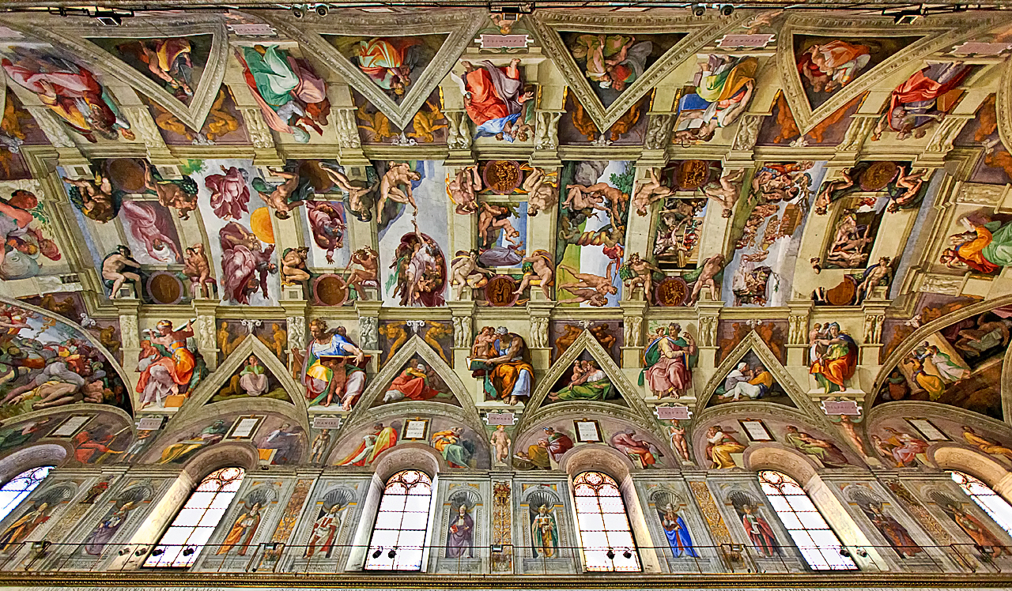

Slide 10
Ceiling of the Sistine Chapel
Artist: Michelangelo
Type:
Created: 1508 and 1512
Subject:

Slide 11
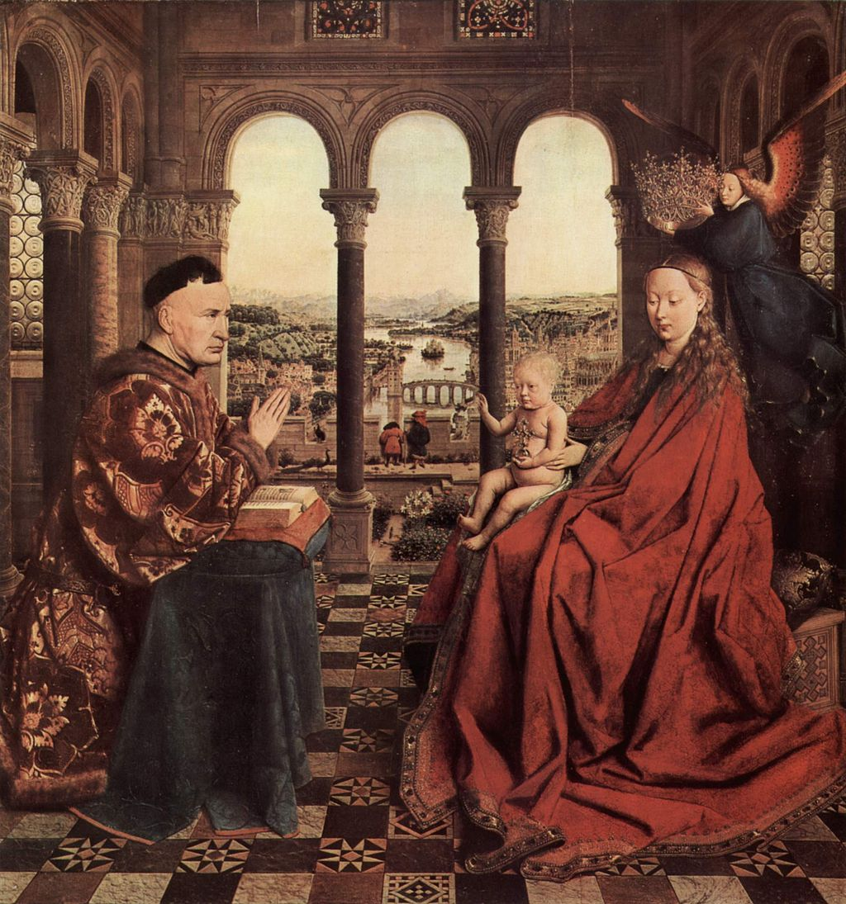

Slide 12
Madonna Of Chancellor Rolin
Artist: Jan van Eyck
Type: Oil Painting
Created: ca 1435
Subject: The scene depicts the Virgin crowned by a hovering Angel while she presents the Infant Jesus to Rolin.

Slide 13
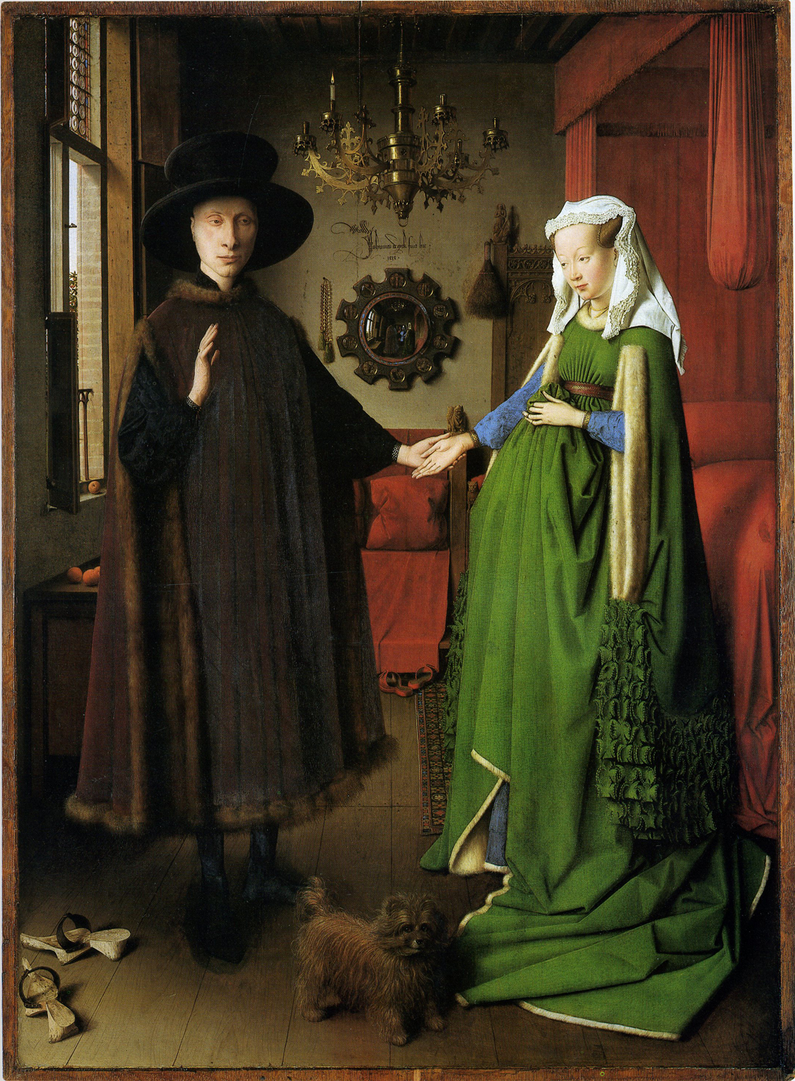
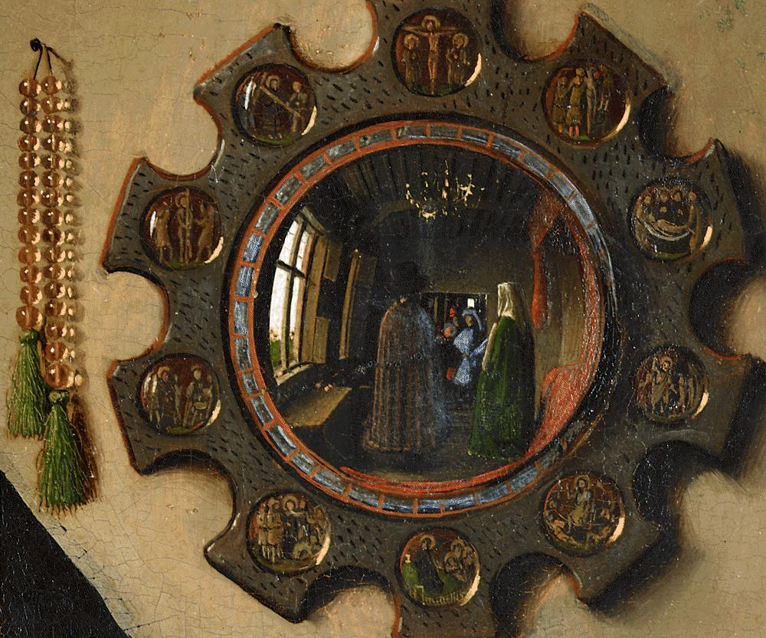

Slide 14
Arnolfini Wedding
Artist: Jan van Eyck
Type: Oil Painting
Created: 1434
Subject: The marriage of Italian merchant Giovanni di Nicolao Arnolfini and his wife.

Slide 15
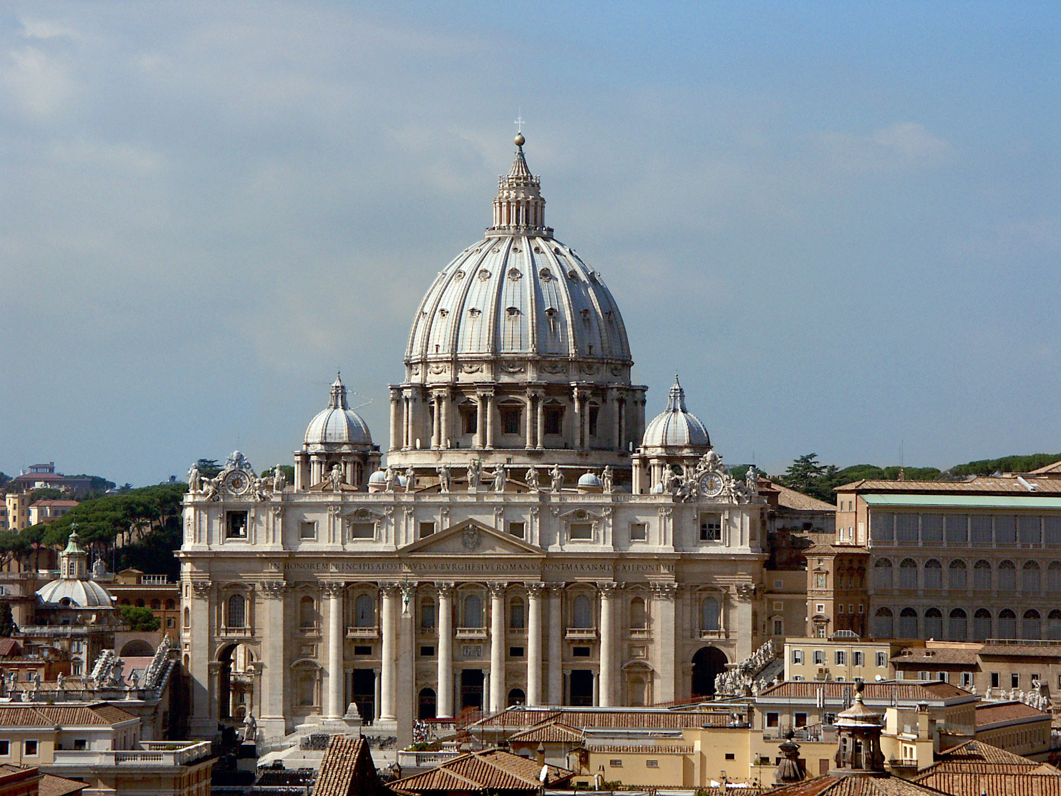

Slide 16
St. Peter’s Basilica
Artist: Designed principally by Donato Bramante, Michelangelo, Carlo Maderno and Gian Lorenzo Bernini
Type: Church in the Vatican
Created: Began 1506/Completed 1626

Slide 17
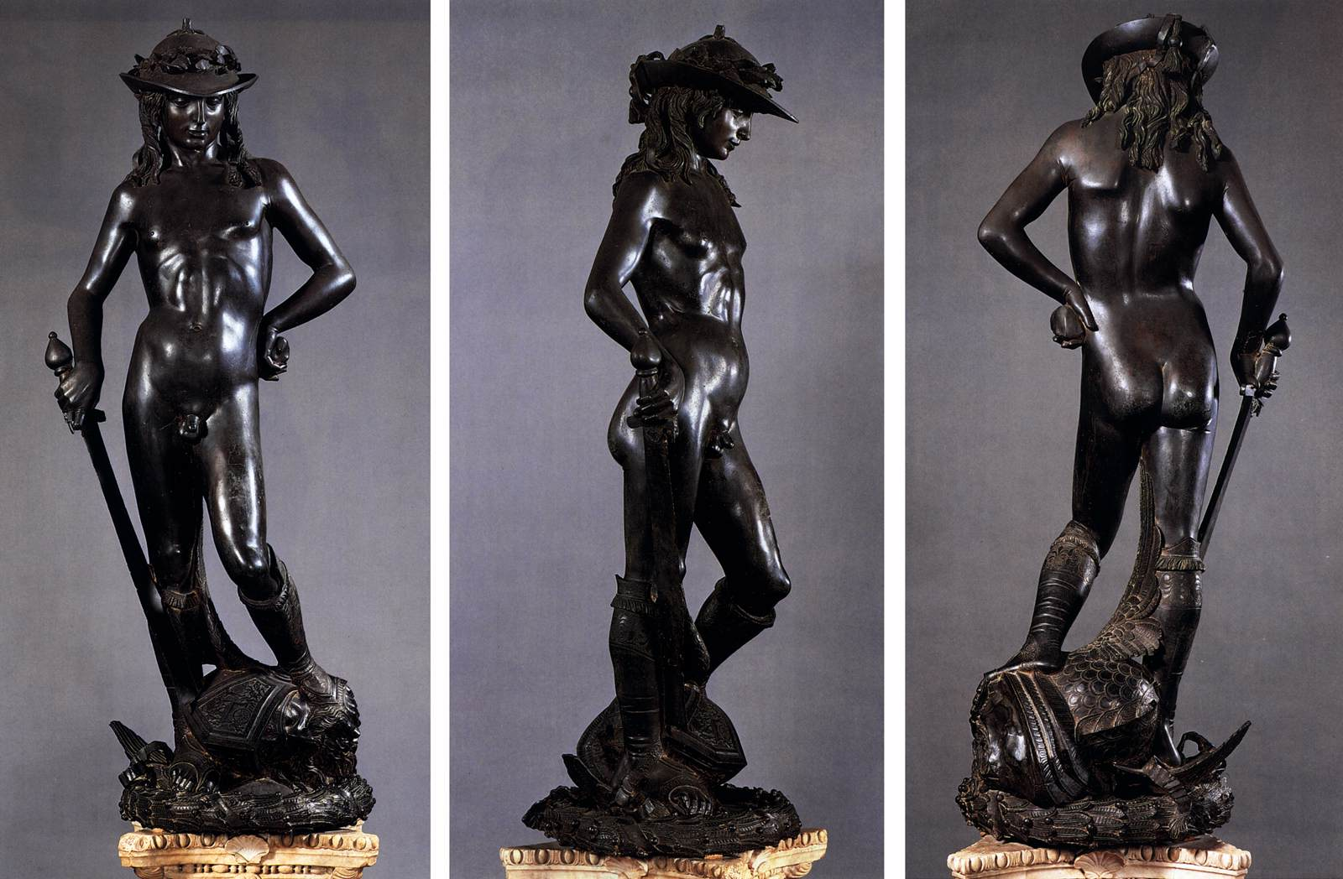

Slide 18
David
Artist: Donatello
Type: Bronze Statue
Created: 1430s or later
Subject: The statue represents the Biblical hero David

Slide 19
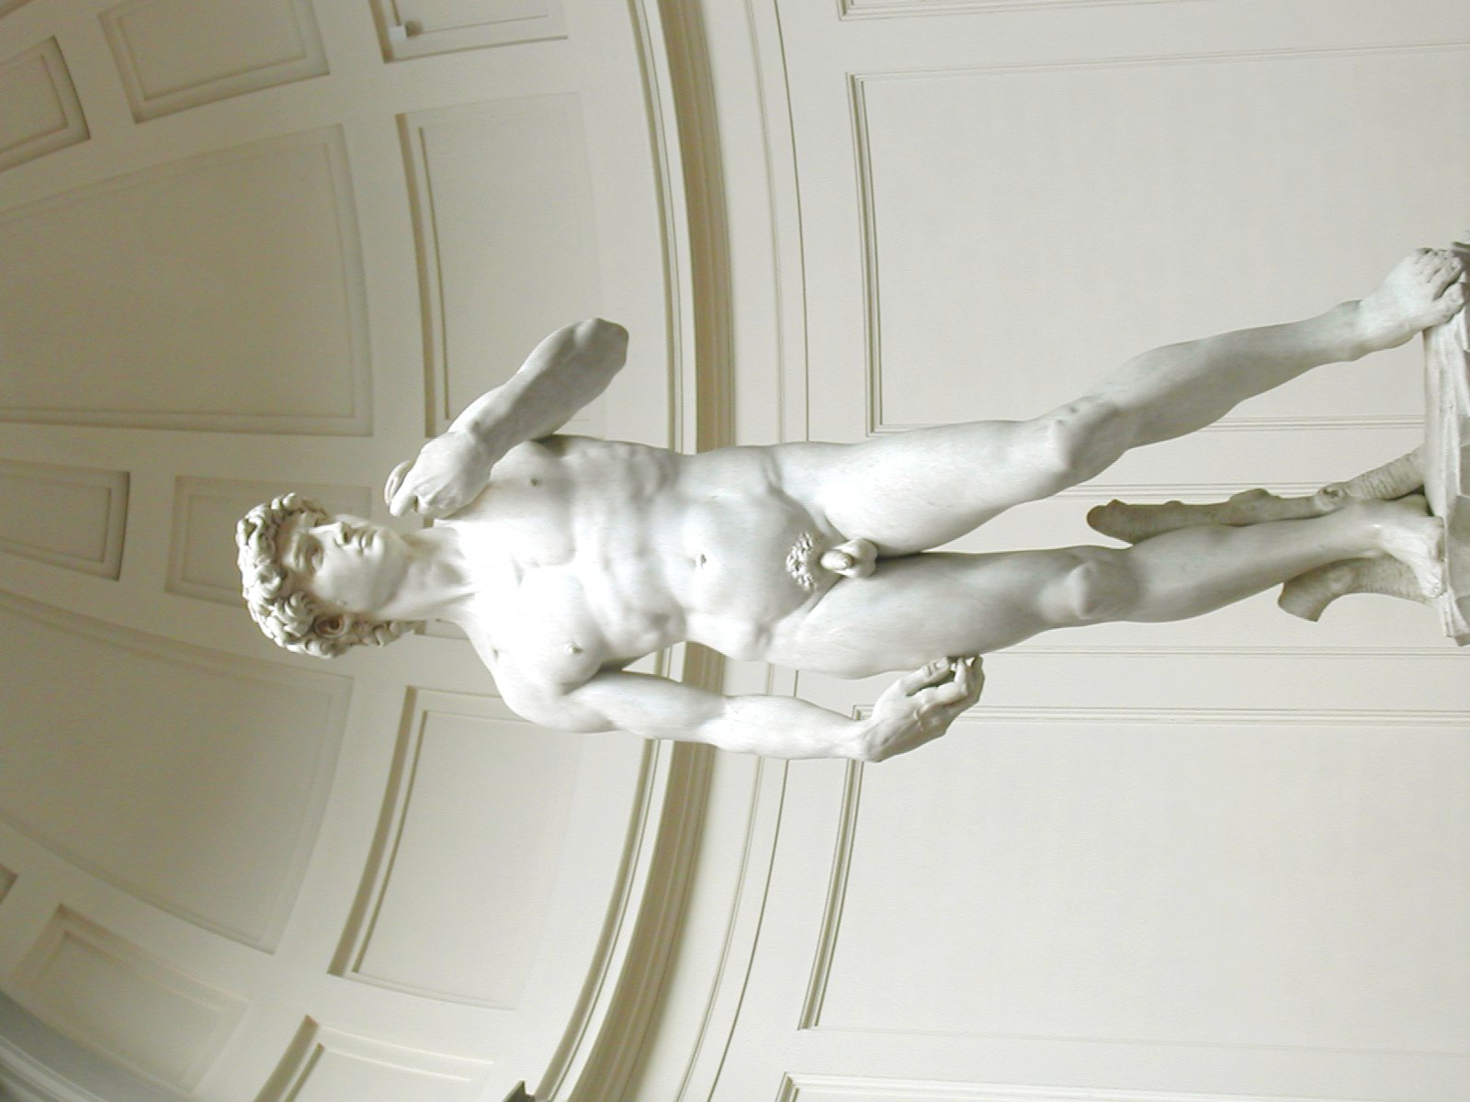

Slide 20
David
Artist: Michelangelo
Type: Marble Statue
Created: 1501 - 1504
Subject: The statue represents the Biblical hero David

Slide 21
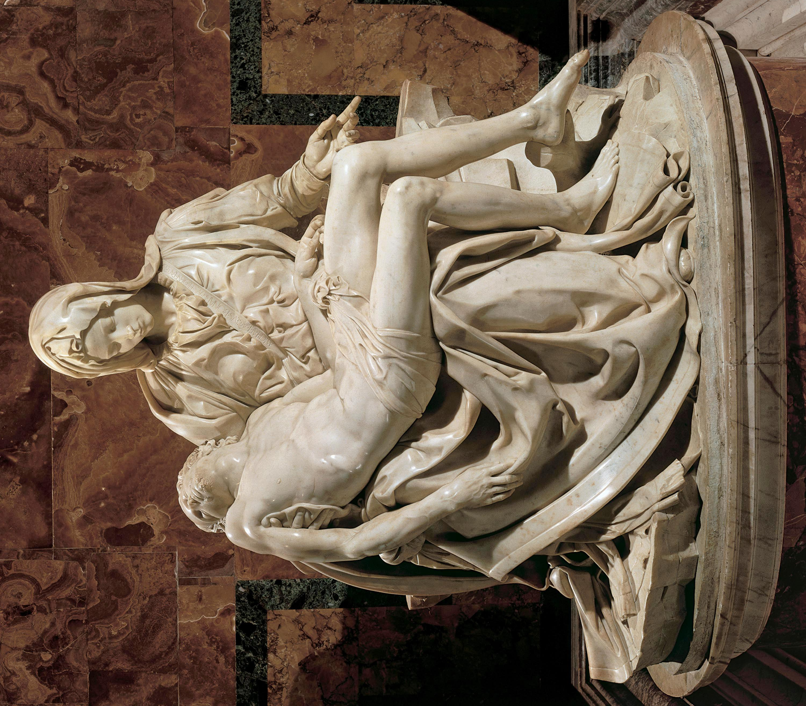

Slide 22
Pieta
Artist: Michelangelo
Type: Marble Statue
Created: 1498–1499
Subject: depicts the body of Jesus on the lap of his mother Mary after the Crucifixion.

Slide 23
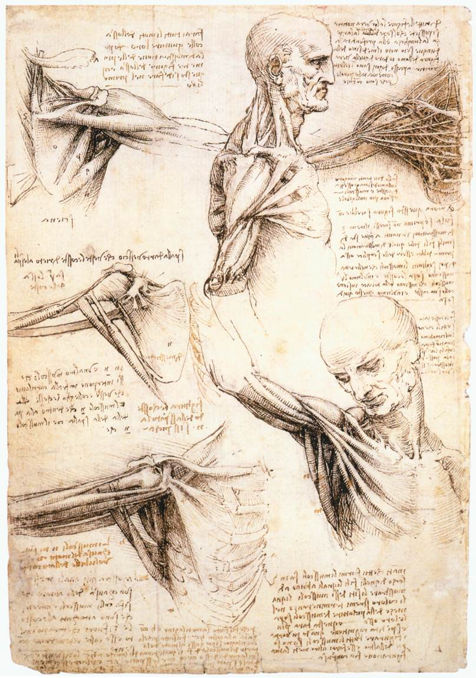
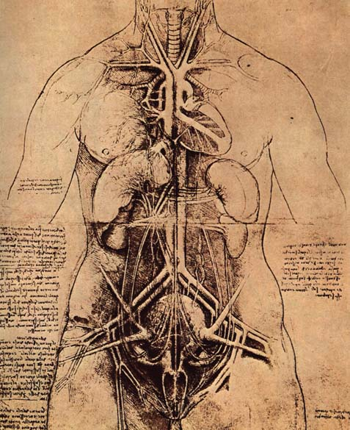

Slide 24
Sketches from Journals
Artist: Leonardo da Vinci
Type: Sketches
Created: 1478 and 1518
Subject: During his lifetime, Leonardo drew many sketches such these in his private notebooks, depicting the muscles and tendons of the upper body. As well as other parts of the human anatomy.

