Slide 1
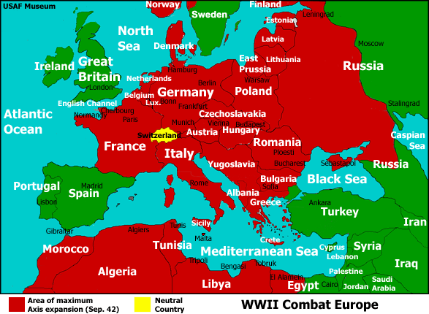
Station 2: Battles in Europe

Slide 2
Allies’ Goal: Force the Nazis back to Germany
USA, Canada & Britain fought from the West
Soviet Union fought from the East
The West
The East

Slide 3
D-Day: Operation Overlord aka The Landing at Normandy
June 6, 1944
The Americans, Brits & Canadians had well-planned, organized and deadly attack on the northern coast of France
Soldiers parachuted in, ships unloaded soldiers who attacked the German defenses on foot
Over 4,000 Allied soldiers killed in 1 day…
Beginning of the Allies land invasion in Europe: a turning-point in the war, Allies began to win

Slide 5
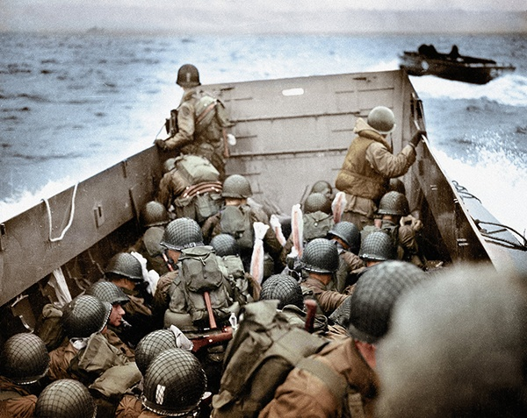
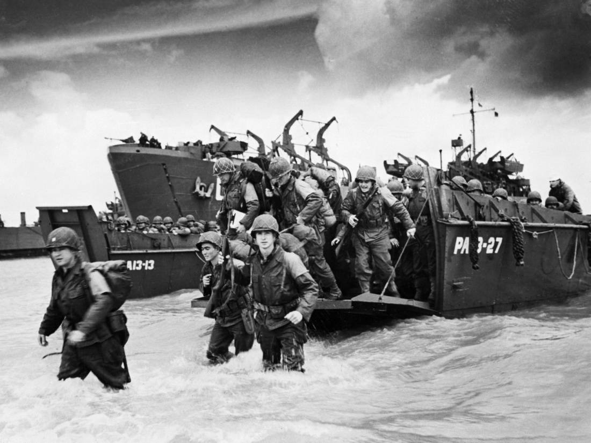
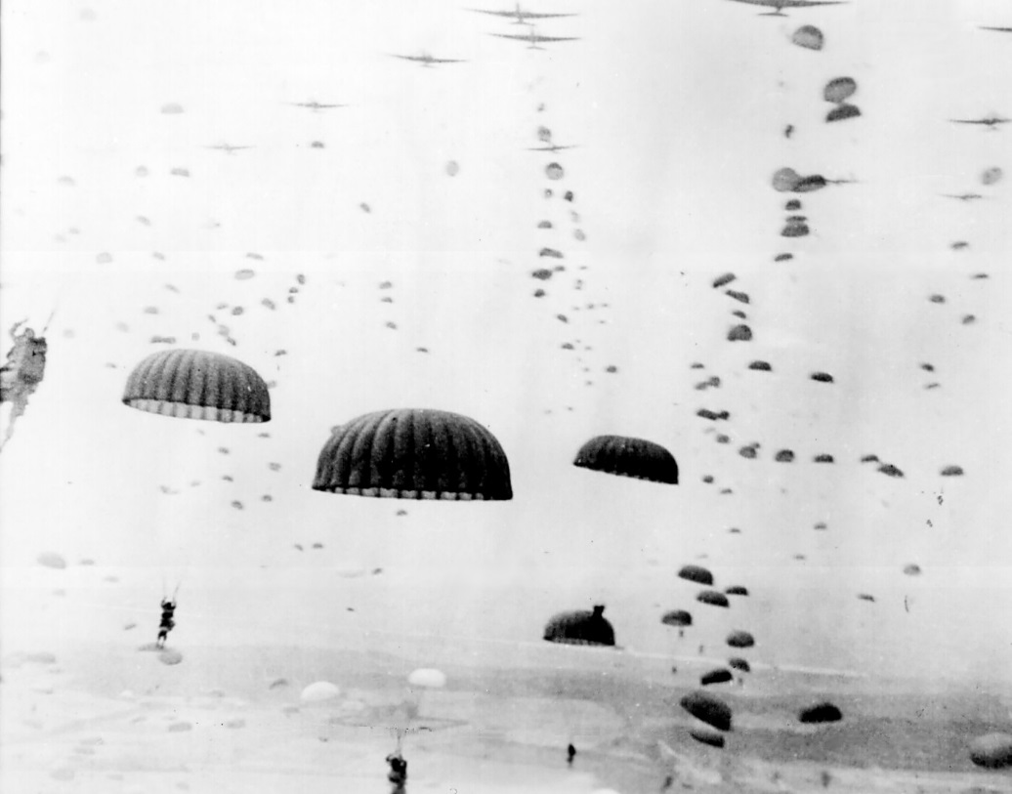
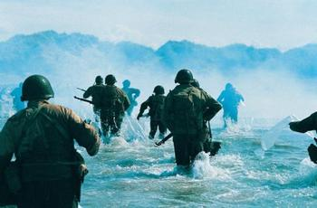

Slide 6
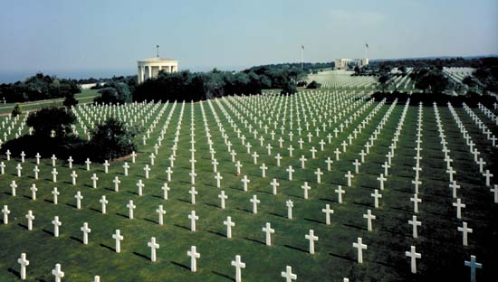
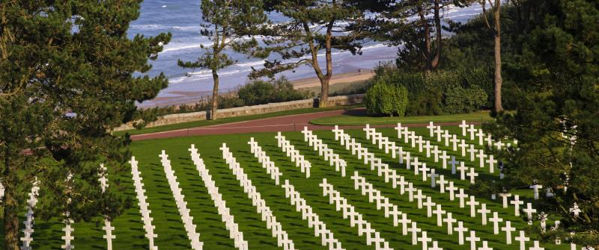
American Soldiers Graveyard at Normandy, France

Slide 7
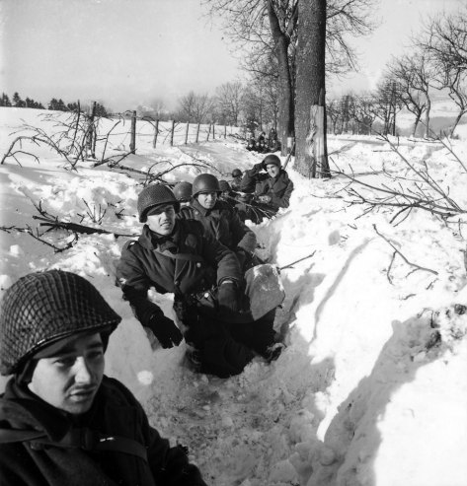
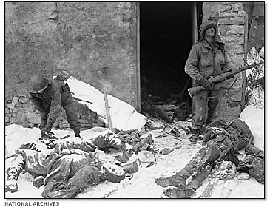
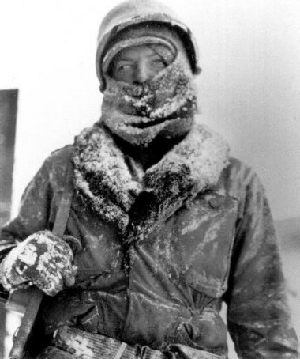
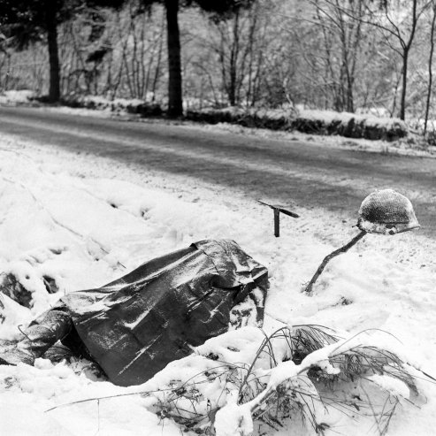
Fighting in Winter

Slide 8
Battle of Stalingrad: 1942-1943
The Nazis had been stopped by the Soviets the previous winter (humiliating for Germany)
Nazis goal: force Soviets to surrender, cut off their supplies, so the Nazis could focus on the West
Began to attack the region in June 1942, successfully advanced, reached Stalingrad in Nov.
Soviets launched a counter-attack
Brutal, hand-to-hand combat for each city block
Soviets trapped the Germans IN Stalingrad- cut off from supplies
Soviet victory in Feb 1943
91,000 Nazis taken prisoner, major loss of soldiers & weapons left Germany vulnerable

Slide 10
