Slide 1
THE COLD WAR
Learning Goal 1: Describe the causes and effects of the Cold War and explain how the Korean War, Vietnam War and the arms race were associated with the Cold War.

Slide 2
RESULTS OF WWII

Slide 3
RESULTS – VE DAY!
May 7, 1945 – German surrender
Nuremberg Trials
22 Nazi Leaders are charged
“Crimes Against Humanity”
12 sentenced to death by hanging
Exposed the world to NAZI atrocities
Slave labor
Medical experiments on humans
Forced starvation
Genocide

Slide 4
RESULTS – VE DAY!
Germany was occupied & divided into 4 sectors
Soviet
British
French
American
Berlin in the Soviet sector was also divided among the 4

Slide 5
RESULTS – VJ DAY!
September 2, 1945 – Japanese surrender
US Occupation
Demilitarization
Japan left with only a small police force
Creation of a new constitution
Large land-holders were required to sell to small farmers (re-distribution of wealth).

Slide 6
United Nations
June 1945
UN – a replacement for the League of Nations
Created to prevent large-scale war
48 Countries join – Including the USA, USSR, France, China, Great Britain.

Slide 7
The Cold War
Communism (USSR) vs. Democracy (USA)
Competing Ideologies
 | Western Democracies | Soviet Communism
Political System | Citizens elect leaders Citizens have the right to form political parties | USSR – dictatorship controlled by Communist Party The only political party allowed
Individual Rights | Basic civil rights Free speech Freedom of press Freedom of religion | Citizens had few rights Censorship Secret police Religion discouraged
Economic System | Economic freedom People & corporations can own land & businesses Goods & services provided for a profit | No private property Govt. controls economy State-owned collective farms

Slide 8
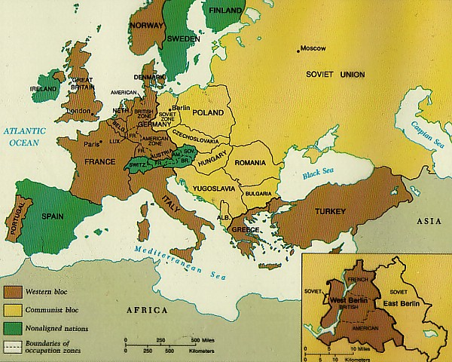

Slide 9
USSR GOALS
Encourage communism in other countries to lead a worldwide proletariat revolution
Rebuild Eastern Europe
Control Eastern Europe (politically and economically) to keep the US from gaining too much power
Wants a buffer zone as protection against aggression from the west
Keep Germany divided to prevent another war.

Slide 10
USA GOALS
Marshall Plan
US gave $$ billions to rebuild economies of Western European nations
Build trade partnerships for US
Gain access to raw materials available in eastern markets
Encourage democracy in other countries to prevent the spread of communism
Rebuild Europe, to create stability and new markets
Reunite Germany to stabilize it and increase the security of Europe.

Slide 11
THE IRON CURTAIN
Division between democratic Western Europe, and the communist-controlled East.
Churchill’s Speech
http://www.youtube.com/watch?v=S2PUIQpAEAQ

Slide 12
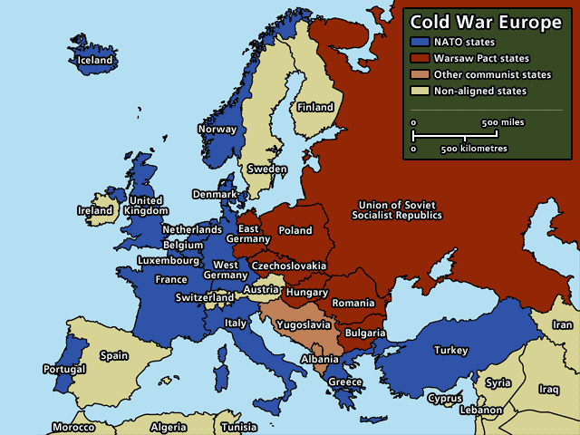

Slide 13
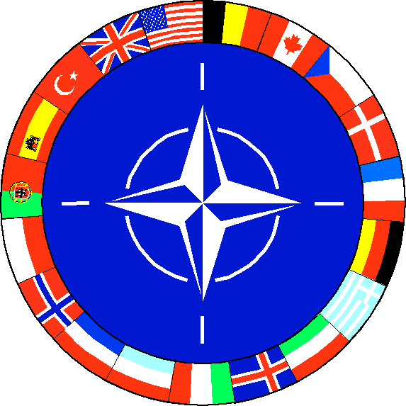
NATO CREATED
NORTH ATLANTIC TREATY ORGANIZATION
Formed in 1949
To ensure freedom for those who sign
Defend Western Europe from the Soviet Union

Slide 14
Who Signed NATO – The Founders
Luxembourg
Netherlands
United Kingdom
United States
Norway
Portugal
Belgium
Canada
Denmark
France
Iceland
Italy

Slide 15
Expansion of NATO During Cold War
Greece – 1952
Turkey – 1952
West Germany – 1955
Spain – 1982

Slide 16
NATO Now Also Includes
Czech Republic – 1999
Hungary – 1999
Poland – 1999
Bulgaria – 2004
Estonia – 2004
Latvia – 2004
Lithuania – 2004
Romania – 2004
Slovakia – 2004
Slovenia – 2004
Albania – 2009
Croatia – 2009

Slide 17
The Warsaw Pact – A Response to NATO
Hungary
Romania
Bulgaria
Albania
Soviet Union
Poland
East Germany
Czechoslovakia

Slide 18
THE BERLIN AIRLIFT
Berlin divided-USA, Britain, France, & USSR
BUT the city was in the USSR sector of Germany
June 1948
Western allies merged their zones of occupation
The Soviets cut land access to Berlin from the west
Western allies began flying in supplies to West Berlin around the clock for 11 months
Stalin admitted defeat & lifted the blockade
First major confrontation of the Cold War

Slide 19
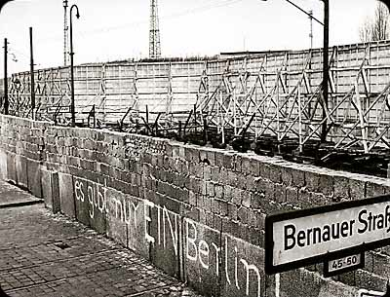
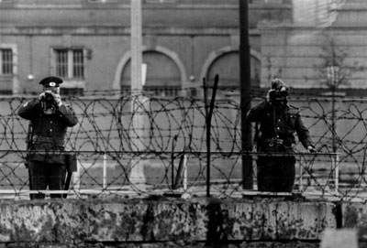
THE BERLIN WALL
Berlin Wall built to separate East and West Germany
Became a universal symbol of the Cold War
Built by East Germany (with Soviet backing) in 1961 to stop East Germans from fleeing to West Berlin

Slide 20
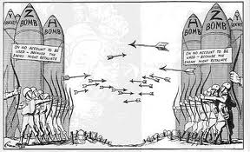
ARMS RACE
USA & USSR make more destructive weapons
ICBMs
Nuclear proliferation
Deterrents
MAD
Space Race
Sputnik – USSR
Apollo moon landing – USA
Nuclear Non-Proliferation Treaty - 1968

