Slide 1
THE COLD WAR
Learning Goal 1: Describe the causes and effects of the Cold War and explain how the Korean War, Vietnam War and the arms race were associated with the Cold War.

Slide 2
RESULTS OF WWII

Slide 3
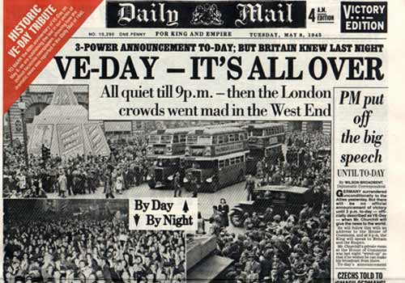
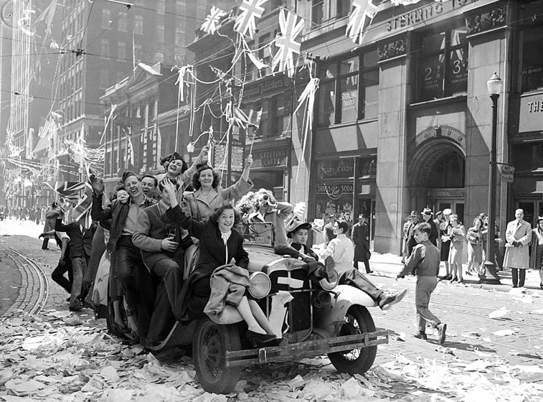
RESULTS – VE DAY!

Slide 4
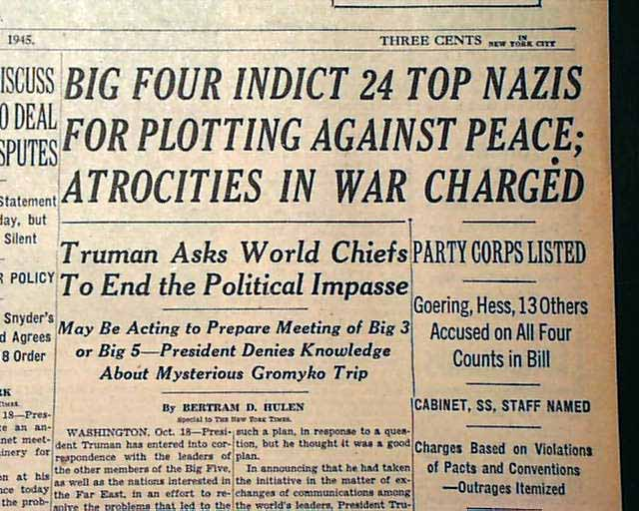
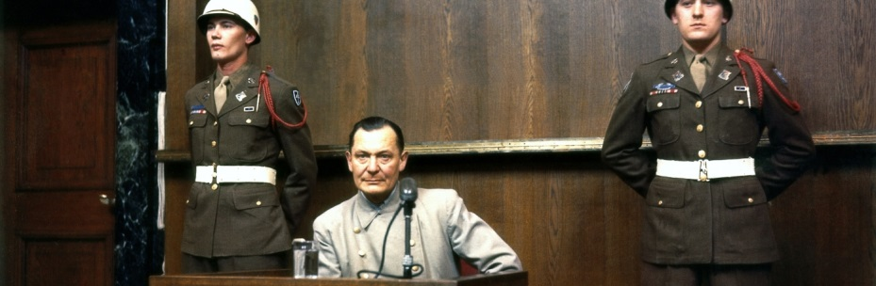
RESULTS – VE DAY!
May 7, 1945 – German surrender
Nuremberg Trials
  22 Nazi Leaders are charged
  “Crimes Against Humanity”
  12 sentenced to death by hanging
  Exposed the world to NAZI atrocities
    Slave labor
    Medical experiments on humans
    Forced starvation
    Genocide

Slide 5
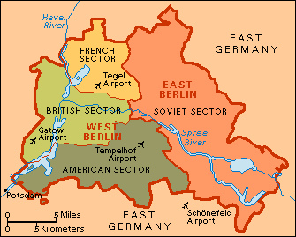
RESULTS – VE DAY!
Germany was occupied & divided into 4 sectors

Slide 6
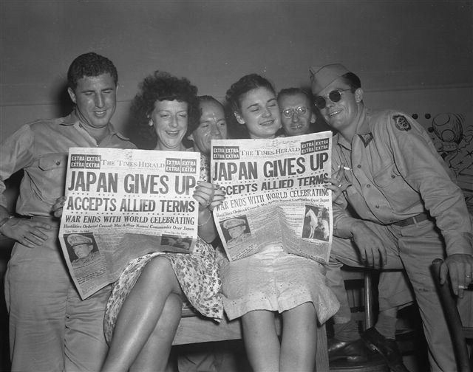
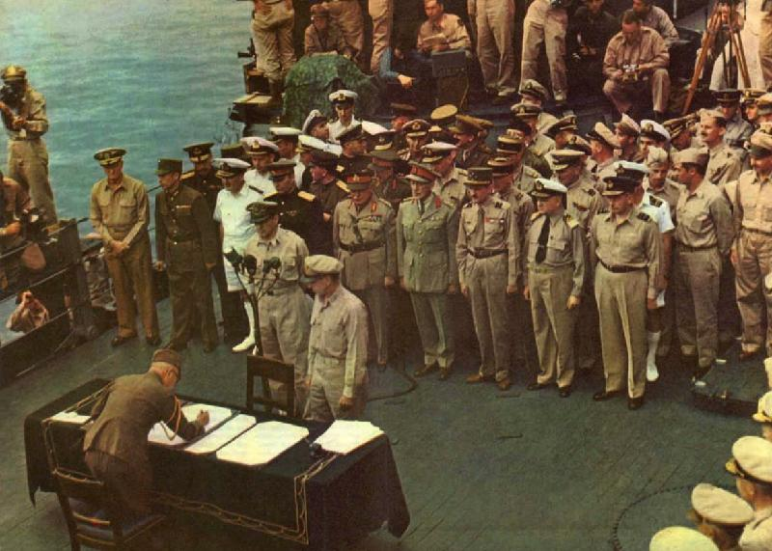
RESULTS – VJ DAY!
September 2, 1945 – Japanese surrender
US Occupation
Demilitarization
  Japan left with only a small police force
  Creation of a new constitution
  Large land-holders were required to sell to small farmers (re-distribution of wealth).

Slide 7
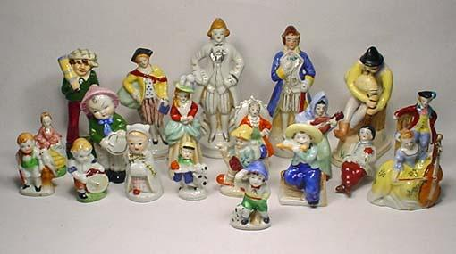
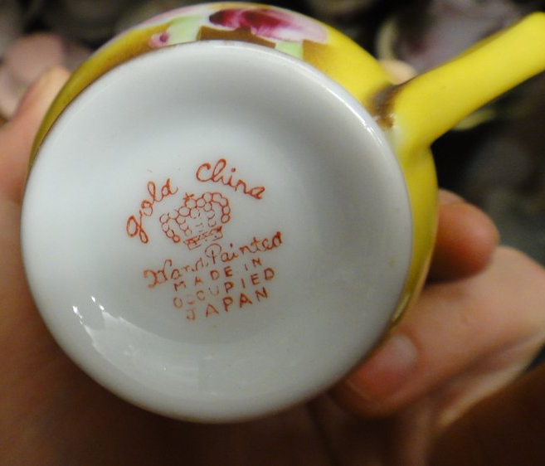
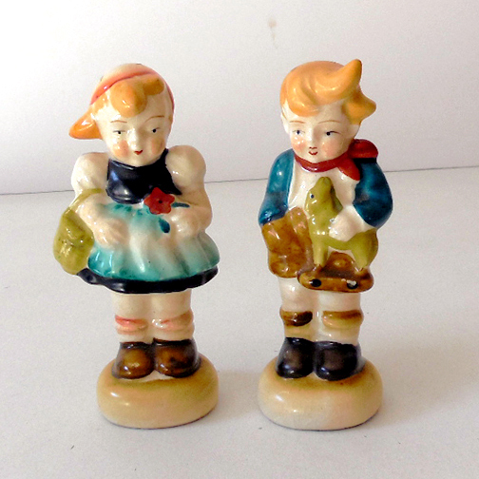
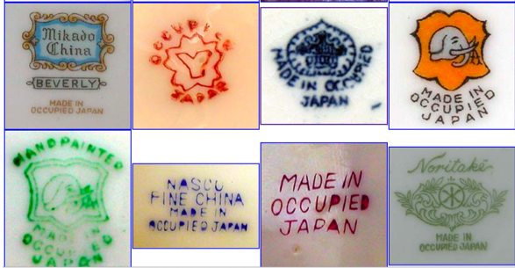

Slide 8
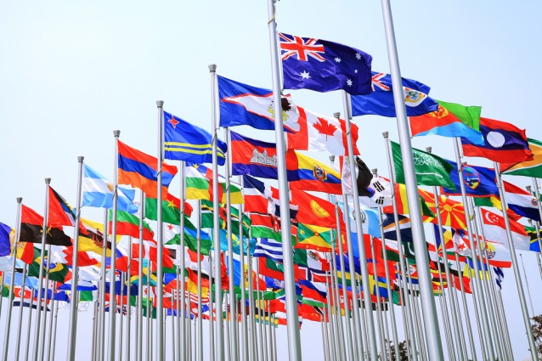

United Nations
June 1945
UN – a replacement for the League of Nations
Created to prevent large-scale war
48 Countries join – Including the USA, USSR, France, China, Great Britain.

Slide 9
The Cold War
Communism (USSR) vs. Democracy (USA)
Competing Ideologies
 | Western Democracies | Soviet Communism
Political System | Citizens elect leaders Citizens have the right to form political parties | USSR – dictatorship controlled by Communist Party The only political party allowed
Individual Rights | Basic civil rights Free speech Freedom of press Freedom of religion | Citizens had few rights Censorship Secret police Religion discouraged
Economic System | Economic freedom People & corporations can own land & businesses Goods & services provided for a profit | No private property Govt. controls economy State-owned collective farms

Slide 10
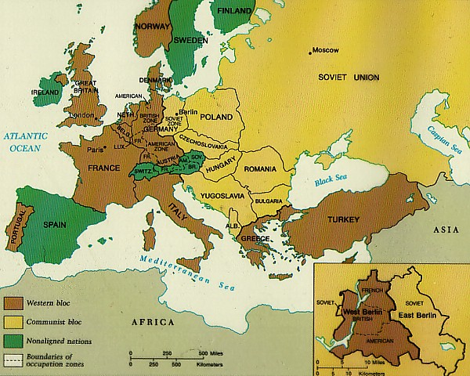

Slide 11

USSR GOALS
Encourage communism in other countries to lead a worldwide proletariat revolution
Rebuild Eastern Europe
Control Eastern Europe (politically and economically) to keep the US from gaining too much power
  Wants a buffer zone as protection against aggression from the west
Keep Germany divided to prevent another war.

Slide 12
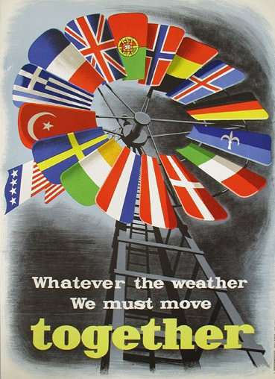
USA GOALS
Marshall Plan
    US gave $$ billions to rebuild economies of Western European nations
    Build trade partnerships for US
    Gain access to raw materials available in eastern markets
Encourage democracy in other countries to prevent the spread of communism
Rebuild Europe
  create stability and new markets
Reunite Germany
  stabilize it and increase the security of Europe.

Slide 13
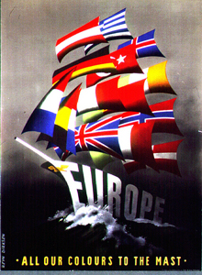
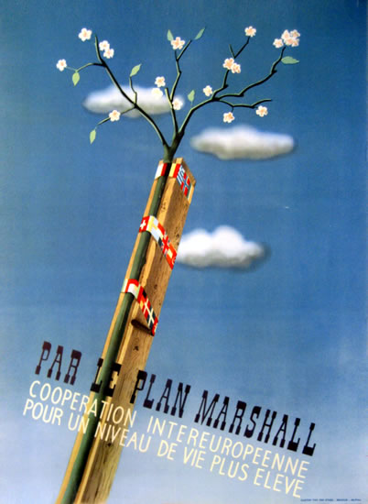
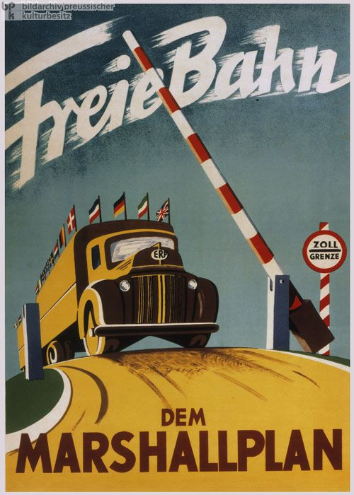

Slide 14
THE IRON CURTAIN
Division between democratic Western Europe, and the communist-controlled East.
Churchill’s Speech
  http://www.youtube.com/watch?v=S2PUIQpAEAQ

Slide 15
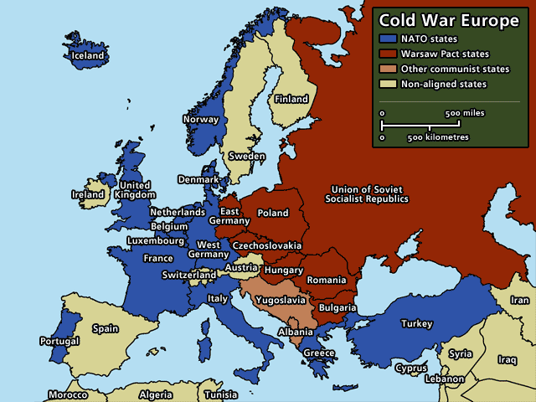

Slide 16
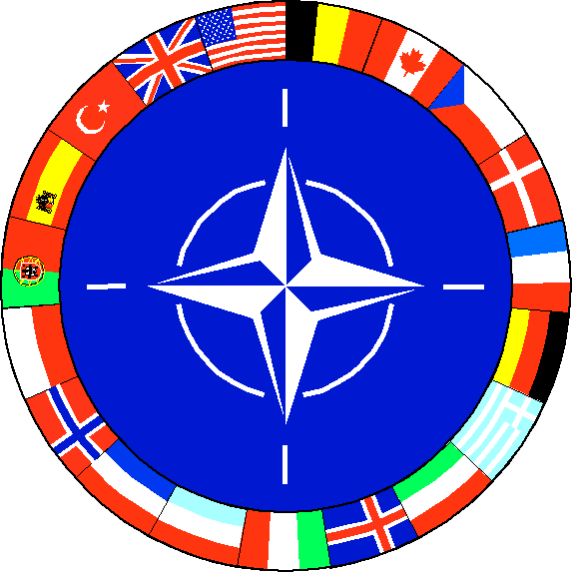
NATO CREATED
NORTH ATLANTIC TREATY ORGANIZATION
Formed in 1949
To ensure freedom for those who sign
Defend Western Europe from the Soviet Union

Slide 17
Who Signed NATO – The Founders
Belgium
Canada
Denmark
France
Iceland
Italy
Luxembourg
Netherlands
United Kingdom
United States
Norway
Portugal

Slide 18
Expansion of NATO During Cold War
Greece – 1952
Turkey – 1952
West Germany – 1955
Spain – 1982

Slide 19
NATO Now Also Includes
Czech Republic – 1999
Hungary – 1999
Poland – 1999
Bulgaria – 2004
Estonia – 2004
Latvia – 2004
Lithuania – 2004
Romania – 2004
Slovakia – 2004
Slovenia – 2004
Albania – 2009
Croatia – 2009

Slide 20
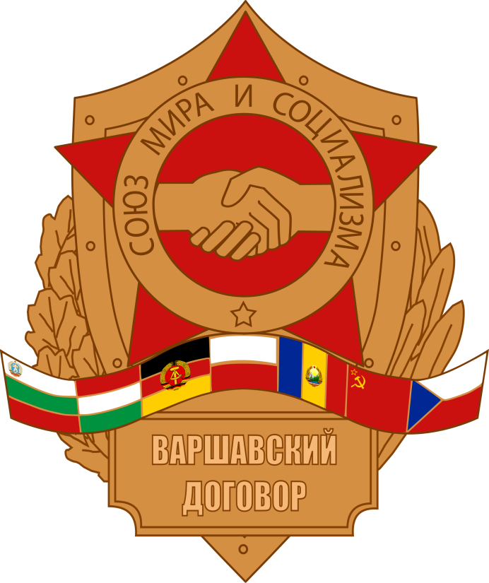
The Warsaw Pact –The communist alliance
Soviet Union
Poland
East Germany
Czechoslovakia
Hungary
Romania
Bulgaria
Albania
Bloc in Eastern Europe along with SU, A Response to NATO
Notes:
WARSAW PACT: THE COMMUNIST ALLIANCE
The formation of the Warsaw Pact was in some ways a response to the creation of NATO, although it did not occur until six years after the Western alliance came into being. It was more directly inspired by the rearming of West Germany and its admission into NATO in 1955. In the aftermath of World War I and World War II, Soviet leaders felt very apprehensive about Germany once again becoming a military power–a concern that was shared by many European nations on both sides of the Cold War divide.

Slide 21
Germany Divided
Germany was occupied & divided into 4 sectors
  Soviet
  British
  French
  American
Berlin in the Soviet sector was also divided among the 4

Slide 22
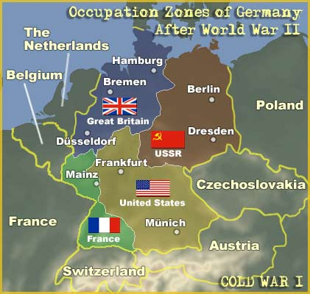
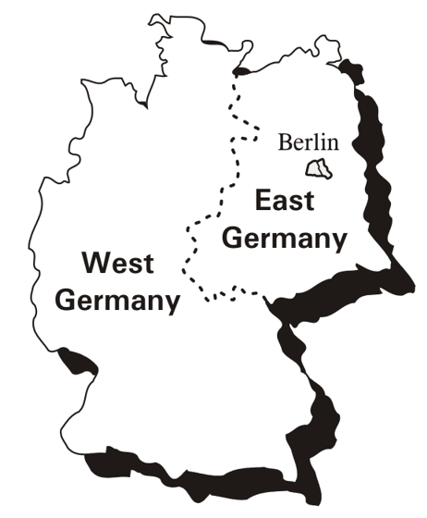
Germany Divided!

Slide 23
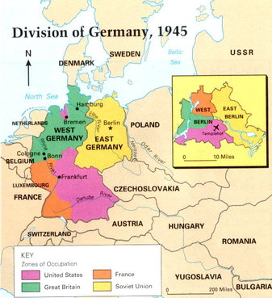

Slide 24
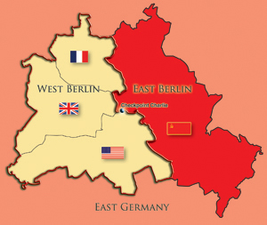
Which country does the pink territory belong to?

Slide 25
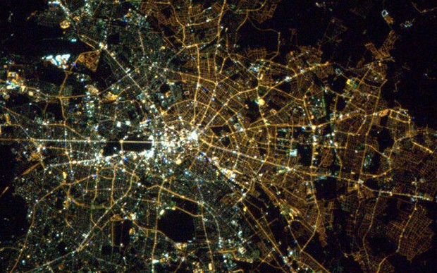
Berlin by satellite - 2013
Notes:
A satellite image has revealed enduring divisions between the east and west of Berlin, with the eastern half of the city much less brightly illuminated at night.

Slide 26
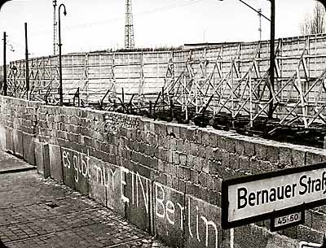
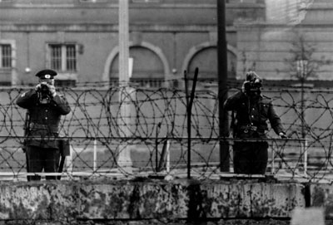
THE BERLIN WALL
Berlin Wall built to separate East and West Germany
Became a universal symbol of the Cold War
Built by East Germany (with Soviet backing) in 1961 to stop East Germans from fleeing to West Berlin

Slide 27
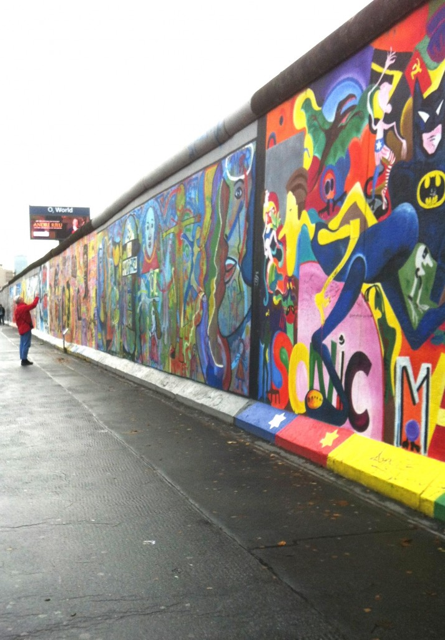
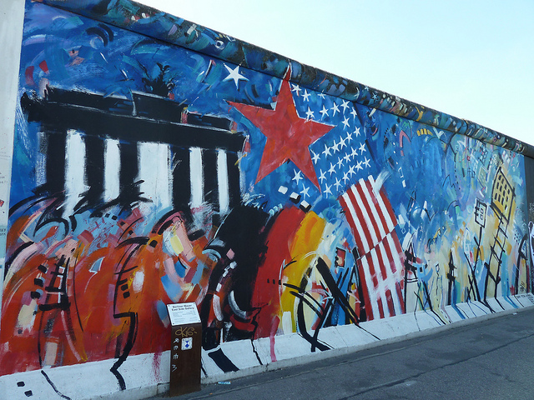

Slide 28
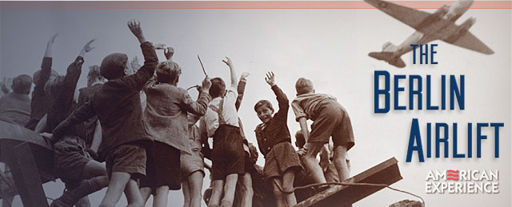
THE BERLIN AIRLIFT
Berlin divided-USA, Britain, France, & USSR
  BUT the city was in the USSR sector of Germany
June 1948
  Western allies merged their zones of occupation
  The Soviets cut land access to Berlin from the west
  Western allies began flying in supplies to West Berlin around the clock for 11 months
  Stalin admitted defeat & lifted the blockade
First major confrontation of the Cold War

Slide 29
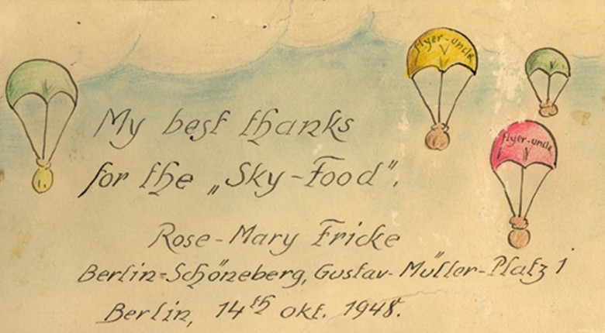
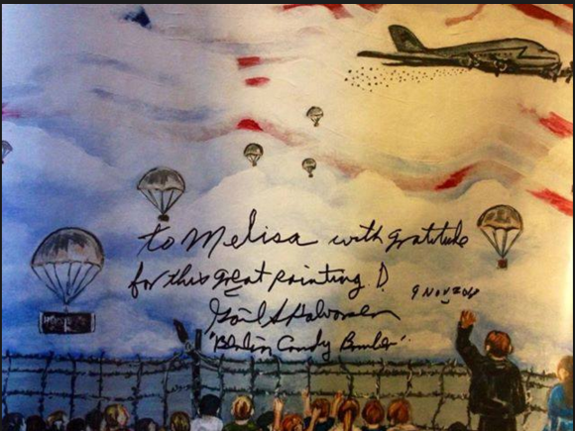
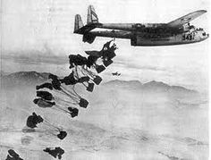
Notes:
Candy Bombers

Slide 30
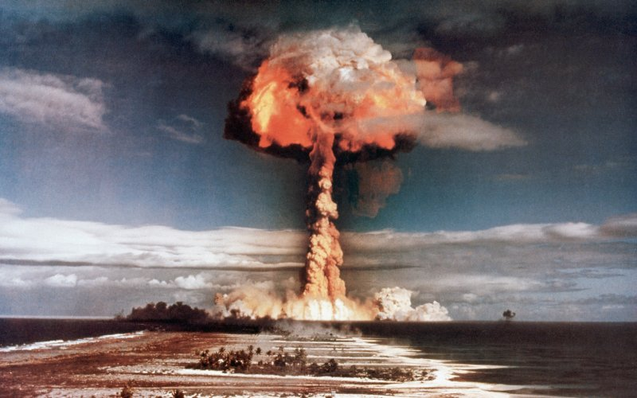
ARMS RACE
USA & USSR make more destructive weapons
  ICBMs (intercontinental ballistic missile)
Notes:
An intercontinental ballistic missile (ICBM) is a guided ballistic missile with a minimum range of 5,500 kilometres (3,400 mi)^{[1]} primarily designed for nuclear weapons delivery

Slide 31
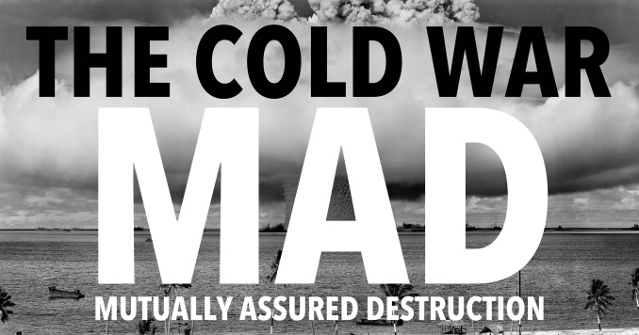
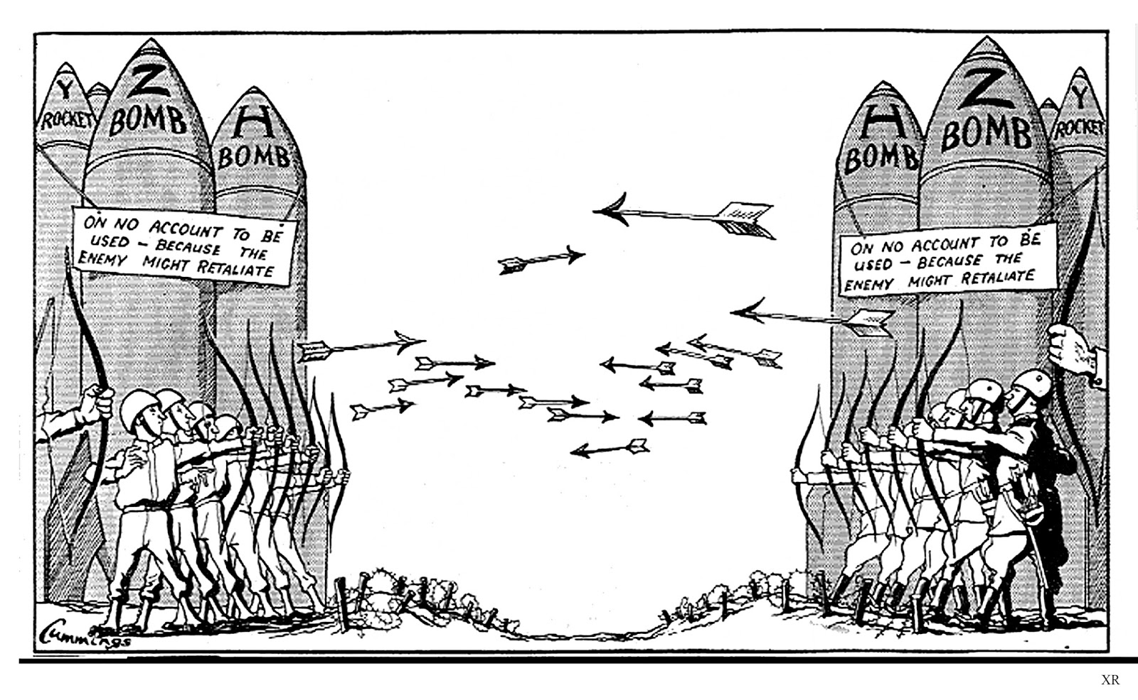
ARMS RACE
  Nuclear proliferation → spread of nuclear weapons (tech/info/materials) to nations not recognized as a weapon state
    Deterrents
    MAD
Notes:
Nuclear proliferation is the spread of nuclear weapons, fissionable material, and weapons-applicable nuclear technology and information to nations not recognized as "Nuclear Weapon States"

Slide 32
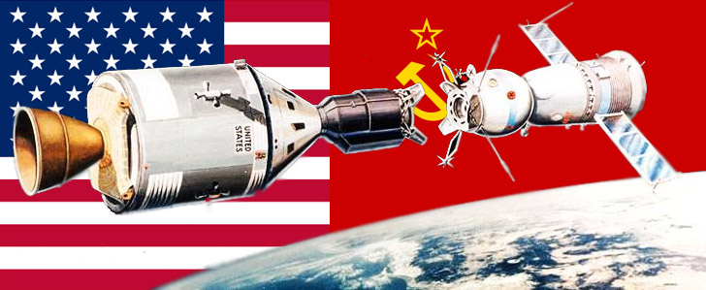
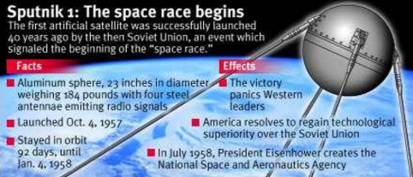
ARMS RACE
Space Race
  Sputnik – USSR
  Apollo moon landing – USA
Nuclear Non-Proliferation Treaty – 1968
  objective is to prevent the spread of nuclear weapons and weapons technology
  Limit nuclear capabilities to China, Russia, US

Slide 33

The Korean & Vietnam Wars
LG 1: Describe the causes and effects of the Cold War and explain how the Korean War & Vietnam War, and the arms race were associated with the Cold War.

Slide 34
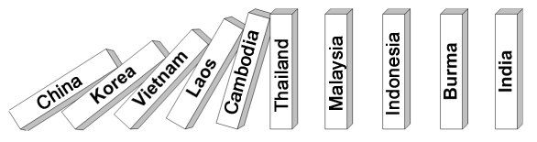
Policy of foreign containment
First made public by President Truman in the Truman Doctrine Speech (March 12, 1947)
United States policy to prevent spread of Communism
  US would not overturn Communism where it existed, but it would try to prevent it from spreading any further
Based on a belief in the Domino Theory of Communism
  if one country became communist other countries around it would also fall under communist control, falling like a row of dominoes.

Slide 35
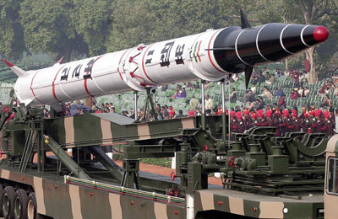
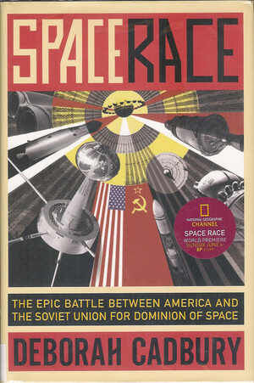
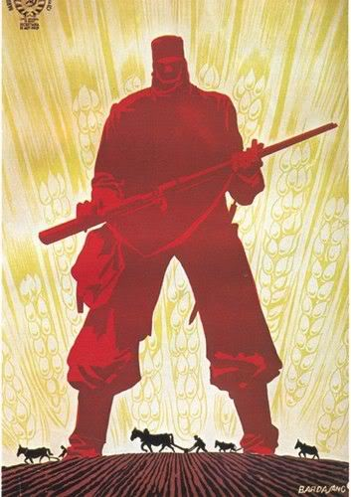
CONTAINMENT
Led to the nuclear arms race
Space Race
Korean War
Vietnam War

Slide 36
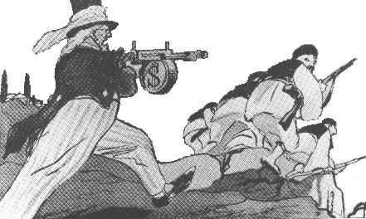
Containment Policy:
This Russian cartoon shows the
Greeks being helped by Uncle Sam.
Notice the $ sign on the gun –
Symbolizing the $400 million in aid
From the Truman Doctrine

Slide 37
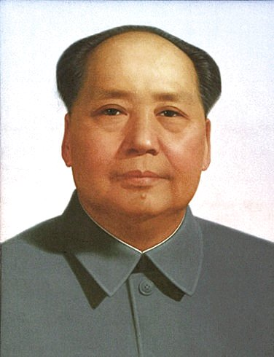
COMMUNISM IN CHINA
End of WWII
  Chinese Communist revolution
Mao Zedong
  Communist leader
Mao gained total control in 1949 – People’s Republic of China
Worked to expand China’s influence (Mongolia, India, Tibet, etc.)
US fears “Domino Theory”

Slide 38
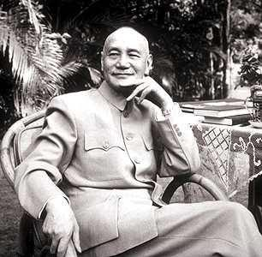
Containment Policy: China
For 20 years there was a civil war in China
The US supported the nationalist government led by Chiang Kai-shek
The American public supported Chiang because of the Nationalists support and determination during WWII against Japan
However, Chiang’s government was inefficient and corrupt. His policies undermined the support for the Nationalist government
The Communist were led by Mao Zedong and gained support by encouraging reading and food production. They had the support of the peasants

Slide 39
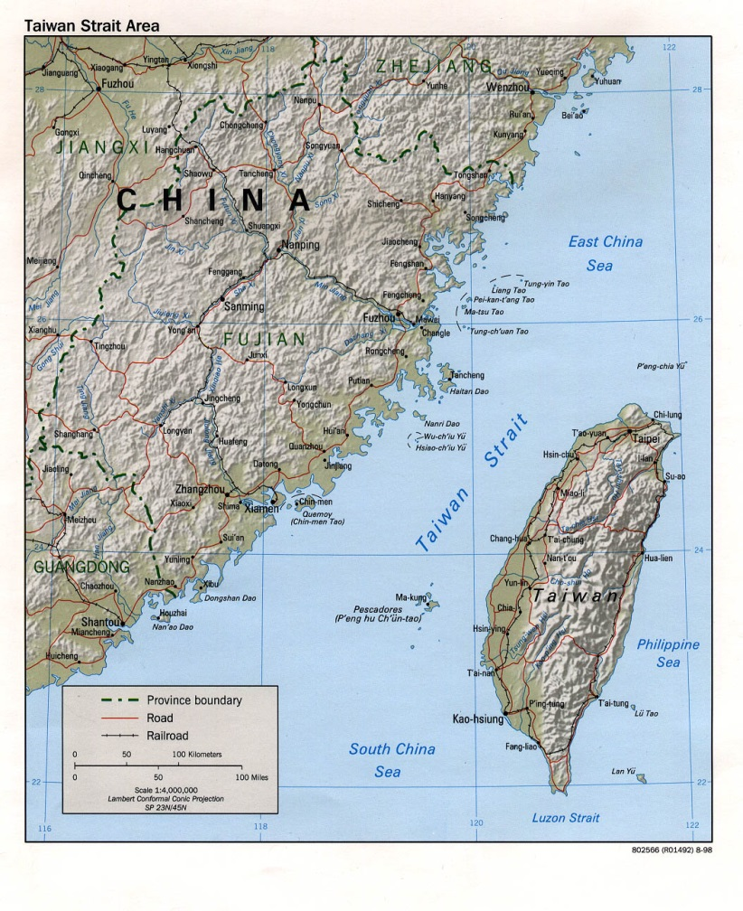
Containment Policy: China
From 1944-1947, the US tried to keep the peace between the Nationalists and Communist.
At the same time they sent $2 billion in aid to the Nationalists
The aid was not enough and in 1949, Chiang and the Nationalist and his supporters fled to the island of Taiwan
The US did not recognize the communist government of the People’s Republic of China
The American public was upset and conservatives blamed the Truman administration and the Democrats for not giving enough aid
The Democrats blamed the internal government.

Slide 40
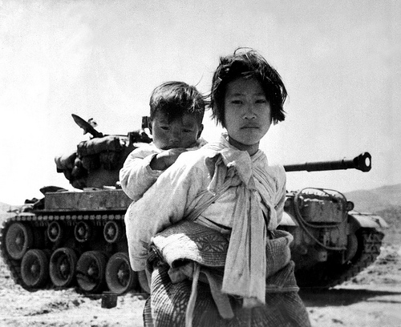
KOREAN WAR
1950 - 1953
Korea was split (like Germany) between Communist North and Democratic South
  Split along 38th Parallel
After WWII, Soviets supplied North Korea with military aid/supplies hoping to take control of South Korea as well
USA (helped the south) involved to prevent spread of communism
  Containment!
Cease fire signed 1953
  Boundaries still on 38th parallel = NO CHANGE FROM THE WAR
Korean War Synopsis

Slide 41
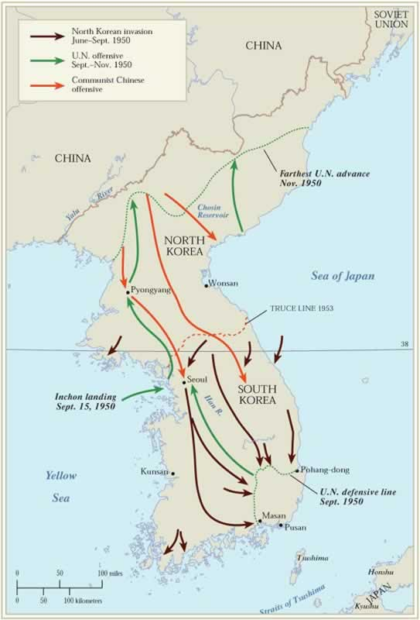
Containment Policy: Korean War
The Korean War (1950-1953) resulted from border clashes between Northern Korea (supported by USSR) and Southern Korea (supported by the US) after it was divided at the end of WW II
It was never a declared war, instead called a “Police Action”
United Nations forces (90% of them US and controlled by US General Macarthur)fought North Korean troops and later Chinese troops (supported by the USSR)
When the war was over the country was divided (and still is) at the 38th parallel

Slide 42
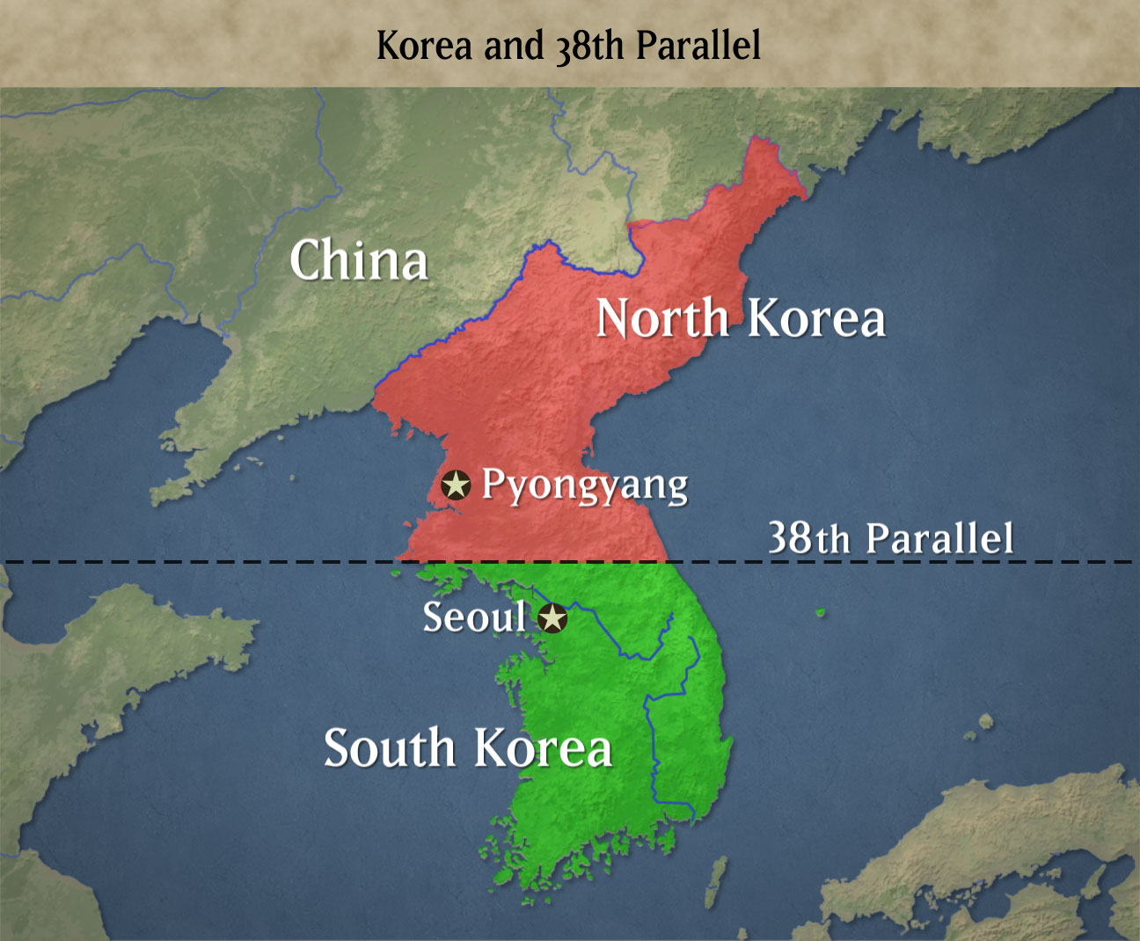
Containment Policy: Korean War
After WWII, Korea was divided at the 38th parallel establishing two countries: North Korea (communist) and South Korea (Democracy)
Soon after WWII the US cut its forces in Korea and by June of 1949 there were only around 500 troops in South Korea
The USSR concluded that the US would not defend the South

Slide 43
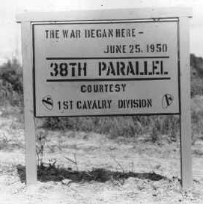
Containment Policy: Korean War
On June 25, 1949 the North Korean troops came across the 38th parallel and within a few days they were deep into the South
South Korea went to the UN Security Council to ask for help. The USSR was boycotting the UN, so the vote was passed
On June 27th Truman sent troops from Japan to help
In all, 16 nations and 520,000 troops were sent to Korea. 90% were American

Slide 44
Containment Policy: Korean War
At first the North Koreans seemed unstoppable, but the UN troops led by Gen. Douglas MacArthur were able to push the North Koreans back to the 38th parallel
Soon the US troops were close to the Chinese border and it appeared that Korea would be united again.
However, the Chinese wanted North Korea as a buffer state and sent 300,000 troops to fight the Americans
The Chinese outnumbered the Americans 10 to 1 and pushed the Americans southward and captured the capital Seoul
Troops serving in theater
Service | Number | % of Total | Hostile Deaths | % of Total
ARMY | 1,153,000 | 64% | 27,731 | 82%
NAVY | 265,000 | 15% | 506 | 1%
AIR FORCE | 241,000 | 14% | 1,238 | 4%
MARINES | 130,000 | 7% | 4,266 | 13%
Totals | 1,789,000 | - | 33,741 | -

Slide 45


Containment Policy: Korean War
For two years the sides fought to gain a strategic location of the hills of Korea
Neither side was successful and MacArthur called for an invasion of China
Truman said no because China and the USSR had an agreement.
Fighting with China meant a war with the USSR
Instead of fighting with China, the US was able to push the North Korean and Chinese troops northward back to the 38th parallel
By July 1953, an armistice was signed by both sides

Slide 46


Slide 47


VIETNAM WAR
1954 - 1975
Ho Chi Minh led the Vietminh (communist party) -> North
Democratic South (supported by the US)
USA involved to prevent spread of communism
  Containment!
Pulled US troops out of war because of how unpopular the movement was at home.
Vietnam War Synopsis

Slide 48
Effects of Cold War (new military technology)
Continued development of nuclear weapons resulted in arms race during the Cold War
The ability to drop nuclear bombs from planes, launched from submarines and the development of intercontinental ballistic missiles were features of the arms race
Nations worked to develop defensive technologies and the space race developed out of this pursuit

Slide 49



Soviet Cold War Propaganda

Slide 50


American Cold War propaganda
Notes:
the superhero was able to contain anything that threatened the American way of life, while also being free of restrictions. Bank robbers could be viewed as “the capitalist fear of communist system’s redistributing the wealth.” In the age of intercontinental missiles with only minutes between launch and death, who better to save the world than the strength of Superman or the speed of the Flash?
Even if you don’t agree with the metaphors, the Cold War did lead to the revival of superheroes in the comic books. The Comics Code pushed publishers to the more wholesome tales of bravery, strength, and speed. Superheroes of the era battled supervillains and the Soviet threat.

Slide 51


Slide 52



Futurism
2
A major new exhibition at London's V&A Museum illustrates how the Cold War influenced world culture and design on both sides of the Iron Curtain.
1
3
Notes:
1-Space Age Fashion
Futurism begins to influence fashion in a big way. This space hat is from 1965
2-Plastic Fantastic
The plastic chair was a regular focus of post war design with Charles and Ray Eames becoming the first to experiment with fibregass. \
3- Radical Chic
Political consciousness in art raises the theme of Third World revolution as 'freedom fighters' peer into a chic American interior.

Slide 53




1
2
3
4
Notes:
1-Democratic Design
In post war Europe, micro cars flourished as an affordable and quickly manufactured vehicle for factory workers and farmers. The Messerschmitt Kabinenroller of 1955
2 Pneumatic Architecture
Increasing anxiety over the effects modern technology was having on the environment led to all sorts of futuristic concepts such as this installation named 'Oasis No.7'. The bubble protected the occupants as well as nature.
3Spaceship Earth
A poster produced by Olivetti featuring Richard Buckminster Fuller's Dome Over Manhattan scheme of the early 60s. His 1963 book asked readers to imagine the planet from space.

Slide 54


Music → Leningrad Symphony

Slide 55

Literature→ spy novels
James Bond: The Spy Who Loved Me
James Bond: From Russia With Love
The Spy Who Came in from the Cold

