Slide 1
End of the Cold War
Mikhail Gorbachev:
Became Premier of the Soviet Union in 1985
USSR was falling behind Western democracies so he embarked on economic and diplomatic reforms
Agricultural production
Industrial production
Perestroika – reorganization of Soviet system: more economic freedom, more voice in government
Glasnost – increased freedom of speech, freedom of the press
These were supposed to make the USSR more efficient and less corrupt, but they led to public discontent and nationalistic uprisings among Soviet satellite states

Slide 2
Gorbachev:
Increased negotiation with the USA & NATO.
Worked with Reagan to end the arms race and limit nuclear weapons.

Slide 3
Ronald Reagan:
Republican President of the US (40th POTUS)
Committed to putting an end to Communism
Used US forces to prevent spread of Communism worldwide
Nicaragua
Grenada
Afghanistan

Slide 4
“Mr. Gorbachev, tear down this wall!”
Reagan:
Brandenburg Gate Speech: 1987
Challenge to USSR to
destroy the Berlin Wall.

Slide 5
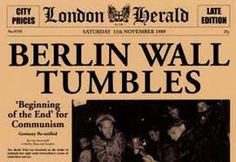
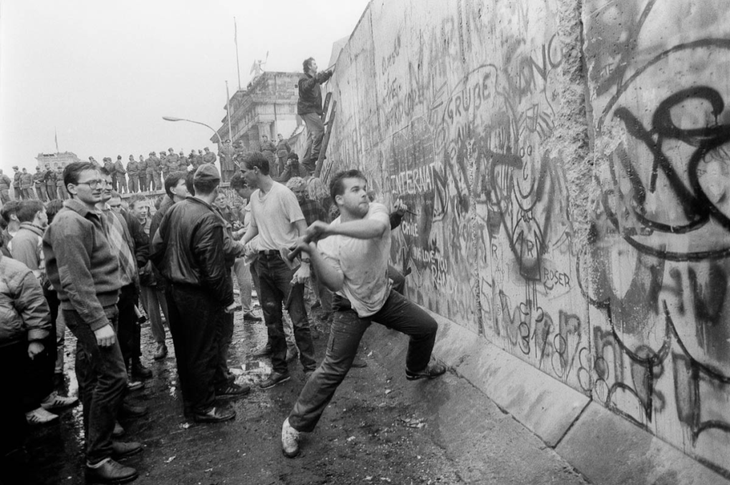
Fall of the Berlin Wall November 9, 1989
Seen as the symbolic end of the Cold War

Slide 6
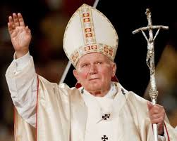
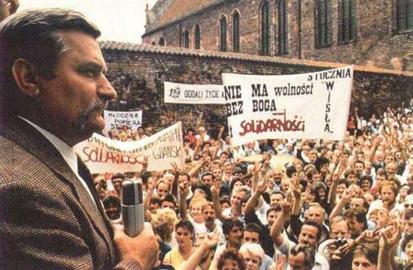
Lech Walesa
Polish Worker
Organized the Solidarity movement, and fought for worker’s rights
Helped move Poland away from Communism
Became President of Poland after fall of Soviet Union until 1995
Pope John Paul II
Head of the Roman Catholic Church
1st non-Italian Pope in 500 years.
Born in Poland
Helped inspire Polish nationalism, and independence from Soviet Control

Slide 7
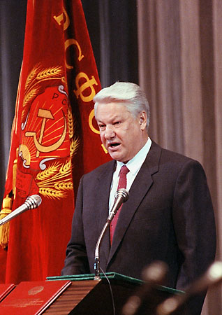
Fall of Soviet Union
Boris Yeltsin:
Came into power after Communism collapses
1st Democratically elected President of the Russian Federation

Slide 8
Effects of Cold War
World Conflict:
- Korean War
- Vietnam War
- Iran-Contra (Nicaragua)
- Afghanistan
Divided world into two camps, West vs. East or Democracy vs. Communism
The West supported very undemocratic governments because they weren’t communists.

Slide 9
Effects of Cold War
Arms Race-
- Largest “peacetime” military buildup in history, countries main goal was to have more weapons than their enemy
- Mutually Assured Destruction (MAD)
- Increase in number and destructive capabilities of nuclear weapons
- Led to more countries becoming a nuclear power

Slide 10
Effects of Cold War
New Technologies -
Nuclear launch technologies: from planes, submarines, intercontinental launches
Improved jet fighters, tanks, submarines
Space Race: emphasis on Math & Science education, satellites, spacecraft, Space exploration, and velcro

