Slide 1
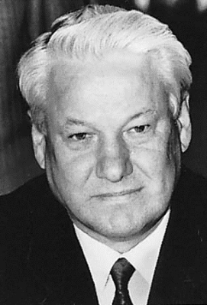
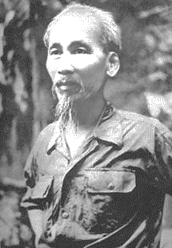
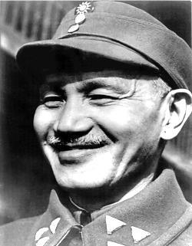
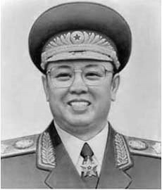
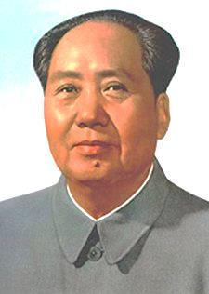
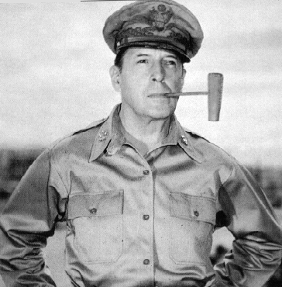
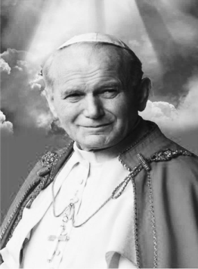
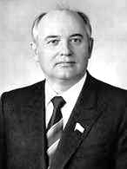
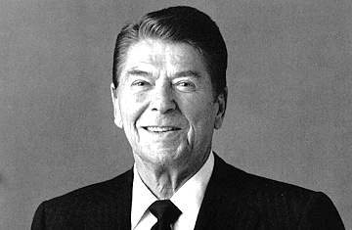
Unit 10 People Review

Slide 2
Mao Zedong
Who
Principal Chinese Marxist theorist, soldier, and statesman.
Significance
Led China’s communist revolution.
Leader of the Chinese Communist Party (CCP) from 1935 until his death, and the chairman (chief of state) of the People’s Republic of China from 1949 to 1959.

Slide 3
Chiang Kai-shek
Who:
Chinese military and political leader of the Chinese Nationalist Party
Significance:
Expelled Chinese communists from the party
Led a successful unification of China until the end of the Chinese civil war in 1946.

Slide 4
Ronald Reagan
Who:
U.S. president from 1981 to 1989
Significance:
Known as the “Great Communicator.”
He cut taxes, increased defense spending, negotiated a nuclear arms reduction agreement with the Soviets and is credited with helping to bring a quicker end to the Cold War.

Slide 5
Mikhail Gorbachev
Who:
Appointed General Secretary of the Communist Party in 1985, became the President of the Soviet Union in 1990
Significance:
Attempted to create reforms for the people, and better relationships between Russia and the West.
Met multiple times with President Reagan, and helped bring an end to the Cold War.

Slide 6
Pope John Paul II
Who:
Pope from 1978 until his death in 2005
Significance:
First non-Italian pope in 400 years.
He was a vocal advocate for human rights and used his influence to effect political change, and is credited with the fall of communism in his native Poland.

Slide 7
Gen. Douglas MacArthur
Who:
American general who commanded the Southwest Pacific in World War II (1939-1945) and led United Nations forces in the Korean War (1950-1953)
Significance:
During World War II, he famously returned to liberate the Philippines in 1944 after it had fallen to the Japanese.
Oversaw the successful Allied occupation of postwar Japan

Slide 8
Kim Il Sung
Who:
Premier and President of North Korea from 1972 until his death in 1994
Significance:
Aimed to foster the concept of economic self-reliance, met with former U.S. president Jimmy Carter in 1994 to talk about the possibility of aid from the West in exchange for a halt in the country's weapons program.
Kim had also made plans for a historical meeting with South Korean leader, but Kim died before the summit could take place.

Slide 9
Ho Chi Minh
Who:
Founded and became President of North Vietnam at the end of WWII
Significance:
A symbol of Vietnam’s struggle for unification during a long and costly conflict with the strongly anti-Communist regime in South Vietnam and its powerful ally, the United States.
Eventually defeated the U.S. and created and Communist Vietnam.

Slide 10
Boris Yeltsin
Who:
Served as the president of Russia from 1991 until 1999
Significance:
Though a Communist Party member for much of his life, he eventually came to believe in both democratic and free market reforms
Played an instrumental role in the collapse of the Soviet Union.

