Slide 1
Unit 11 Vocabulary

Slide 2
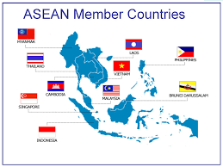
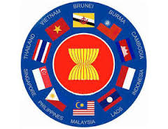
ASEAN
The Association of Southeast Asian Nations (ASEAN) is an organization of countries in southeast Asia set up to promote cultural, economic and political development in the region. ASEAN was officially formed in 1967 with the signing of the Bangkok Declaration.

Slide 3
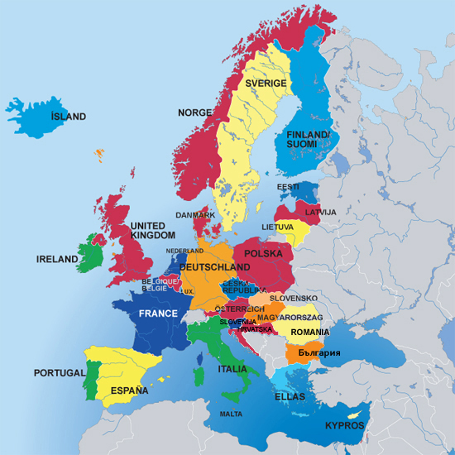
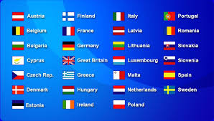
EU
An association of European nations formed in 1993 for the purpose of achieving political and economic integration.

Slide 4
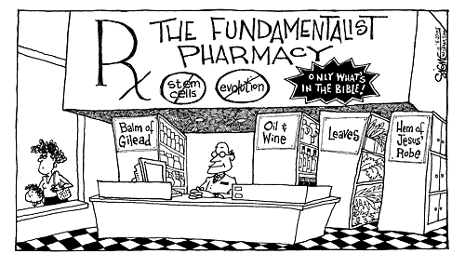
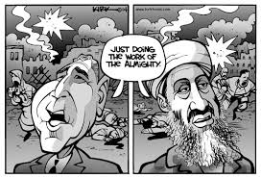
Fundamentalism
A religious movement characterized by a strict belief in the literal interpretation of religious texts, especially within American Protestantism and Islam.

Slide 5
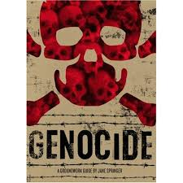
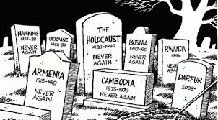
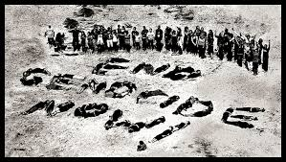
Genocide
The deliberate killing of a large group of people, especially those of a particular ethnic group or nation.

Slide 6
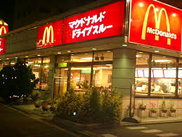
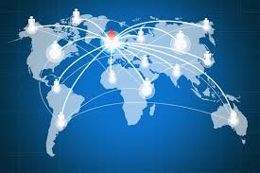
Globalization
The process of international integration arising from the interchange of world views, products, ideas and other aspects of culture.

Slide 7
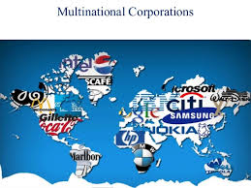
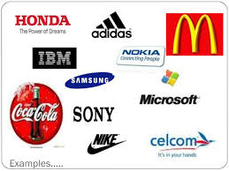
Multinational Corporation
A corporation that has its facilities and other assets in at least one country other than its home country. Such companies have offices and/or factories in different countries and usually have a centralized head office where they co-ordinate global management.

Slide 8
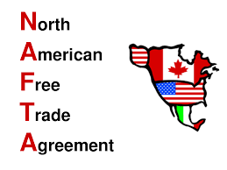
NAFTA
In 1994, the North American Free Trade Agreement (NAFTA) came into effect, creating one of the world's largest free trade zones and laying the foundations for strong economic growth and rising prosperity for Canada, the United States, and Mexico.

Slide 9
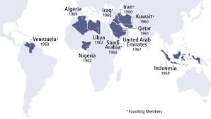
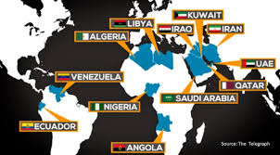
OPEC
A cartel that aims to manage the supply of oil in an effort to set the price of oil on the world market, in order to avoid fluctuations that might affect the economies of both producing and purchasing countries.

Slide 10
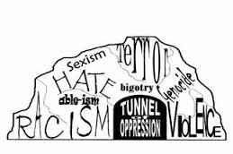
Oppression
The exercise of authority or power in a burdensome, cruel, or unjust manner.

Slide 11
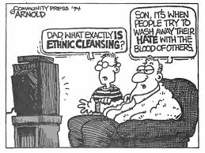
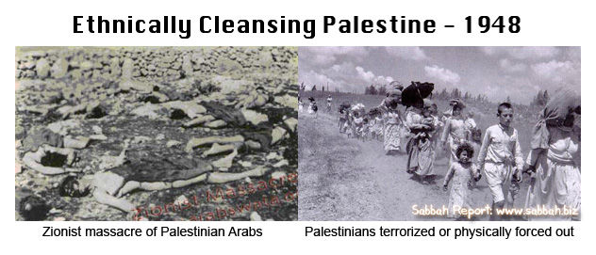
Ethnic Cleansing
The mass expulsion or killing of members of an unwanted ethnic or religious group in a society.

Slide 12
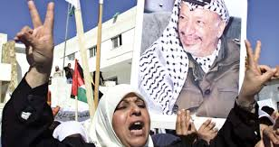
PLO
Palestine Liberation Organization, a political and military organization formed in 1964 to unite various Palestinian Arab groups and ultimately to bring about an independent state of Palestine.

Slide 13
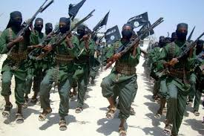
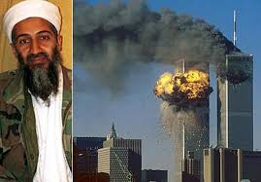
Terrorism
The use of violence and intimidation in the pursuit of political aims.

Slide 14
Taliban
An Islamic militant group operating in Afghanistan and western Pakistan. In the late 1990s it made a government, the Islamic Emirate of Afghanistan.

Slide 15
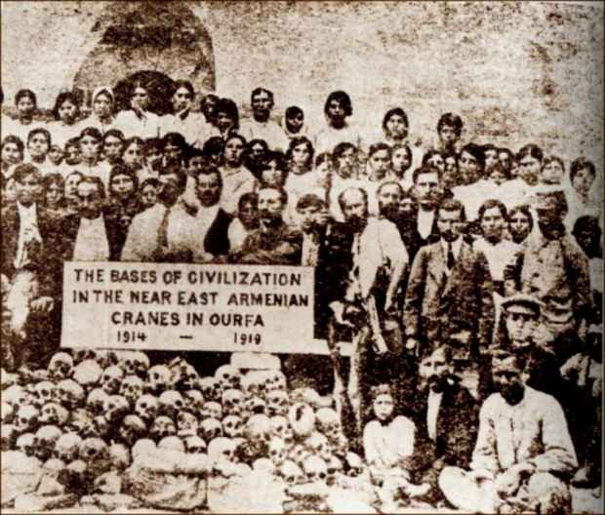
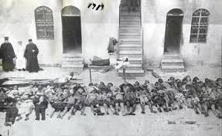
Armenian Massacre
The killing of large numbers of Armenians who lived within the Ottoman Empire and its successor Turkish state in the late nineteenth and early twentieth centuries.

Slide 16
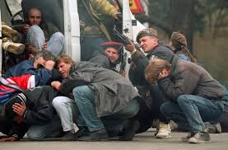
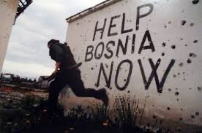
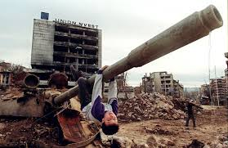
Bosnian War
A war in Bosnia-Herzegovina, where the three different groups of people living in this area - Serbs, Croats, and Bosnian Muslims - fought each other to gain land.

Slide 17
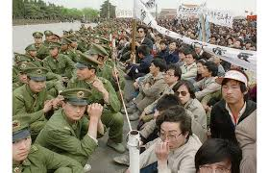
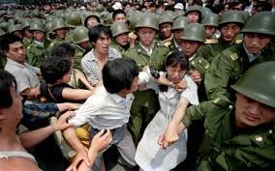
Tiananmen Square
A large plaza in central Beijing, China: noted especially as the site of major student demonstrations in 1989 suppressed by the government.

Slide 18
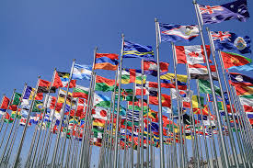
WTO
The only global international organization dealing with the rules of trade between nations. At its heart are the WTO agreements, negotiated and signed by the bulk of the world's trading nations and ratified in their parliaments.

Slide 19
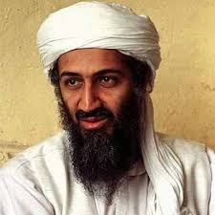
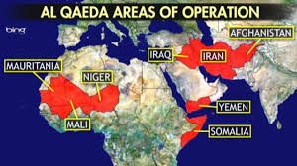
Al Qaeda
A radical Islamic group organized by Osama bin Laden in the 1990s to engage in terrorist activities. A group of militant Muslim fundamentalists founded by bin Laden is an example of Al-Qaeda.

Slide 20
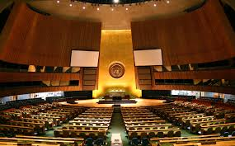
UN
An international organization, with headquarters in New York City, formed to promote international peace, security, and cooperation under the terms of the charter signed by 51 founding countries in San Francisco in 1945.

