Slide 1
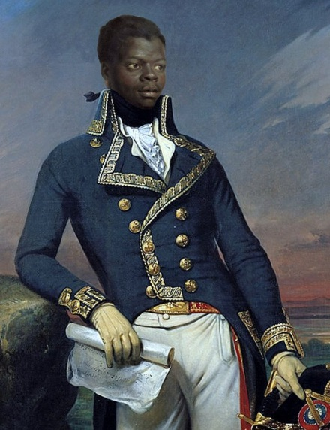
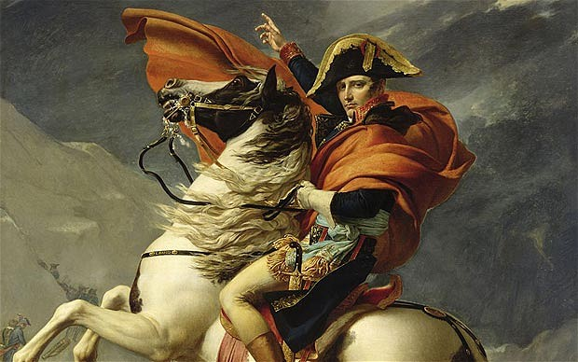
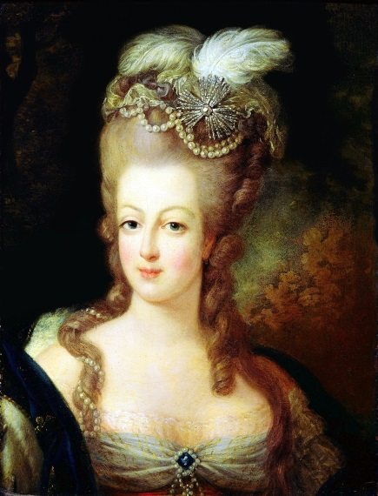
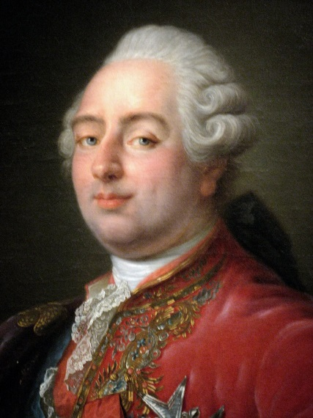
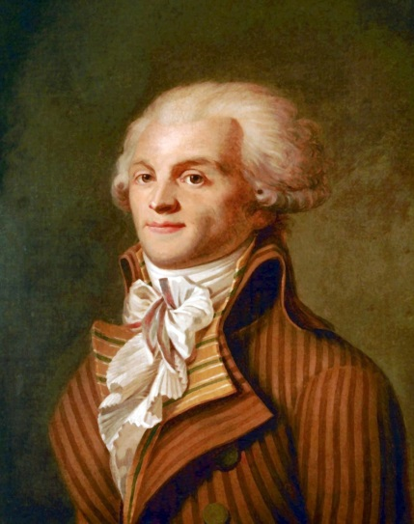
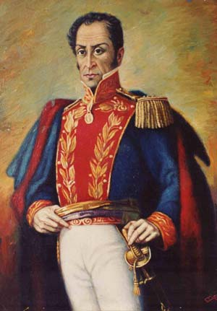
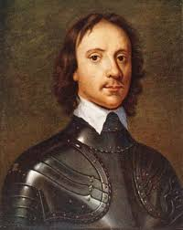
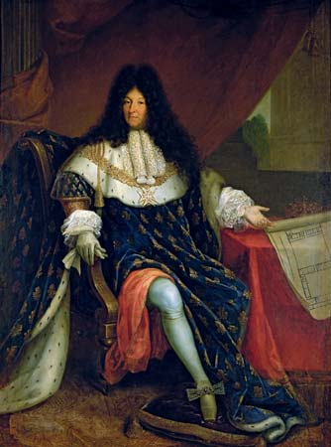
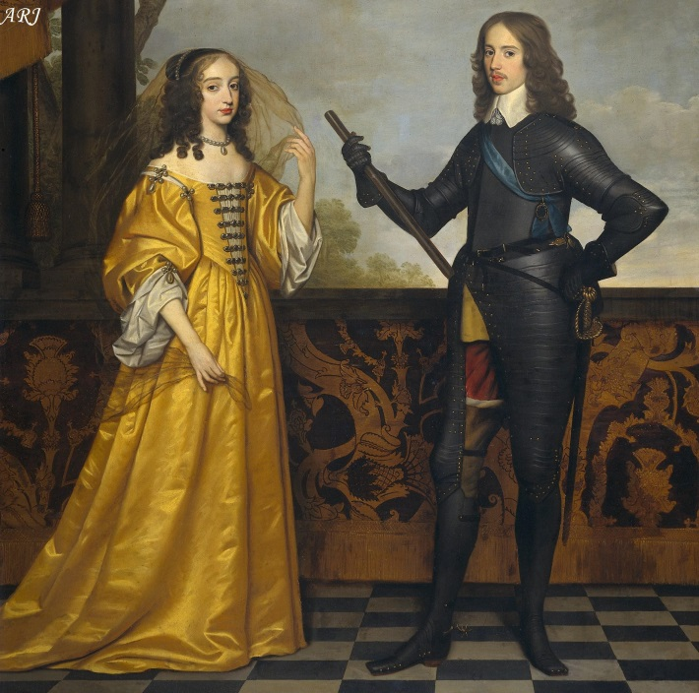
Unit 7 People Review

Slide 2
Oliver Cromwell
Who
English Puritan military leader
Contributions/Discoveries
He led the Parliamentary army, the Roundheads, during the English Civil War
Significance
Successful in the English Civil War
Overthrew and beheaded King Charles I
Became “Lord Protector”
Imposed his Puritan Christian values on England

Slide 3
William and Mary
Who:
King & Queen of England
Contributions/Discoveries:
Became King and Queen after the Glorious Revolution
Signed the English Bill of Rights
Significance:
By signing the English Bill of Rights they oversaw England’s transformation from an absolute monarchy to a constitutional monarchy.

Slide 4
Louis XIV
Who
French King
Contributions/Discoveries:
He exemplified absolutist rule with the phrase “L’état, c’est moi” (I am the state)
Built the extravagant palace of Versailles.
Significance:
Absolutist rule and the building of Versailles set the stage for later generations to revolt in the French Revolution.

Slide 5
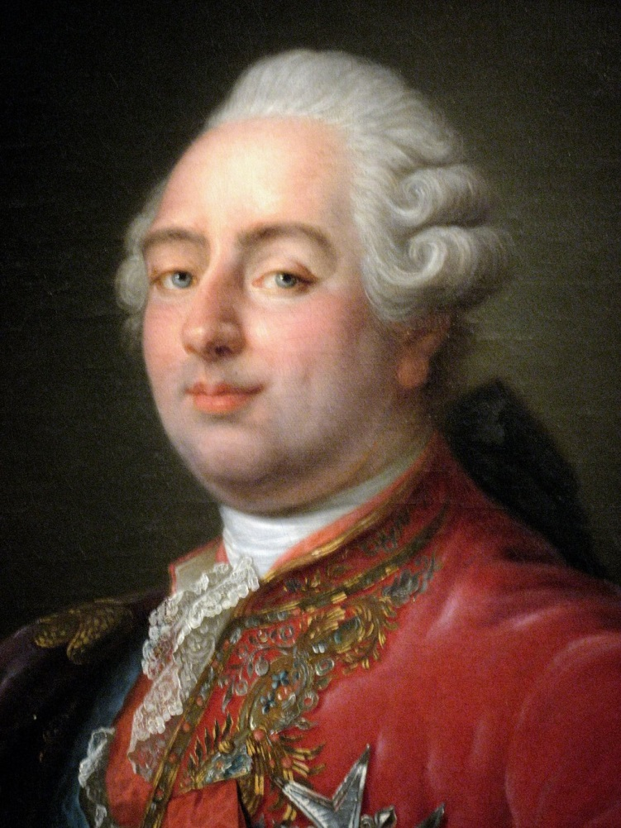
Louis XVI
Who
French King
Contributions/Discoveries
Raised taxes on the poor masses to pay for France’s rising debt as well as his lavish lifestyle.
Significance
The rising debt resulted in miserable conditions for the French people
Contributed to the French Revolution and his eventual beheading by the guillotine

Slide 6
Marie Anoinette
Who
Queen of France
Contributions/Discoveries
Her lavish lifestyle and lack of concern for the commoners made her unpopular with the people of France.
Significance
The extravagant lifestyle of herself & Louis XVI and their lack of concern for the French people contributed to the French Revolution.
She was beheaded by the guillotine.

Slide 7
Maximillian Robespierre
Who
Jacobin Leader in France
Contributions/Discoveries
He was known for the “reign of terror” and tried to rid France of “enemies of the revolution”, any one against his ideas was killed.
Significance
Actions led to later political reforms and a limited constitutional monarchy.
The National Convention turned against him and had him killed in the guillotine

Slide 8
Napoleon
Who
Emperor of France
Contributions/Discoveries
Napoleonic Code (laws)
Grew his (France) empire
Significance
He created an empire that covered most of Europe
Reformed many countries/areas he controlled

Slide 9
Simon Bolivar
Who
General in Venezuela
Contributions/Discoveries
He led Venezuela to Independence
Significance
He started the revolutionary movement in Latin America, and won freedom from Spain.

Slide 10
Toussaint Louventure
Who
Leader in the civil war vs. France
Contributions/Discoveries
Helped lead the fight for independence of St. Dominque people against France
Significance
His actions led to Haitian independence

