Slide 1
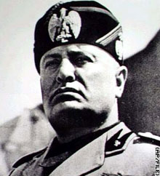
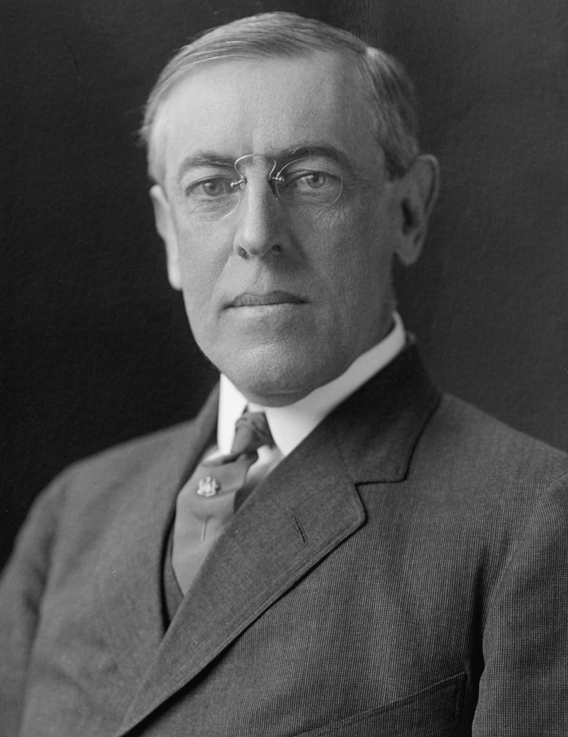
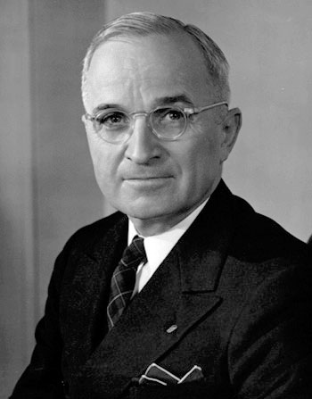
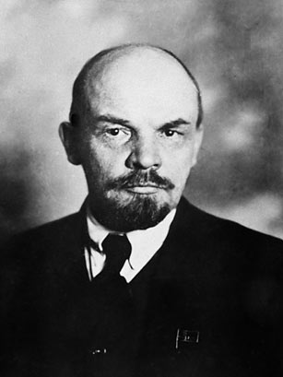
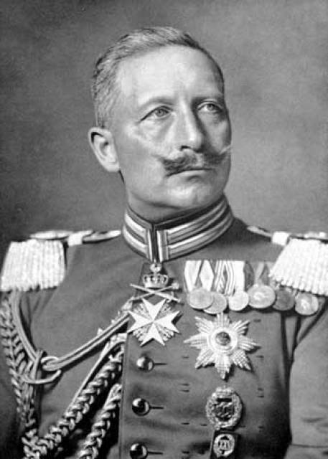
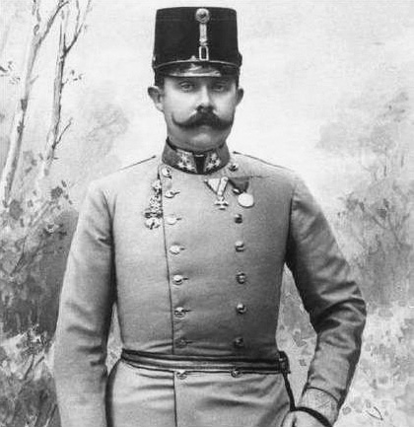
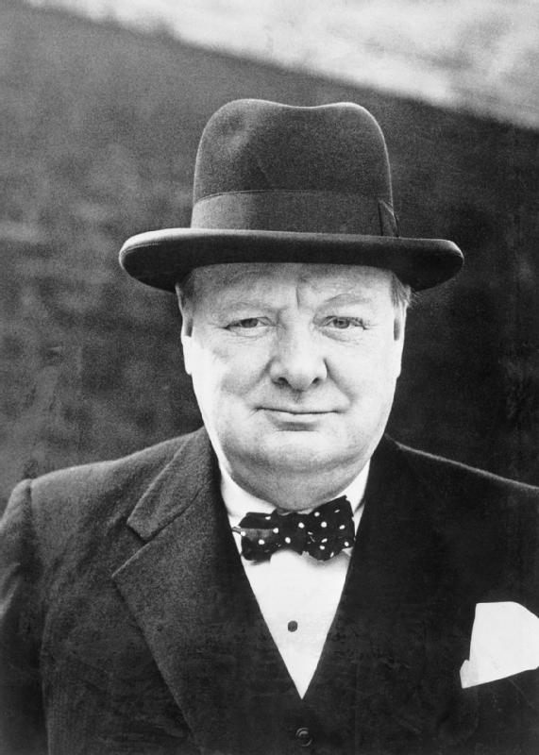
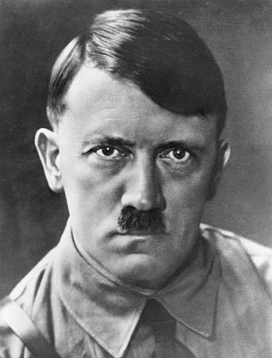
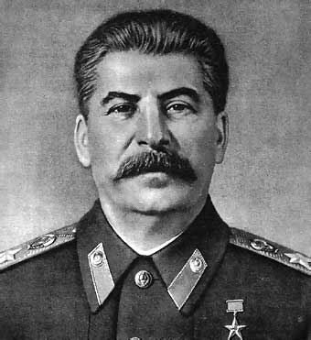
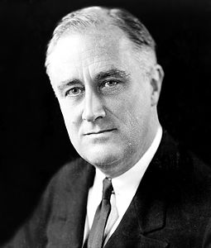
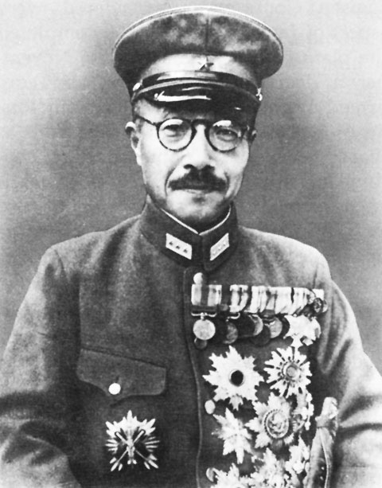
Unit 9 People

Slide 2
Kaiser Wilhelm II
Who:
The German kaiser (emperor) and king of Prussia from 1888 to 1918.
Significance:
Signed the order for German mobilization for war following pressure from his generals
He was largely a shadow monarch during the war, useful to his generals as a public-relations figure who toured the front lines and handed out medals.

Slide 3
Archduke Franz Ferdinand
Who:
Archduke of Austria-Este, Austro-Hungarian Empire and Royal Prince of Hungary and Bohemia
Significance:
His assassination in Sarajevo brought about Austria-Hungary's declaration of war against Serbia.
This caused the Central Powers (including Germany and Austria-Hungary) and Serbia's allies to declare war on each other, starting World War I.

Slide 4
Woodrow Wilson
Who:
U.S. president, served in office from 1913 to 1921 and led America through World War I
Significance:
Tried to keep the United States neutral during World War I but ultimately called on Congress to declare war on Germany in 1917.
After the war, he helped negotiate a peace treaty that included a plan for the League of Nations. Although the Senate rejected U.S. membership in the League, Wilson received the Nobel Prize for his peacemaking efforts.

Slide 5
Vladimir Lenin
Who:
Founder of the Russian Communist Party (Bolsheviks)
Significance:
His ideas inspired the Communist Revolution in Russia
The architect, builder, and first head (1917–24) of the Soviet state.

Slide 6
Joseph Stalin
Who:
The dictator of the Soviet Union from 1929 to 1953
Significance:
Soviet Union was transformed from a peasant society into an industrial and military superpower.
Ruled by terror, and millions of his own citizens died during his brutal reign, many executed for opposing him.
Stalin aligned with the United States and Britain in World War II (1939-1945) but afterward engaged in an increasingly tense relationship with the West known as the Cold War

Slide 7
Adolf Hitler
Who:
Leader of Nazi Germany, responsible for the orchestration of the Holocaust, and one of the most powerful and infamous dictators of the 20th century.
Significance:
After World War I, he rose to power taking control of the German government in 1933.
Used the youth of Germany to “cleanse the Aryan race”
The Holocaust resulted in the death of more than 6 million people.
His attack on Poland in 1939 started World War II, and by 1941 Germany occupied much of Europe and North Africa.

Slide 8
Benito Mussolini
Who:
Italian dictator who rose to power after World War I as a leading proponent of Fascism
Significance:
Allied himself with Germany and Japan during WWII because he thought it was preferable to an alignment with Britain and France as it was better to be allied with the strong instead of the weak.

Slide 9
Winston Churchill
Who
Prime minister of England during WWII
Significance:
His speeches and radio broadcasts helped inspire British resistance, especially during the difficult days of 1940-1 when the British Commonwealth and Empire stood almost alone in its active opposition to Adolf Hitler.
He led Britain as Prime Minister until victory over Nazi Germany had been secured.

Slide 10
Franklin Delano Roosevelt
Who:
Only U.S. president to be elected four times.
Significance:
Led the United States through the Great Depression and World War II, and greatly expanded the powers of the federal government through a series of programs and reforms known as the New Deal.

Slide 11
Harry S. Truman
Who:
The president of the United States after Franklin Delano Roosevelt's sudden death.
Significance:
Presided over the end of WWII and dropped the atomic bomb on Japan.
His policy of communist containment started the Cold War, and he initiated U.S. involvement in the Korean War.

Slide 12
Hideki Tojo
Who
Leader of Japan during WWII
Significance
General of the Imperial Japanese Army
Pushed for the occupation of China to seek resources for the Japanese Empire

