Slide 1
Learning Goal 2: Analyze how geography affected the development of the River Valley Civilizations and
describe the political and technological advances made in the River Valley Civilizations. (TEKS/SE’s 15B,16A,B,
19A,27A)

Slide 2
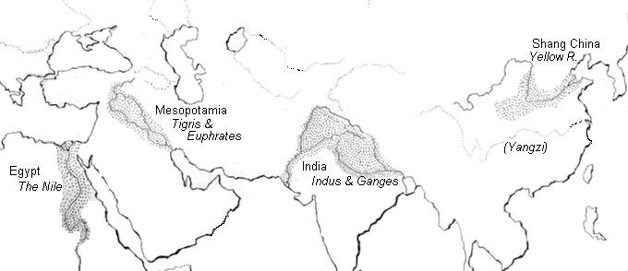
The earliest civilizations formed in the areas below. Why do you think they developed in these locations?

Slide 3
Why there?
Climate
Mesopotamia first to develop agriculture then it diffused to Indus Valley and Egypt
In China and later in the Americas, agriculture developed independently from other civilizations
River access for irrigation and transportation
Seasonal flooding provided fertile soil
Crop surplus, early irrigation projects led to rise of cities, government, social structure, writing, religion and art

Slide 4
A TOOL FOR ANALYSIS

Slide 5
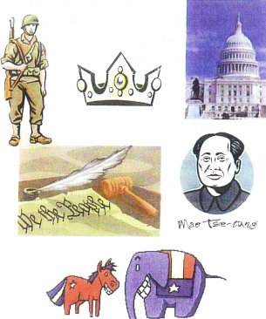
P for POLITICAL
Political Characteristics- structures and affairs of government and politics
What kind of government?
Did society have conflict? explain.
Agreements with other societies?
How did society keep order? Laws, Courts..
Significant leaders (including founders)
Did citizens participate in government? If so how?

Slide 6
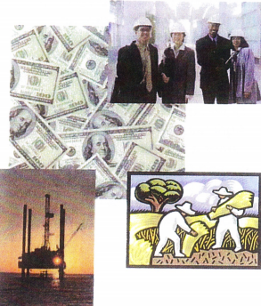
E for ECONOMIC
Economic Characteristics – Production, development, and management of material wealth
Who controlled industry?
What is the main way society supported itself?
Who did the work?
Technological advancements that affected the economy?
Did society trade with other societies?
Where did women and slaves fit into the economy?
Did they have a currency or did they barter for goods?

Slide 7
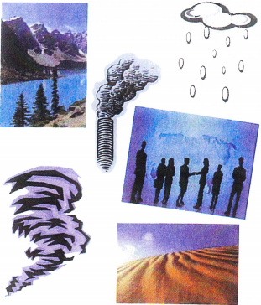
G for GEOGRAPHICAL
Geographic Characteristics – Physical features and the distribution of those features.
Where is it?
What is the physical geography and climate?
Human Interaction: how do they adapt to or modify their environment?
Movement: how did people get around?
Spatial Diffusion: geographically isolated or was their contact with other groups?

Slide 8
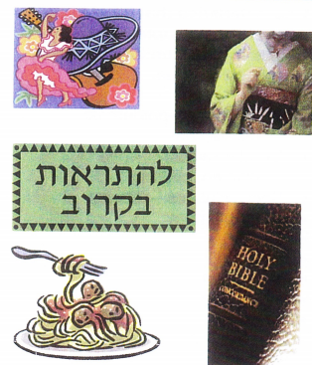
S for SOCIAL
Social Characteristics – way people live together in communities or similar organized groups
Patriarchal? Matriarchal?
Role of women and children?
What types of social classes did they have?
Social Inequalities? (women, slavery, etc..)
What were their religious beliefs
Did they have education system?
Language?
Lifestyle?

Slide 9
PEGS Chart
You will complete the PEGS chart for each region in stations.
Mesopotamia pg. 29-34
Egypt (Nile River Valley) pg. 35-41
Indus Valley pg. 44-49
Huang He (Yellow) River / China pg. 50-55
Mesoamerica pg 240-249

Slide 10
Activity
Now, you will meet with your entire RVC group.
You will then share with your group your points for each PEGS section. (five minutes)
Each person in your RVC group will need to share a portion of your PEGS analysis with the class. So make sure you have 1-2 people present for each section (Political, Economic, Geographic and Social)
All students will be responsible for recording notes into your chart

Slide 11
P - Political
Mesopotamia | Theocracy Ruler was king & high priest City-states
Egypt The Nile | Theocracy (Monarchy) Pharaoh - considered to be a god Absolute ruler Owned all land, commanded army, made laws
Indus Valley | Government & religion closely linked Palace & Temple were same building
Huang He (Yellow River) China | Dynasty (monarchy) Ruling family Aristocracy Centralized government

Slide 12
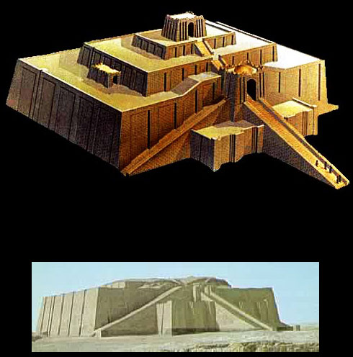
Mesopotamia
Ziggurat of Ur
Cuneiform
http://fact-o-tron.com/wp-content/uploads/2010/03/CuneiformTablet1.jpg
http://www.wayfaring.info/2006/12/05/ziggurats-and-the-greatest-of-them-sumerian-ziggurat-of-ur/

Slide 13
E - Economic
Mesopotamia | Traded with Harrapans Barley, wheat, sheep, cattle Wheel Wagons Pottery wheel
Egypt | Trade along the Nile, Mesopotamia, & Mediterranean Farming & cattle herding
Indus Valley | Traded with Mesopotamian city-states Wheat, barley, dates, melons, cotton
Huang He (Yellow River) China | Silk industry Bronze working First Coins Millet, soybeans Chickens, dogs, pigs

Slide 14
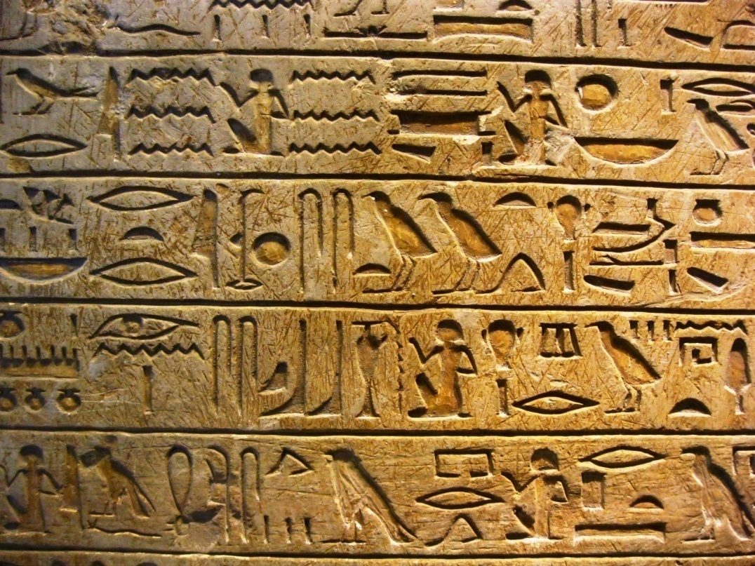
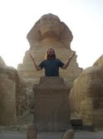
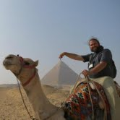
Egypt
Pyramids at Giza
Hieroglyphic Writing
http://www.google.com/imgres?um=1&hl=en&rls=com.microsoft:en-us:IE-SearchBox&biw=1280&bih=627&tbm=isch&tbnid=ftC2UmzLtEARCM:&imgrefurl=http://www.english-online.at/history/ancient-egypt/life-in-ancient-egypt.htm&imgurl=http://www.english-online.at/history/ancient-egypt/ancient-egypt-pyramids.jpg&w=560&h=373&ei=7yVAUN_hH6WI2gWb1YH4Dg&zoom=1&iact=hc&vpx=747&vpy=306&dur=3182&hovh=183&hovw=275&tx=111&ty=130&sig=114288088232264669172&page=2&tbnh=136&tbnw=199&start=21&ndsp=24&ved=1t:429,r:10,s:21,i:239
http://ritournelleblog.files.wordpress.com/2010/12/louvre-hieroglyph.jpg

Slide 15
G - Geographical
Mesopotamia | Fertile river valleys Lack of physical barriers Constant invasions First agriculture
Egypt | Fertile river valley Natural barriers for protection Deserts Mediterranean & Red Seas
Indus Valley | Fertile river valleys Himalayas & other mountains provide protection
Huang He (Yellow River) China | Fertile river valley Isolated due to mountains & deserts

Slide 16
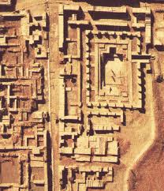
Indus Valley
Harappan Clay Seals
Mohenjo Daro
http://www.google.com/imgres?um=1&hl=en&sa=X&rls=com.microsoft:en-us:IE-SearchBox&biw=1280&bih=627&tbm=isch&tbnid=DSOS8wpszo5aMM:&imgrefurl=http://rolfgross.dreamhosters.com/India-ArchitectureWeb/IndusValley.htm&imgurl=http://www.harappa.com/indus/gif2/indusseals.jpg&w=550&h=374&ei=-CtAUKjyEOSJ2AWan4DQDA&zoom=1&iact=hc&vpx=952&vpy=30&dur=8471&hovh=185&hovw=272&tx=135&ty=105&sig=114288088232264669172&page=3&tbnh=139&tbnw=170&start=46&ndsp=24&ved=1t:429,r:23,s:46,i:360
http://www.bibliotecapleyades.net/arqueologia/worldwonders/md.htm

Slide 17
S - Social
Mesopotamia | Cuneiform - writing Polytheism Number system based on 60 Sundial Ziggurats - temples
Egypt | Hieroglyphics Polytheism Pyramids Geometry 365 day calendar Medically advanced (embalming& mummification)
Indus Valley | Plumbing & sewage system Urban planning Standardized brick industry
Huang He (Yellow River) China | Pictograms Ancestor worship Royal palaces Large royal tombs

Slide 18
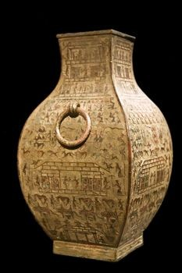
Huang He
Pictograms
Bronze Ware
http://www.art-virtue.com/introduction/GiaGuWen.gif
http://www.buzzle.com/articles/shang-dynasty-china.html

Slide 19
 | Mesoamerica | The Andes
Political | Olmec & Maya City-states Rulers considered children of gods | Caral , Moche, Chavin Centralized government
Economic | Agriculture Maize (corn), beans, squash, peppers Dogs, turkey Trade Advanced calendar | Agriculture Maize, peanuts, potatoes, cotton, llamas, guinea pigs Trade
Geographic | Tropical forests Slash & burn agriculture Intercropping | Extensive irrigation of rivers Vertical climate zones
Social | Hieroglyphics most advanced writing system in the ancient world Monumental architecture Large urban centers As many as 100,000 – 200,000 inhabitants | Polytheism Monumental architecture Quipu – system of knotted string used to keep records

Slide 20
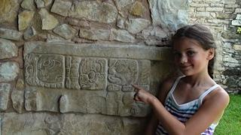
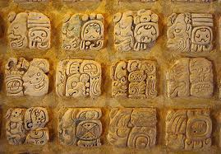
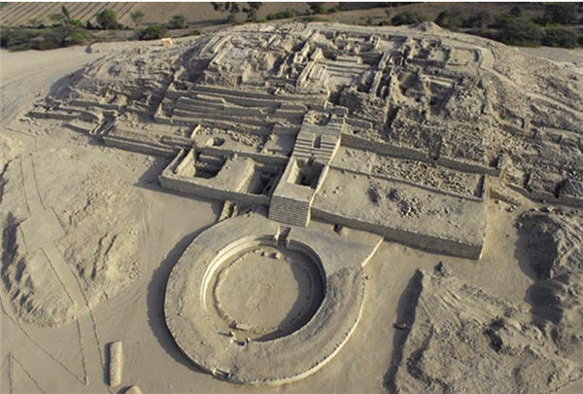
Mesoamerica & The Andes
Mayan Hieroglyphs
Colossal Olmec Head
http://www.haciendachichen.com/Chichen-Itza-Yucatan.htm
City of Caral – The Andes
http://www.freewebs.com/black-legacy/ancestors.htm
http://www.peruviantimes.com/wp-content/uploads/2010/06/Part-1-Caral.jpg

